Slide 1
Population Response to Employment Growth in the Gulf Coast Region: Assessing the Oil and Gas Related Employment on Population Change
Troy C. Blanchard
Brett Lehman
Department of Sociology

Slide 2
Acknowledgement of Funding
This research is part of a larger project funded by a cooperative agreement with the Minerals and Management Coastal Marine Institute (MMS09HQPA0005).
The project is designed to assess the potential demographic and economic impact of oil and gas activity on the Gulf Coast Region with special attention to Louisiana.

Slide 3
Demographic Responses to Change in Oil and Gas Activity
Sociologists have a long standing interest in the social impacts of economic growth in the energy sector.
For example, does rapid economic growth in energy-related employment cause decreases in noneconomic well-being (e.g. higher crime rates, poor public health)?
The key mechanism is that employment growth attracts new residents.
The community loses cohesiveness and ability to address local problems.

Slide 4
Demographic Responses to Change in Oil and Gas Activity
Regional economists also focus on this relationship.
Key question: Does job creation benefit local residents?
The addition of jobs may increase population (i.e. new jobs are taken by in-migrants).
The addition of jobs may increase commuting (i.e. new jobs are taken by residents of nearby communities via commuting)

Slide 5
Demographic Responses to Change in Oil and Gas Activity
Although this issue has been addressed for local markets in selected states (Regional Economists) and for the energy sector in the West (Sociologists), much less is known about how this relationship may work in the Oil and Gas Sector in the Gulf Coast region.
In this paper, we explore this relationship.
Research Question: Are changes in oil and gas related employment associated with population change in Gulf Coast counties/parishes?

Slide 6
Data
Key Variables:
Oil and Gas Employment
WholeData 2000 and 2004
Raw Change=Employment 2004 – Employment 2000
Population Change
U.S. Census Population Estimates 2000 and 2004
Raw Change=Population 2004 – Population 2000

Slide 7
Regression Analysis
OLS Regression
Independent Variables:
Variables used in prior studies, Yeo and Holland (2004) and Bartik (1993), drawn from the 2000 Census:
County Population in 2000
% of LF Working Outside of County
% Rural
% Age 25+ with Associate’s Degree or Better
% Unemployed Age 16+
Average Wage for Workers Age 16+ with Wage and Salary Income
% Age 16+ Not in the Labor Force
Binary variables for states

Slide 8
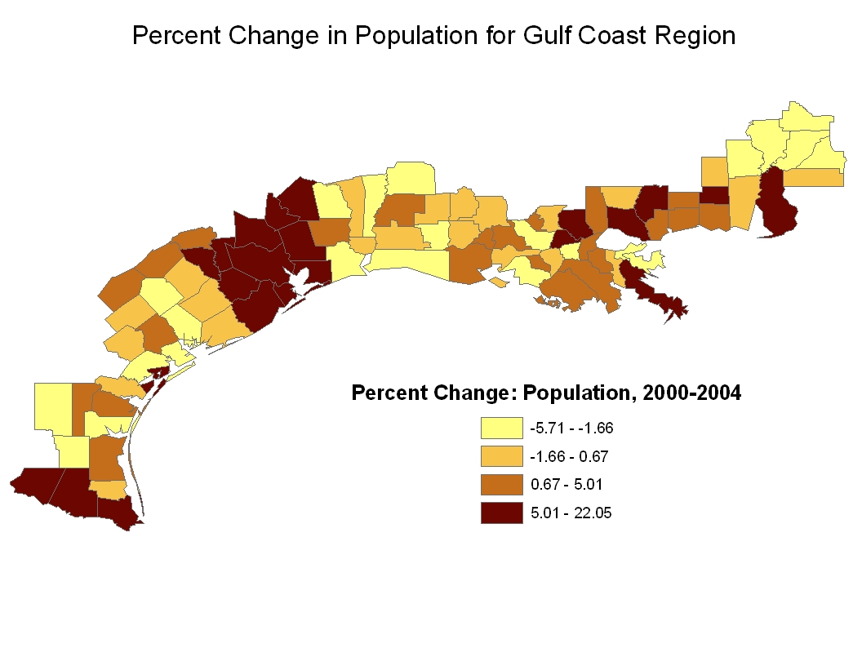

Slide 9
OLS Regression Predicting Population Change, 2000-2004
 |  |  |  | b |  | s.e. | Standardized Coefficient
Key Independent Variable
Employment Change, Oil and Gas
 | Sector, 2000-2004 |  |  | 4.68 | * | 1.81 | 0.18
Control Variables, 2000 Census
Population Size |  |  |  | 0.09 | *** | 0.01 | 1.05
% of LF Working Outside of County |  |  |  | 168.75 |  | 105.02 | 0.09
% Rural |  |  |  | 171.82 | * | 75.98 | 0.15
% Age 25+ with Associate’s
 | Degree or Better |  |  | -74.58 |  | 393.59 | -0.02
% Unemployed Age 16+ |  |  |  | -670.33 |  | 758.81 | -0.06
Average Wage for Workers Age 16+
 | with Wage and Salary Income |  |  | 1.82 | * | 0.70 | 0.24
% in Poverty |  |  |  | 1080.84 | * | 436.95 | 0.25
% Age 16+ Not in the Labor Force |  |  |  | -375.51 |  | 375.91 | -0.07
State
 | Louisiana |  |  | -7068.94 | * | 2936.63 | -0.11
 | Mississippi |  |  | -1307.16 |  | 4915.29 | -0.01
 | Alabama |  |  | -8205.47 |  | 5328.34 | -0.07
 | Texas (Excluded Category) |  |  | ----- |  | ----- | -----
Intercept |  |  |  | -59216.00 | * | 23013.00 | -----
* p<.05, **p<.01, ***p<.001

Slide 10
Age Disaggregated Models
Age Group | Coefficient | p-value | R2
Age 0-19 | 2.091 | .0018 | .82
Age 20-64 | 3.121 | .0075 | .88
Age 65 and Over | 0.262 | .1353 | .84

Slide 11
Conclusions
Growth in oil and gas employment in Gulf Coast counties is associated with population growth of specific demographics segments (less than 65).
Suggests that new jobs may be attracting new residents directly or by creating vacancies in existing jobs.
Next steps:
Use shift component of shift-share analysis of population change as dependent variable to isolate locally driven population change.
Integrate better controls for commuting.
Examine changes in commuting as an outcome using data from the Longitudinal Employment Dynamics data from the U.S. Census Bureau.

