Slide 1
Impacts of Media Coverage of Coastal Weather Events on Attendance Levels at Northern Gulf State Parks
By Kimberly L. Morgan
CNREP 2010, New Orleans, LA
27 May 2010

Slide 2
PROBLEM
Recreational park location and amenities, weather conditions, water quality, temperature, wind, and seasonality were expected to impact the daily fees collected by public parks that are used to support these taxpayer-funded facilities.

Slide 3
PROBLEM
Numerous anecdotal reports have attributed the publication of numerous press articles and widespread media attention concerning coastal weather events as a primary contributing factor in reducing demand for coastal recreational activities, regardless of the actual environmental conditions at a specific site.

Slide 4
PROBLEM

Slide 5
OBJECTIVE
To estimate the impact of adverse weather events and media coverage of adverse weather on attendance at publicly funded recreational facilities.

Slide 6
BACKGROUND
Media coverage of FL red tides has significant impact on park attendance at Gulf Coast Florida park (Morgan et al., in review, 2010)
Tourists to resident park visitors ratio averages 50/50 in FL state parks – up to 90% tourists in-season! (pers. comm., Michael Hensley, 020209)
Notes:
Lit review:
Know media coverage of FL red tides has significant impact (source: Morgan et al., in submission, 2009) on park attendance at Gulf Coast FL park
Tourists to resident park visitors ratio is about 50/50 in FL state parks (pers. comm., Michael Hensley 020209.)

Slide 7
BACKGROUND
Know expenditures by out-of-state visitors to state parks have positive economic impact on NC, SC, TN & GA (Bergstrom et al., 1990)
“…the economic impact of parkland use and the value placed on it by society is large and underreported.” (Eagles, McLean & Stabler, 2000)
Notes:
Lit review:
know expenditures by out-of-state visitors to state parks have positive economic impact on NC, SC, TN & GA (Bergstrom et al., 1990);
Eagles, McLean & Stabler (2000) concluded that “…the economic impact of parkland use and the value placed on it by society is large and underreported.”

Slide 8
BACKGROUND
Econometric model of annual SW national park visitation revealed that fire & drought resulted in statistically significant reductions in attendance levels by 21% and 7%, respectively (Matzarakis, de Freitas & Scott 2007)
“…a fundamental driver of tourism climatology is the identification & evaluation of environmental information for business planning & decision-making in the recreation and tourism industry (de Freitas 2003)
Notes:
Lit review:
Econometric model of annual SW U.S. national park visitation revealed that fire & drought resulted in statistically significant reductions in attendance levels by 21% and 7%, respectively (Matzarakis, de Freitas and Scott, 2007).
According to a 2003 article by de Freitas published in the International Journal of Biometeorology, “…a fundamental driver of tourism climatology is the identification and evaluation of environmental information for business planning and decision-making in the recreation and tourism industry

Slide 9
BACKGROUND
The decline in per capita visits to US national parks since 1988 was found to be significantly correlated with several electronic entertainment indicators…hours of television, movie attendance, video games and internet use (Pergams & Zaradic, 2006)
“… the media in general have a primary influence in destination image formation.” (Govers, Go & Kumar, 2007)
Notes:
Lit review:
The decline in per capita visits to US national parks since1988 was found to be significantly correlated with several electronic entertainment indicators, which were described as hours of television, movie attendance, video games and internet use (Pergams & Zaradic, 2006)
Govers, Go & Kumar (2007) used content analysis software to analyze survey responses and concluded that “… the media in general have a primary influence in destination image formation.”

Slide 10
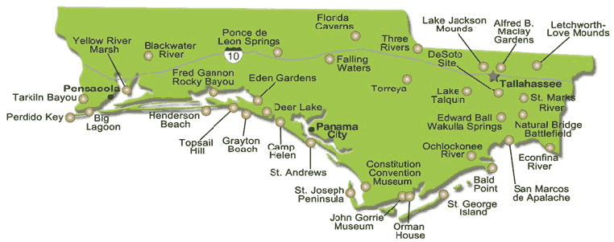
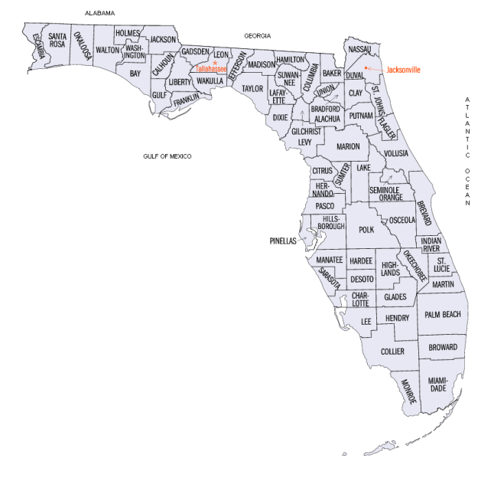
STUDY REGIONS
PENSACOLA, FLORIDA AREA
Tarkiln Bayou
Perdido Key
Big Lagoon
1
3
2
Notes:
Pensacola, FL – Tarkiln Bayou (free), Perdido Key ($2/car - honor) & Big Lagoon ($4/car)

Slide 11
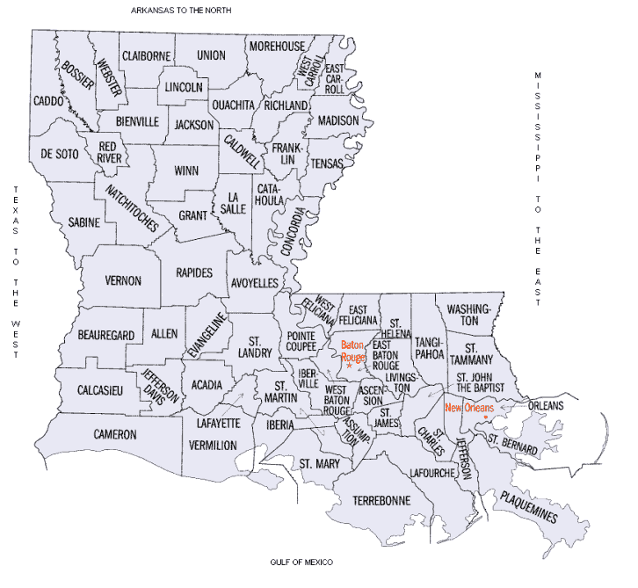
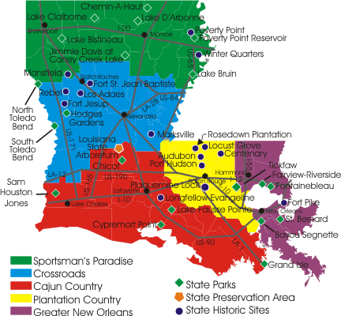
STUDY REGIONS
GREATER NEW ORLEANS, LOUISIANA
St. Bernard
Bayou Signette
Grand Isle (re-opened 01 May 2009 after Gustav)
1
2
3

Slide 12
DATA
Monthly visitor data were collected July 2001 through September 2008
Park attendance was measured as number of vehicles that paid admission fees (managers estimate an average ~ 2 persons per car)
Notes:
Pensacola, FL – Tarkiln Bayou (free), Perdido Key ($2/car - honor) & Big Lagoon ($4/car)

Slide 13
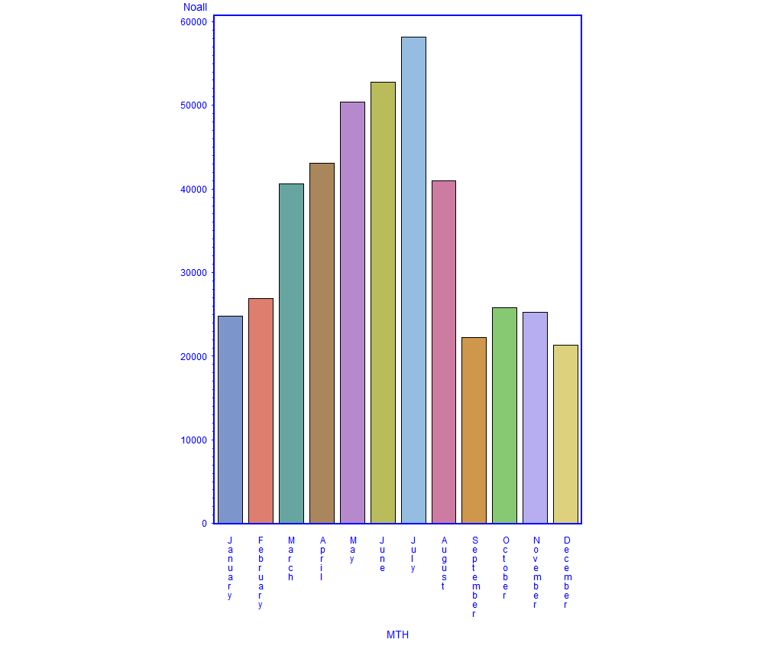
AVERAGE NUMBER OF PARK VISITORS, BY MONTH, 2001-08, GREATER NEW ORLEANS, LA

Slide 14
AVERAGE NUMBER OF PARK VISITORS, BY YEAR, 2001-08, GREATER NEW ORLEANS, LA
morgan@agecon.msstate.edu

Slide 15
DATA
Weather events that resulted in financial property damages (Sources: National Climatic Data Center stations at Pensacola, FL and New Orleans, LA international airports)
Flash floods, coastal floods, hail, heavy surf, high winds, hurricane, lightning, storm surge, thunderstorm, tornado & tropical storm winds
hurricane
moran@agecon.msstate.edu

Slide 16
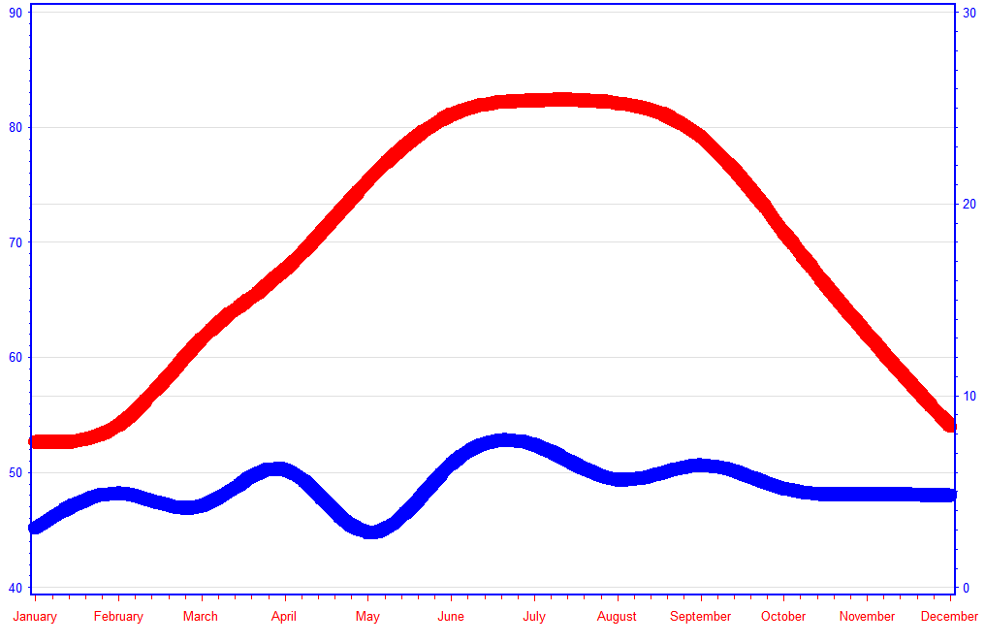
DATA
Average monthly temperature & precipitation
Greater New Orleans, LA

Slide 17
DATA
News articles were collected using NewsLibrary.com
Keyword phrases: “hurricane and state park” & “storm and tourism and state park”.
Articles that included these phrases during each month for 5-6 local newspapers per study area were noted

Slide 18
ANALYSIS
A multiple regression model was estimated for each of the two study regions to assess the relationships between weather events and media publications on monthly park attendance.
Monthly and annual dummies included to account for seasonal visitation trends (base set to December 2001).

Slide 19
FINDINGS
Greater New Orleans, Louisiana
Overall, explained 82% of the variation in monthly attendance levels recorded by park managers
Only a weak negative relationship between weather events and park visitation, though not statistically significant

Slide 20
FINDINGS
Greater New Orleans, Louisiana
Explained 82% of the variation in monthly attendance levels recorded by park managers
Negative and statistically significant decline in average monthly attendance -> when keywords appeared in newspapers at least once monthly
Decrease of 5,761 visitors, representing approximately $103,698 in lost annual revenues across 3 parks

Slide 21
FINDINGS
Pensacola, Florida
Explain 75% of the variation in monthly attendance levels recorded by park managers
Only a weak negative and statistically insignificant decline in average monthly attendance when keywords appeared in newspapers

Slide 22
FINDINGS
Pensacola, Florida
Explain 75% of the variation in monthly attendance levels recorded by park managers
Negative and statistically significant relationship between adverse weather events and park visitation
4,659 fewer visitors per month when extreme weather occurred, represents approximately $83,862 in lost annual revenues

Slide 23
RELEVANCE
Improve decision-maker awareness of media messages which significantly impact recreational attendance levels linked to adverse weather events
Local news mattered in NO region, actual weather mattered in FL Panhandle
NO relatively more local visitors vs FL out-of-state?
Trip planning timeframe – spur of the moment vs Spring Break?
Alternative recreational options?
Park characteristics/amenities?
Notes:
; in particular, the impacts on public park revenues by unanticipated and unintended public response to news media.

Slide 24
RELEVANCE
Interviews of state park managers…
Park attendance?
Special events
Economy
Fishing regulations
Park expenditures?
Labor > 50%
Insurance < 20%
Facilities > 30%
Advertising < 1%
Notes:
In general, what factors other than seasonality and weather condition do you believe affect park attendance?

Slide 25
FUTURE WORK
Estimate media and adverse weather impacts on additional coastal recreation facilities
Stratify media coverage by capital (natural, built, human, social) type
Estimate indirect revenue losses to study regions resulting from both media coverage and weather events
Notes:
; in particular, the impacts on public park revenues by unanticipated and unintended public response to news media.

Slide 26
In a time of extraordinary human effort to control the natural world, the global toll from extreme events of nature is increasing…It may well be that the ways in which mankind deploys its resources and technology in attempts to cope with extreme events of nature are inducing greater rather than less damage and that the process of rapid social change work in their own way to place more people at risk and make them more vulnerable. ‘…' To sum up, the global toll of natural disaster rises at least as fast as the increase in population and material wealth, and probably faster.” Burton et al. (1978, pp. 1&2)
Notes:
Role of technology in exposing humankind to natural disasters…

Slide 27
questions?
Thank you!
morgan@agecon.msstate.edu

