Slide 1
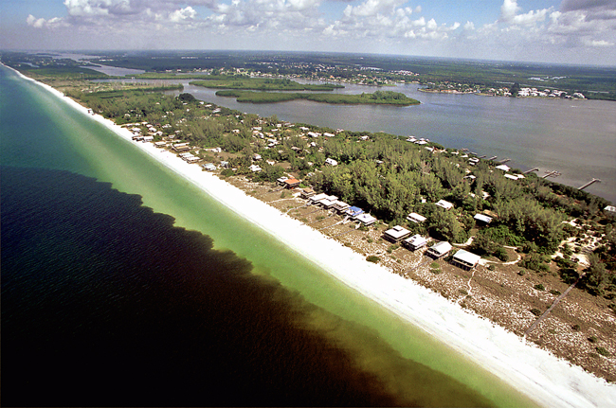
Willingness-to-Pay for Red Tide Mitigation, Control and Prevention Strategies: A Case Study of Florida Coastal Residents
Kristen Lucas
Dr. Sherry Larkin
Dr. Chuck Adams

Slide 2
Survey Information
14,400 mail surveys
1,454 responses
Funded by Florida Wildlife Commission
Topics:
Level of knowledge
Level of concern
Information sources
Willingness-to-pay
North Central: 1,674
(St. Johns, Flagler, Volusia, and Brevard)
Northwest: 6,102
(Gulf, Franklin, Bay, and Okaloosa)
Southwest : 6,624
(Manatee, Sarasota, Charlotte, and Lee)

Slide 3
Demographics
Age distribution
(years):
N=1,426
Average age of respondents: 59.9 years
Average length of Florida residency: 24.2 years
Notes:
72% over 50 years of age

Slide 4
Education:
N=1,431
Annual Income:
N=1,322
Notes:
60% college graduate or higher
Over 50% are in the lowest income bracket (many retirees)

Slide 5
How many miles (by car) do you live to the coast?
N=1,426
(Average miles of residence to coast = 8.7 miles)
Notes:
67% live within 10 miles of coast
11% lived directly on the beach

Slide 6
How dependent are you on coastal water quality and quantity?
N=1,338
Notes:
Not at all scine I don’t plant plants, fish or live on the beach
Somewhat because I water my lawn, and occasionally fish or visit the beach
Very, it is important to my recreation or livelihood.

Slide 7
Are you aware of the coastal condition known as Red Tide?
Awareness, Experience, Knowledge and Concern
Are you at all concerned about Florida Red Tide Events?
N=1,431
N=1,305
Notes:
No respondents were asked to skip directly to the demographics section

Slide 8
What is the one reason you are generally not concerned about red tide events in Florida?
What is the one reason you are at least somewhat concerned about red tide events in Florida?
29% | Red tides have not affected me
10% | Red tides are unpredictable so being concerned serves no purpose
6% | Scientists are working on the issue
44% | Red tides are a natural occurrence
11% | Other
10% | Red tides cause economic losses
24% | Red tides prevent fishing, beach going, and other marine activities
32% | Red tides affect human health
12% | Red tides indicate poor water quality
23% | Other
N=287
N=858

Slide 9
What has been your experience with red tide in Florida?
Yes
No
N
I have noticed red tide condition in the water | 74% | 26% | 1,325
I have seen dead animals on the shore during a red tide | 74% | 26% | 1,326
I have experienced the odor of decaying fish on the beach | 82% | 18% | 1,327
I have (or a member of my family has) experienced burning eyes, scratchy throat or coughing from red tide | 69% | 31% | 1,336
I have changed plans to visit a beach because of a red tide event | 64% | 36% | 1,330
I have changed a hotel reservation because of a red tide event | 6% | 94% | 1,304
I have changed a restaurant reservation because of a red tide event | 6% | 94% | 1,319

Slide 10
Do you believe each statement is True (T) or False (F) with respect to red tides in Florida? If you are unsure, please circle don’t know (DK):
T
F
DK
N
Red tide conditions can vary greatly from one area to another due to winds and currents | 92% | 1% | 7% | 1,347
Seafood bought in stores or restaurants is safe to eat during red tides | 44% | 16% | 40% | 1,342
Recreationally caught shrimp and crab are safe to eat during a red tide | 13% | 37% | 50% | 1,337
Recreationally caught finfish are unsafe to eat during a red tide | 32% | 15% | 53% | 1,342
Recreationally caught oysters are unsafe to eat during a red tide | 43% | 9% | 48% | 1,342

Slide 11
CON’T
T
F
DK
N
People with asthma are more likely to notice the effects of red tide | 78% | 12% | 20% | 1,343
“Red drift” is just another name for a red tide | 17% | 6% | 77% | 1,334
Reddish-brown water indicates that humans will experience respiratory problems | 18% | 32% | 50% | 1,344
The algae that causes red tides is always present in the Gulf of Mexico | 45% | 8% | 47% | 1,345
Red tides are the same all over the world | 9% | 26% | 65% | 1,344

Slide 12
Information
Which of the following statements best describes how frequently you seek information about Florida red tides?

Slide 13
Willingness-to pay
Respondents presented with 3 WTP scenarios
Prevention
Control
Mitigation
3 price levels: High, Medium and Low
Surveys randomized: 18 versions
Follow-up questions for each scenario
“Yes” responses asked about the certainty of their response
“No” responses asked if there is any amount they would be WTP
Respondents asked to evaluate each independently

Slide 14
Would you pay a one-time donation of $X into a trust fund for access to information provided by a Beach Reporting System for the next three years?
Mitigation:
Average days spent at beach, per year:
49 days

Slide 15
Would you vote for a 3-year ad-valorem fee of $X per $100,000 of the assessed value of all taxable property in your county to fund a local Red Tide Control program?
Control:
Did you pay property taxes in the state of Florida in 2009?
Yes: 87% No: 13%
In general, which type of control most appeals to you?
Biological: 56% Chemical: 21% Neither: 23%

Slide 16
Would you vote for a X% tax on all fertilizer sales to support a long-run prevention program?
Prevention:
Would this program cost you more because you use plant fertilizers in Florida?
55% Yes 45% No

Slide 17
Of the three types of red tide programs you just evaluated, which would you prefer if the State of Florida only had funds for one?

Slide 18
Methodology
Preliminary modeling in LIMDEP using logit distribution
dichotomous choice (DC) model to estimate “yes” or “no” binary response for each WTP scenario
separate model for each scenario
independent variables include demographics, location, concern with red tide, dependence on local water quality, and the order in which the scenario appears.
distinct variable that is based on whether respondent is affected by strategy for each model

Slide 19
Willingness to Pay
Scenario | Grand Constant | Delta Method
Mitigation | ($11.70) | $3.37
Control | $0.69 | $10.54
Prevention | 10.4% | 16.4%

Slide 20
Binomial Logit: Mitigation
Variable | Mean | Est. β
Constant | ---- | (2.257)
M_Price (Price level) | 14.774 | (0.062)
M5 (Beach days) | 47.1 | 0.003
Pref_M (Mitigation pref. strategy) | 16.9% | 0.737
Q4 (Level of concern) | 75.2% | 1.058
*Variables significant at 5% level
Notes:
N=832; χ2=130.93; LnL=-485.70; 69% correct predictions

Slide 21
Binomial Logit: Control
Variable | Mean | Est. β
Constant |  | (2.607)
C_Price | 9.995 | (0.074)
C5N | 21.6% | (1.405)
CFST | 30.9% | 0.418
DV_EST | 38.4% | 0.729
DV_SW | 50.7% | 0.565
PREF_C | 21.5% | 1.856
Q16 | 23.849 | (0.013)
Q3 | 4.006 | (0.086)
Q4 | 76.4% | 0.605
Q6 | 2.202 | 0.199
Q9 | 2.357 | 0.329
*Variables significant at 5% level
Notes:
N=997; χ2=296.97; LnL=-542.49; 71% correct predictions

Slide 22
Binomial Logit: Prevention
Variable | Mean | Est. β
Constant |  | (2.310)
Price level | 5.36 | (0.069)
East coast region dummy variable | 38.6% | 1.050
Southwest region dummy variable | 50.6% | 0.813
Prevention preferred strategy | 44.1% | 2.164
Miles of residence to coast | 24.069 | (0.009)
Level of concern | 75.9% | 0.740
Frequency respondent looks for red tide info | 2.199 | 0.233
*Variables significant at 5% level
Notes:
N=1016; χ2=292.39; LnL=-525.44; 74% correct predictions

Slide 23
Summary Observations:
Sample concerned with red tide mostly due to health issues
Knowledge of safety of seafood consumption during red tide events lacking
Sample prefers biological to chemical
Sample prefers prevention strategies

Slide 24
Future Steps
Ordered model: recode binary response variable using respondent’s level of certainty
Probit or other distributions
Functional forms and interaction terms
Follow up phone interviews

Slide 25
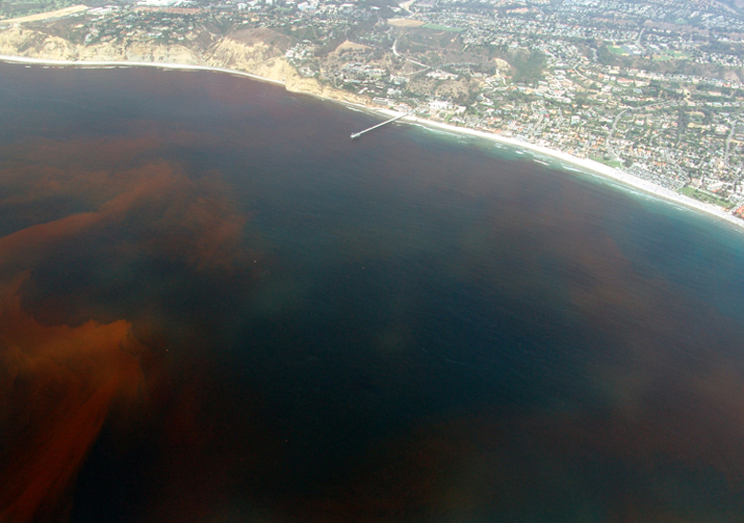
Comments?
Kristen Lucas
Dr. Sherry Larkin
Dr. Chuck Adams

