Slide 1
New Orleans and Venice: Coastal Cities at Risk
Dr. John Day
Department of Oceanography
Louisiana State University
Doug Daigle
CREST Program

Slide 2
CNREP Conference 2010
May 27, 2010
New Orleans, La.

Slide 3
Two unique cities with common challenges and risks
History and Development: Strategic Sites
Alteration of natural systems
Creation of defenses against water
Chronic problems – subsidence, floods
Pivotal Points: Disaster and Response
Challenges of the 21st Century: Climate and Energy

Slide 4
Two cities where elevation is the critical factor
“New Orleans… is like many historic deltaic cities around the world, a place sited on vulnerable ground that exploited the interface of land and water at a time when waterborne transportation accounted for nearly all long-distance human movement and trade”
- Carbonell, Amando, Meffert (2009)
This is true of Venice as well

Slide 5
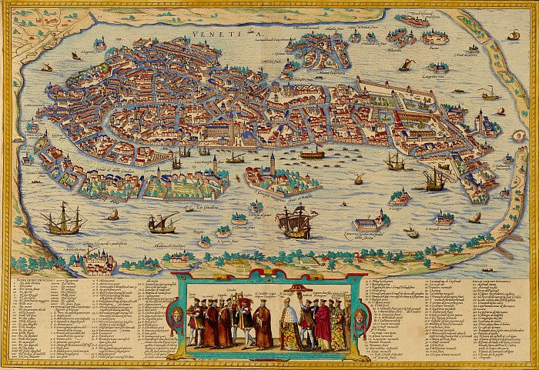

Slide 6
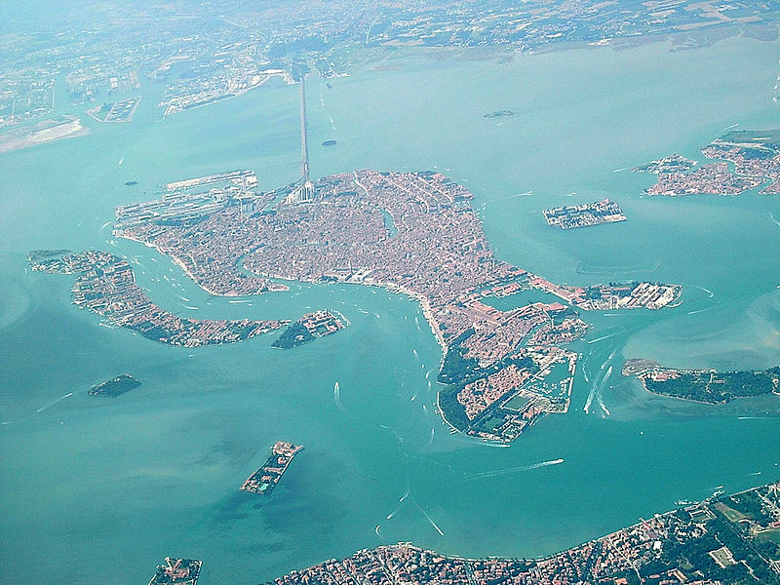

Slide 7
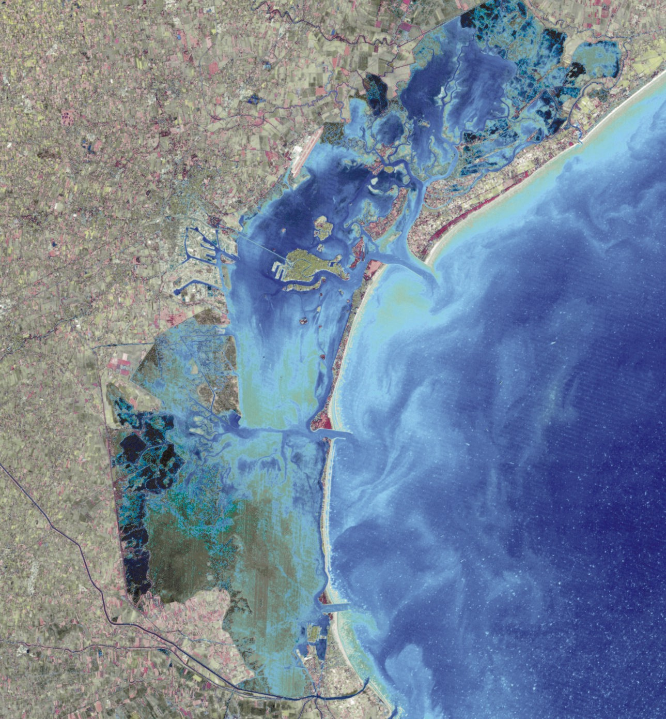
Venice Lagoon
• 550 km²
• Mean depth = 1 meter
• Historic rivers
- Sile, Brenta, Piave
1900 12000 ha wetlands
2000 4000 ha wetlands
Notes:
Diversions of these river began in 1300’s, completed in 1860

Slide 8
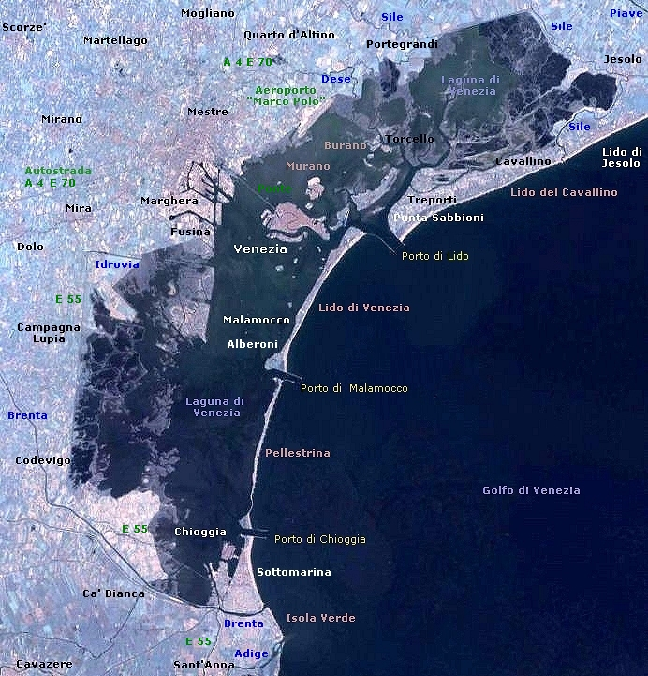

Slide 9
Venice was built up and out
The lagoon formed @6000 years ago -
At the time of Venice’s early habitation (5th
century), the Adriatic was 16 feet lower -
Archaeological excavation has found 5 levels of older
pavement below the current surface of Piazza San
Marco – part of a continual effort to raise and
expand the islands
Acque alte (high tides) are not new, but more
frequent, coupled with subsidence and sea-level rise

Slide 10
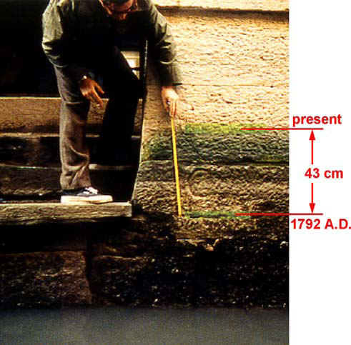

Slide 11
Venice: History and Development
Natural setting provided defenses – shallow lagoon,
barrier islands, hidden channels
Alterations:
Diverting Rivers (14th-19th centuries)
Building up seawalls and jetties (15th-21st centuries)
Raising land and buildings over centuries (6th-18th)
Dredging ship channels (20th century)
Pumping groundwater for industrial use (20th century)
Pollution of lagoon (20th-21st century)

Slide 12
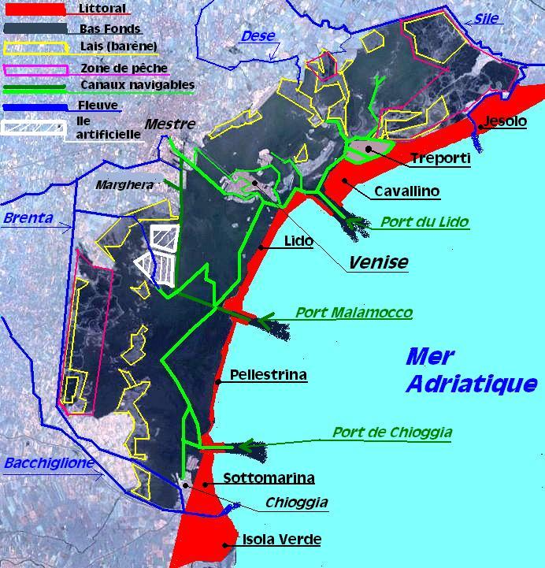

Slide 13
Venice – 1966 Flood: A “Katrina” moment
Process of Response (cf. Keahy)
1973 – Italian Special Law 171 initiates legal protection of Venice and Lagoon
1974 – UNESCO General Convention urges action
(growing international level of concern)
1982 – Consorzio Venezia Nuova created to conduct studies and research, and build fixed barrier at Lido port mouth – courts halt project
1988 – Consorzio presents MOSE – an experimental model for a mobile gates project, to be used for research near Lido (22 years to day after 1966 flood)

Slide 14
Venice: Process of Response (III)
1995 – Italian Parliament revokes Consorzio’s exclusive license; environmental impact study (VIA) authorized for gates project
1997 – EIS/VIA delivered to national government;
panel approves
2001 – Berlusconi cabinet approves final design for
MOSE gates – construction begins 2003

Slide 15
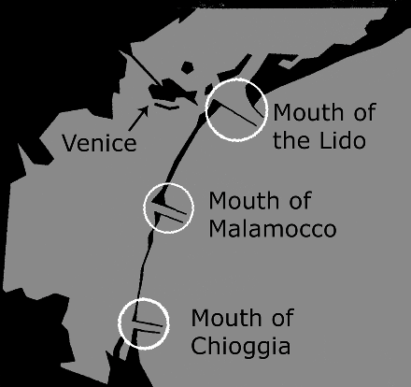

Slide 16
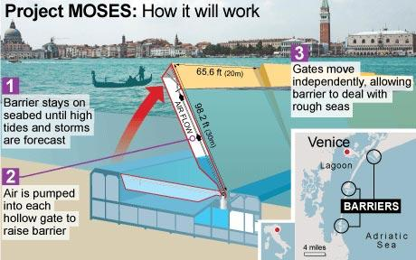

Slide 17
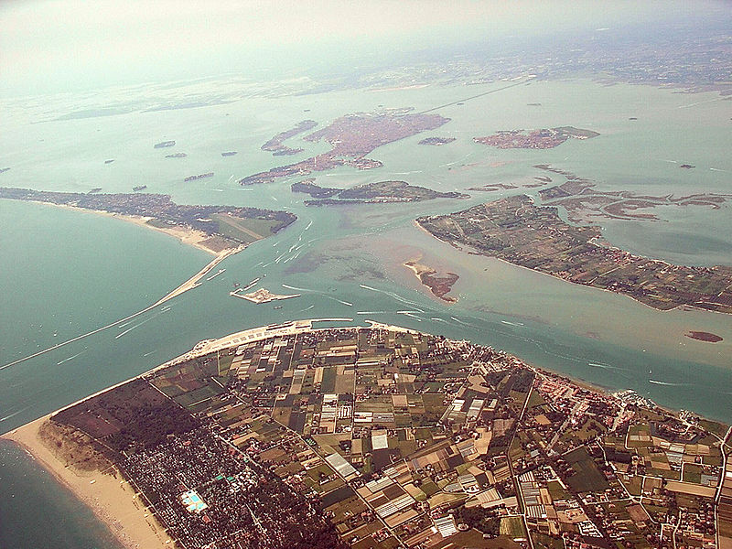

Slide 18
Questions and Issues about the MOSE Project:
Estimated 3 billion euros/$6.3 billion cost, 2012-14
completion
Failure to factor in projected sea-level rise (IPCC)
Impacts on Lagoon and its natural circulation –
More frequent closures than officially predicted?
(CVN – 7 times a year; Ammerman – 150 times);
Impacts of “false alarms” and surprises (Nov 2000)
Gate closure works against re-suspension of lagoon sediments and
wetland sustainability (Day, et al)

Slide 19
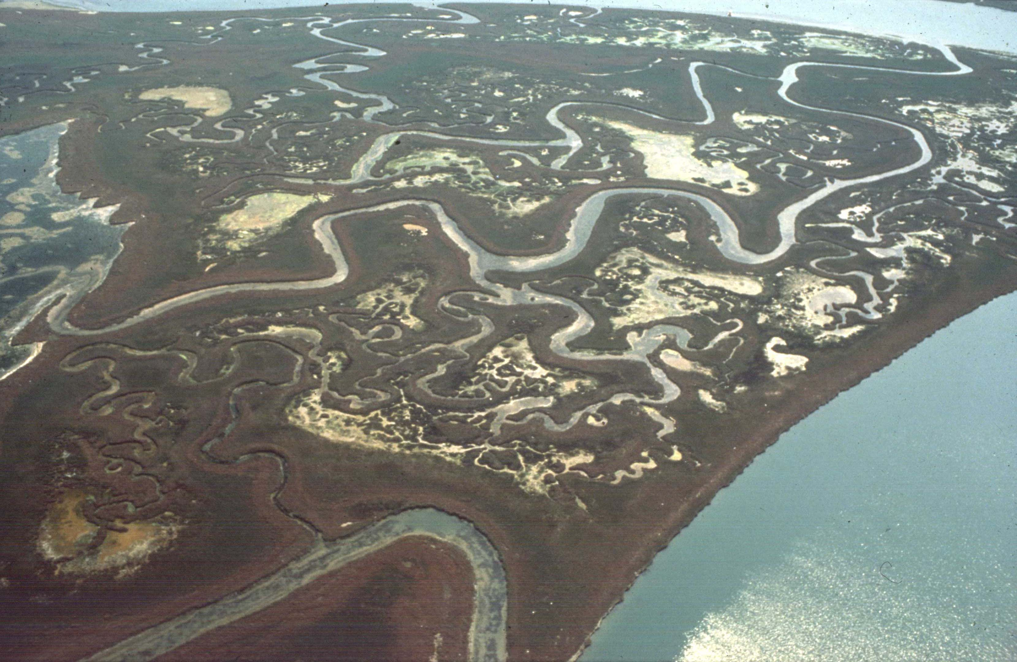

Slide 20
Alternative and complimentary approaches
Special Law 798 (1984): Repair bridges, dredge
canals, raise fondamente, improve sewer systems
Italia Nostra: Reduce depths at lagoon’s 3
entrances, redesign jetties to slow tides, restore
wetlands previously filled for failed industrial
projects, reopen enclosed fish farms to tides

Slide 21
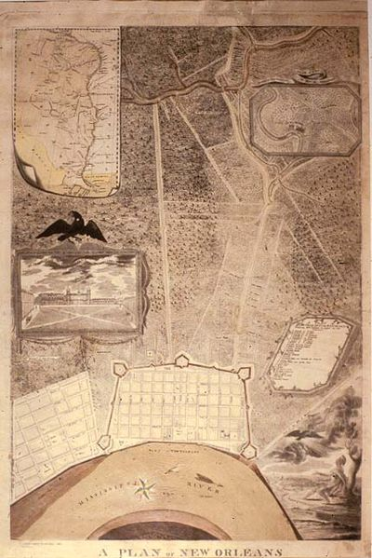

Slide 22
New Orleans: History and Development
Natural setting: The natural levee of the Mississippi
A “virtual island” – The Isle of Orleans
Alterations:
Levees (18th-21st centuries)
Dredging canals for transport and drainage (18th -
20th centuries)
Draining and development of backswamps and
surrounding low areas (19th-20th centuries)
Development of pump system (19th-20th centuries)

Slide 23
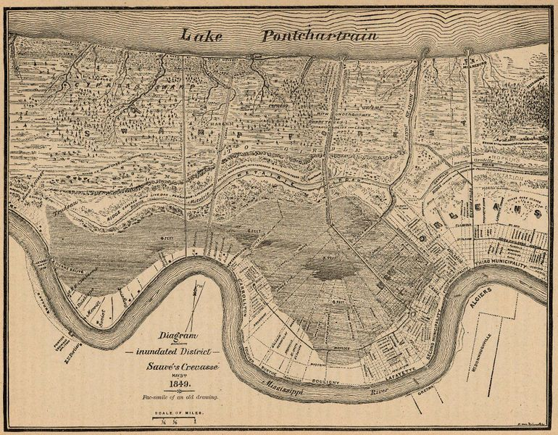

Slide 24
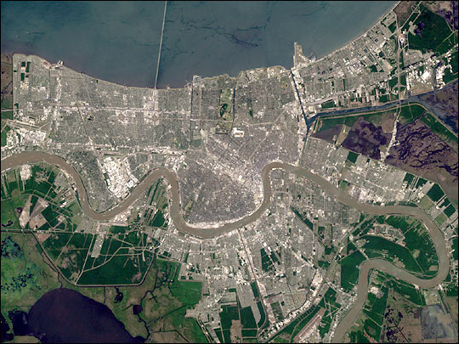

Slide 25
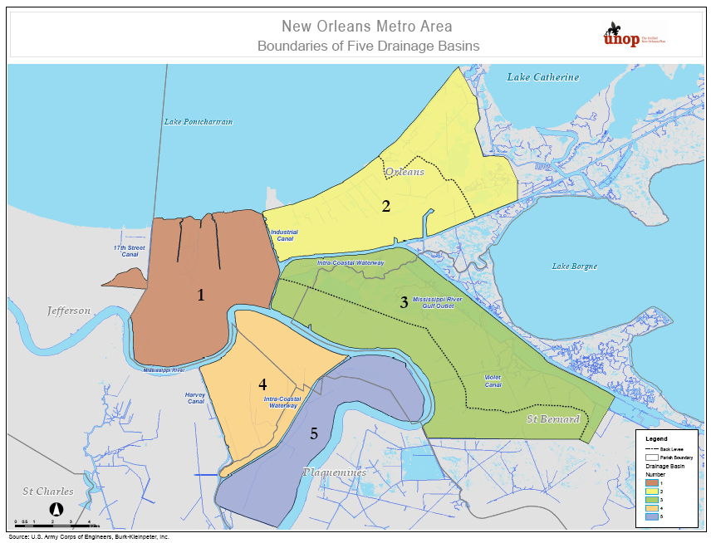

Slide 26
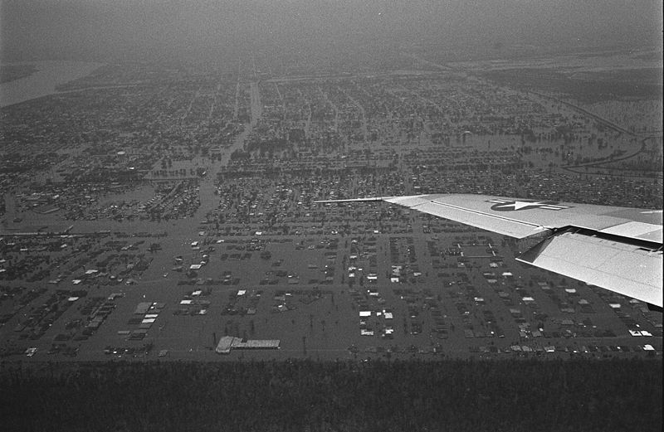

Slide 27
New Orleans’ First Katrina Moment
Hurricane Betsy – 1965
Process of Response
Lake Pontchartrain & Vicinity Project – WRDA
1965
New Orleans East Barrier vs raise lakefront levees
40 years of reduced funding, flawed process
Post-Katrina assessments of New Orleans’
protection system provide details

Slide 28
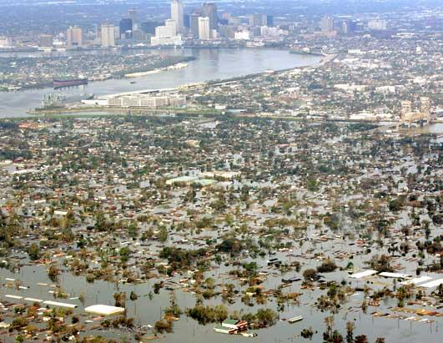

Slide 29
New Orleans and Katrina: Process of Response
Assessments of levee and system failures (ASCE, etc.),
Proposals and Recommendations from outside interests
Citizen and neighborhood engagement/
Official boards and commissions (BNOB, UNOP, etc.)
COE Rebuilding of levees, canals to authorized stds (100 yr)
2006 – Revised subsidence map and figures (Dixon,
Dokka, et al)
2007 – Comprehensive Master Plan for a Sustainable
Coast
2009 – Closure of MRGO
2010 – New Orleans Master Plan

Slide 30
New Orleans: Process of Response (II)
Greater New Orleans Hurricane and Storm Damage
Risk Reduction System (USACE): $14.3 billion (2008)
Inner Harbor Navigation Canal Surge Protection
Project: $695 million (largest design/build project in
Corps history)
LaCPR (2009): Coastwide plan cost $59-139 billion;
Planning Unit 1 Structural Measures: $10-27 billion;
Dutch Perspective “Preferred Strategy”: $20 billion

Slide 31
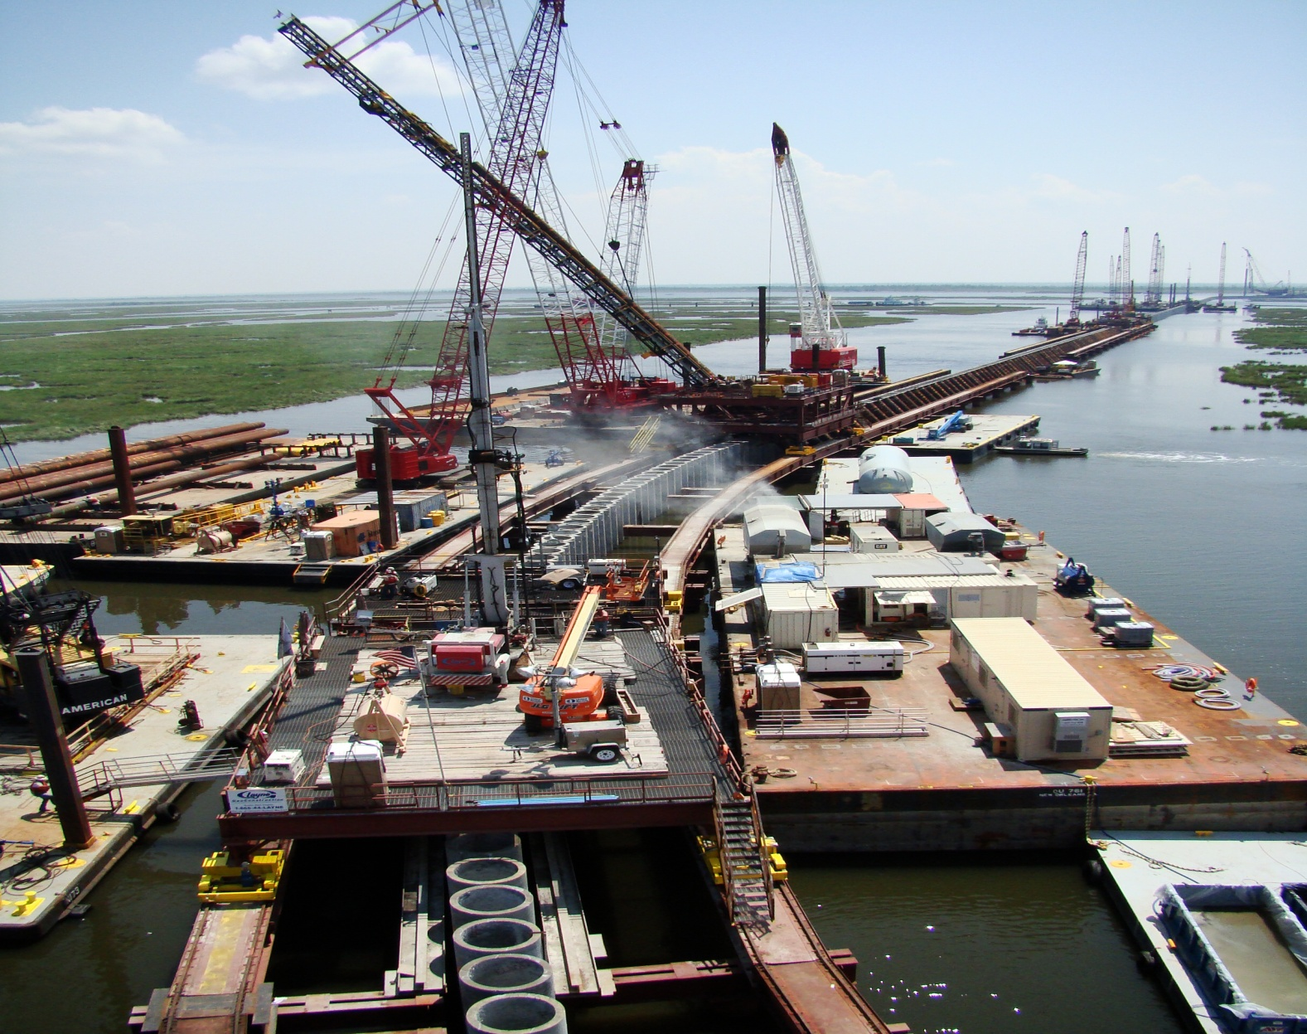

Slide 32
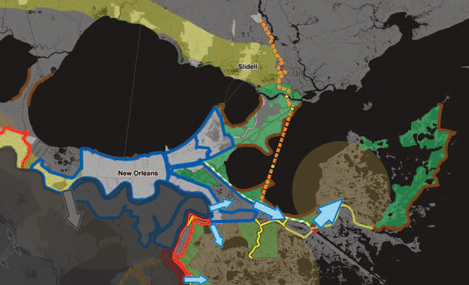

Slide 33
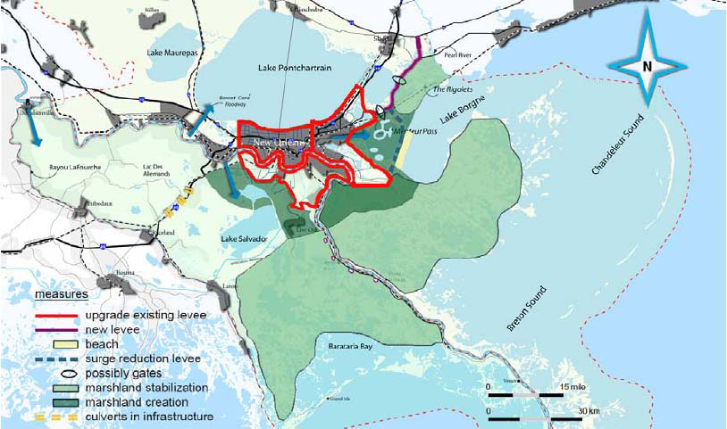

Slide 34
Impacts of Larger Trends?
Accelerated Sea-Level Rise: Post IPCC 2007
Estimates (Rahmstorf, et al)
Energy Costs and Scarcity: Peak Oil, Volatile
Economies
Fiscal Constraints: Federal and State Budgets and
Debt

Slide 35
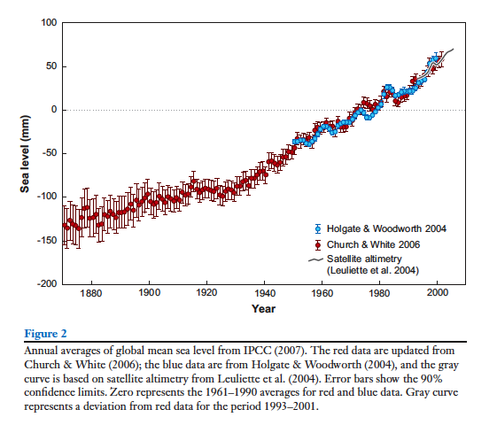

Slide 37
Looking Forward:
Will energy scarcity and fiscal constraints make
large engineering projects unaffordable?
Will climate change and sea-level rise make altered
deltas unsustainable?
What are the implications of these conditions and
trends for commerce, tourism, and sustainability?

Slide 38
Some problems can be helped with local action
Energy:
Using algae for fuel – Venice
Hydrokinetic energy from the river – New Orleans
Cultural and Social Resilience: “Residential Will”
Ecosystem Restoration (with national support):
Venice Lagoon
Mississippi River Delta

Slide 39
But the larger trends of climate, energy, and fiscal constraint surpass local capacity
Effects of climate change – storms, tides, etc. – and
attempts to mitigate them will be more costly
Costs of projects and structures reliant on fossil
fuel can be expected to rise (construction, operation,
repair)
National competition for resources will become more
intense
International action at an effective scale cannot be
assumed

Slide 40
Suggestions for Effective Planning and Policy
Acknowledge that these trends and sustainability
(economic, environmental, social) are real issues and
adopt them as core concerns
Utilize natural energy sources such as rivers where
feasible – Ecological Engineering, Restoration
Ecology
Expand education and engagement efforts beyond
specialists

Slide 41
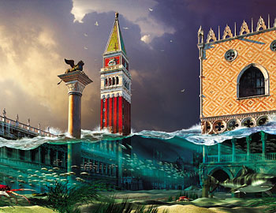

Slide 42
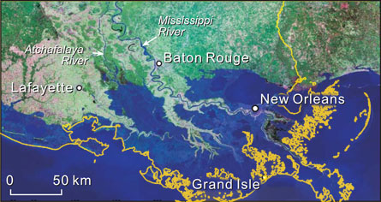

Slide 43
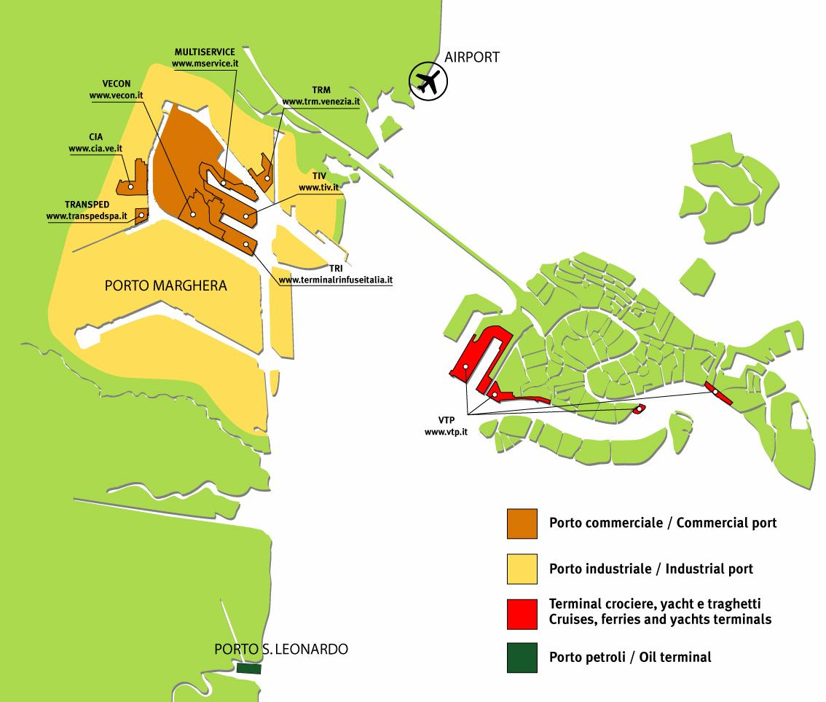

Slide 44
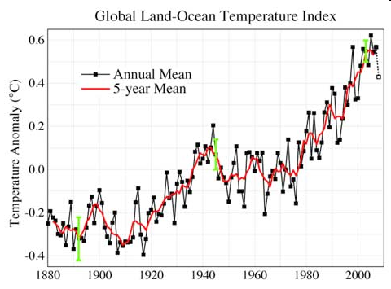
Notes:
44

Slide 45
Hubbert’s
Peak
2006 Gulf
discovery
2009 “giant” BP
Gulf Discovery

Slide 46
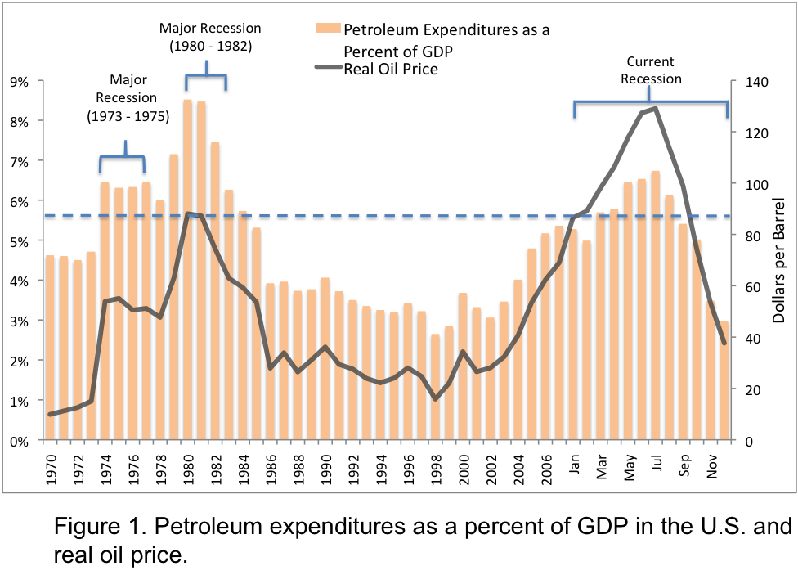

Slide 47
