Slide 1
Working Towards an Ecosystem Service Valuation Standardization
Pamela Kaval

Slide 2
OUTLINE
Goal
Introduction
Literature Review Summary
Recommendations

Slide 3
Goal
Review ecosystem service valuation work
Summarize ecosystem service valuation studies
Make suggestions about standardization

Slide 4
Introduction
Ecosystem Services
Ecosystem services include all services that enable life on earth to exist.

Slide 5
Ecosystem Service Values
• Genetic and medicinal resources, | • Protection from the sun’s ultraviolet rays,
• Plant and animal refugia, | • Partial climate stabilization,
• Purification and regulation of air and water, | • Natural disturbance regulation,
• Soil formation, | • Raw materials,
• Detoxification and decomposition of wastes, | • Food production,
• Plant pollination, | • Erosion control,
• Natural pest and biological control, | • Aesthetic beauty,
• Nursery function, | • Human culture,
• Seed dispersal, | • Recreation,
• Nutrient cycling, | •Preservation (existence, bequest and option value),
• Biodiversity maintenance, | • Science and education.
• Genetic and medicinal resources, | • Protection from the sun’s ultraviolet rays,
• Plant and animal refugia, | • Partial climate stabilization,
• Purification and regulation of air and water, | • Natural disturbance regulation,
• Soil formation, | • Raw materials,
• Detoxification and decomposition of wastes, | • Food production,
• Plant pollination, | • Erosion control,
• Natural pest and biological control, | • Aesthetic beauty,
• Nursery function, | • Human culture,
• Seed dispersal, | • Recreation,
• Nutrient cycling, | • Preservation (existence, bequest and option value),
• Biodiversity maintenance, | • Science and education.

Slide 6
Examples
Paved over a forest to make a parking lot
BP Oil Leaking into the Gulf of Mexico

Slide 7
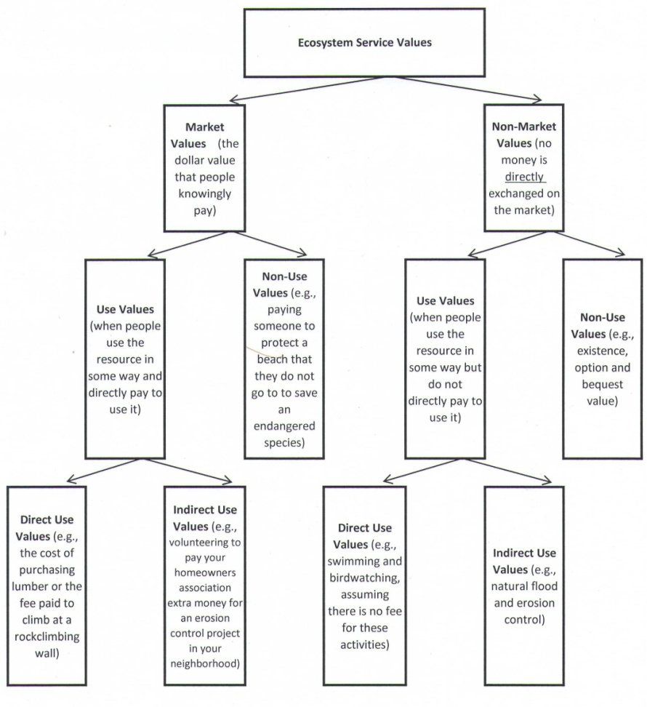

Slide 8
Valuation Tools
Market Values
Contingent Valuation
Travel Cost Method
Choice Experiments
Hedonic Pricing
Benefit or Value Transfer
Avoided Costs
Replacement Costs
Restoration Costs
Factor Income

Slide 9
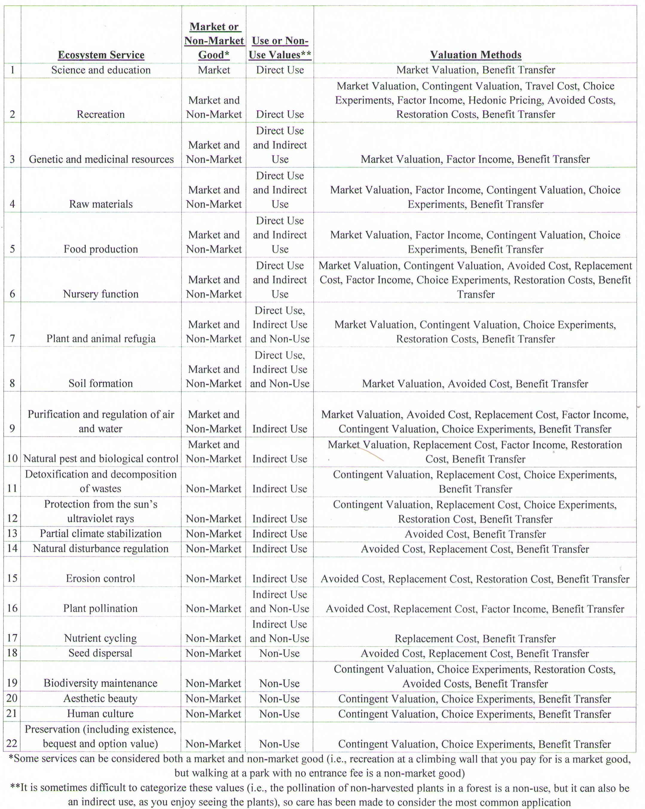

Slide 10
Ecosystem Service Valuation Literature Review Overview
Focus on one value (i.e., recreation)
Focus on one method to value everything (i.e., contingent valuation or choice modelling)
Only present a conceptual model
Conduct a benefit transfer
Calculate new values

Slide 11
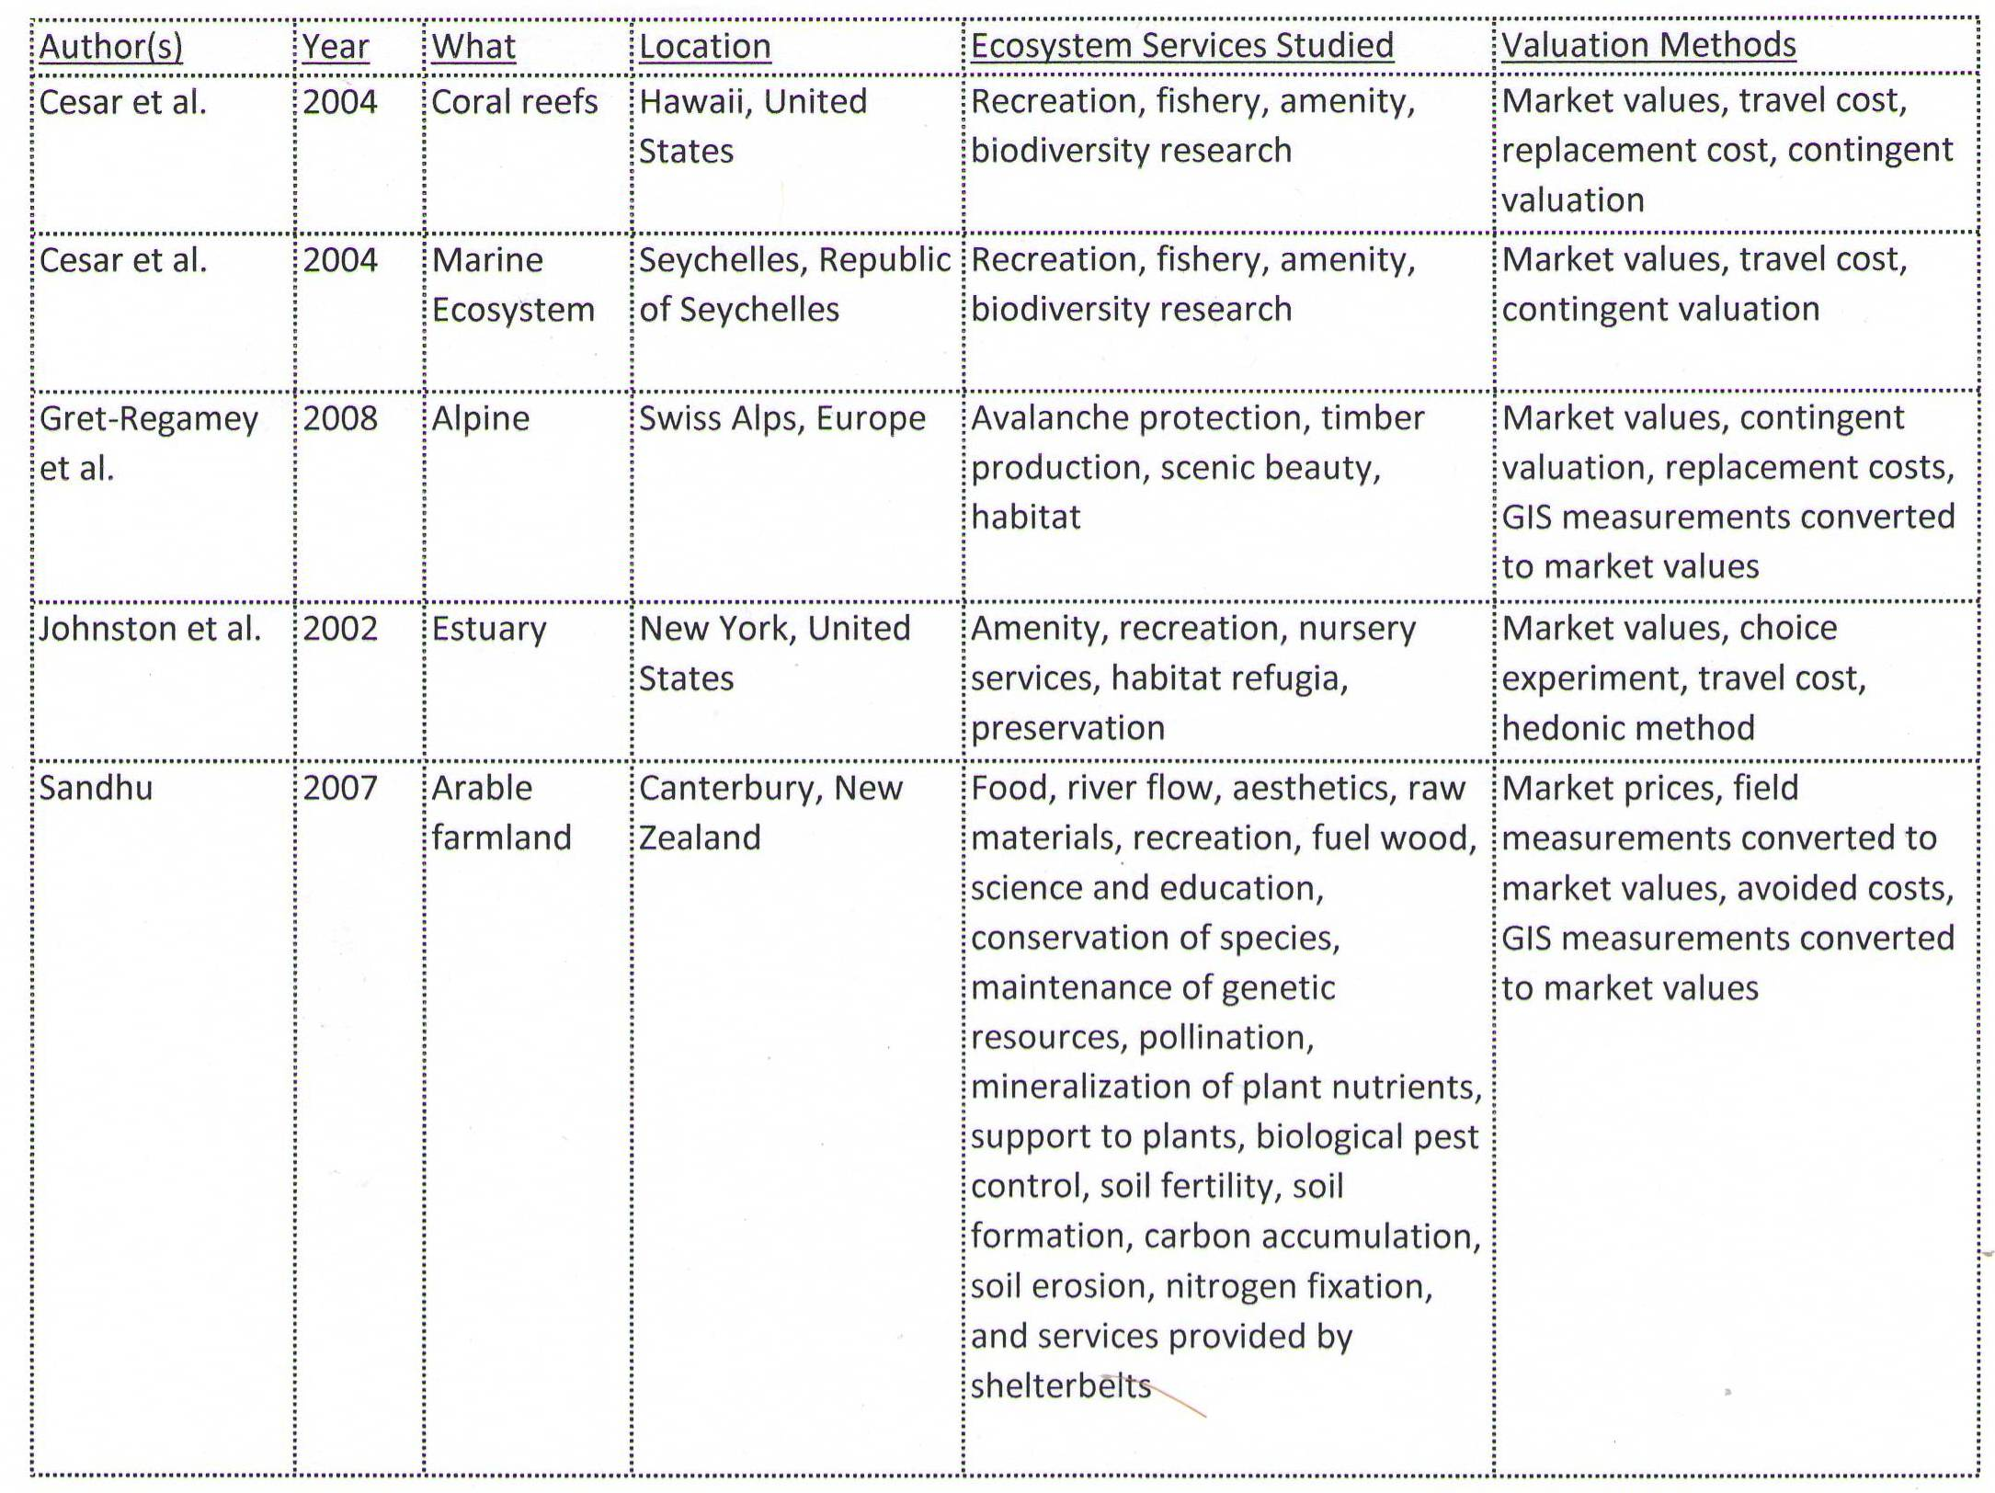
Previous Studies: 3 or more ecosystem service values and more than one valuation method

Slide 12
Example for Considering How to Conduct your Own Study
Sevilleta National Wildlife Refuge
93,000 ha state park located in New Mexico
What ecosystem types will be impacted?

Slide 13
Sevilleta Ecosystem Types
Chihuahuan Desert,
Great Plains Grassland,
Great Basin Shrub-Steppe,
Piñon-Juniper Woodland,
Bosque Riparian Forests,
Wetlands,
Montane Coniferous Forest.

Slide 14
Cattle Grazing Land
Consider only where they are grazing?
Consider the air being affected?
Consider the water downstream being affected?
Consider where the cattle came from and the affects from raising them?
Consider where the cattle will go after they are raised?
Consider the native animals that used to use that area?

Slide 15
Plan of Attack:
Define the boundaries of your research area (e.g., all of Sevilleta National Wildlife Refuge, all areas the refuge effects or only the Great Plains Grassland area).

Slide 16
Define the ecosystem types located in your research area (i.e., in the Sevilleta National Wildlife Refuge, it may include the Chihuahuan Desert, Great Plains Grassland, Great Basin Shrub-Steppe, Piñon-Juniper Woodland, Bosque Riparian Forests, Wetlands and Montane Coniferous Forest).

Slide 17
Determine what ecosystem services are currently functioning (or could be functioning if something is changed) in the research area.
Determine which people benefit from these services (location, demographics).
Determine the scarcity of these services in the region.
Determine whether these services have readily available regional natural or man-made substitutes.
Determine whether these services are restorable in this area.

Slide 18
Determine the ecosystem response to the changes being investigated (e.g., an invasive species enters the area, grazing stops, grazing begins, the land is paved over and no ecosystem services exist there anymore)
Determine which of the defined ecosystem services will change
Determine different scenarios for the types of change possible (e.g., the invasive species spreading quickly vs. the invasive species spreading slowly)

Slide 19
Determine the most appropriate valuation methods to use to value the ecosystem services, given your objectives, as well as your funding and time constraints.

Slide 20
Conduct your research according to the guidelines you have defined.

Slide 21
Conclusions
There are many valuation tools available to value ecosystem services
No studies are alike
There is currently no standardization
It is difficult to decide exactly what to value and what to leave out

Slide 22
Thank you !
Contact Details:
Pamela Kaval
pam98k@yahoo.com

