Slide 1
Valuing New Zealand Native Bird Existence for Conservation Dr. Pamela Kaval Matthew Roskruge Department of Economics Waikato Management School Hamilton, New Zealand
We thank the University of Waikato Summer Research Scholarship programme for partially funding this project. We would also like to
thank the Waikato Management School.

Slide 2
OUTLINE
Goal
Introduction
Methodology
Phone Survey
Survey Results
Conclusions

Slide 3
Goal
To determine if native bird conservation was important to Waikato residents
To determine the characteristics of birds that are important to people
To determine the value of native bird conservation

Slide 4
Introduction

Slide 5
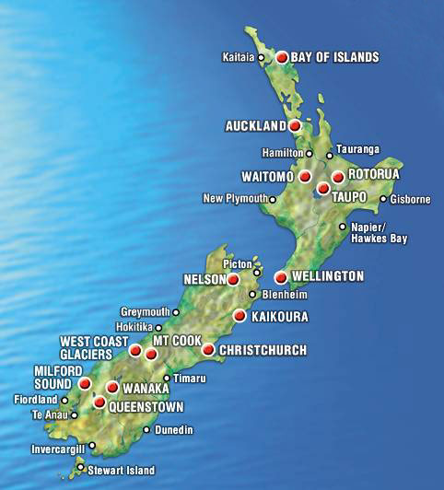
New Zealand
Aotearoa

Slide 6
New Zealand
One of last places on earth settled by humans (1300’s)
Biodiversity destruction by 1600:
1/3 forested land replaced by grassland
Hunting and loss of habitat to over 23 bird species
Today:
26% of the original bird species are extinct
42% of those left are threatened with extinction

Slide 7
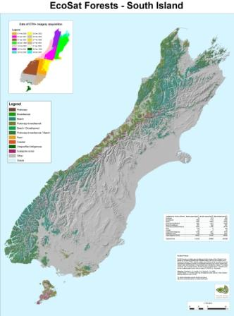
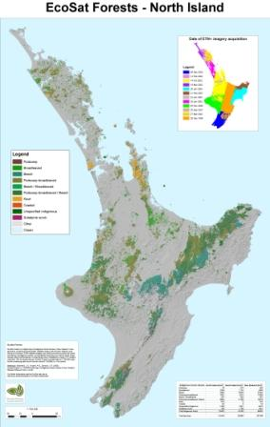
Remaining areas of indigenous forest (2000-2005)
Landcare Research, ecosat series

Slide 8
Species lost
Haast Eagle
and
Moa

Slide 9
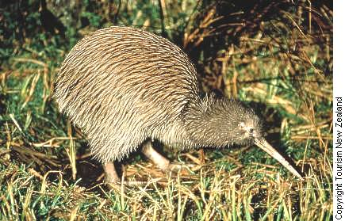
Species nearing extinction
Kiwi

Slide 10
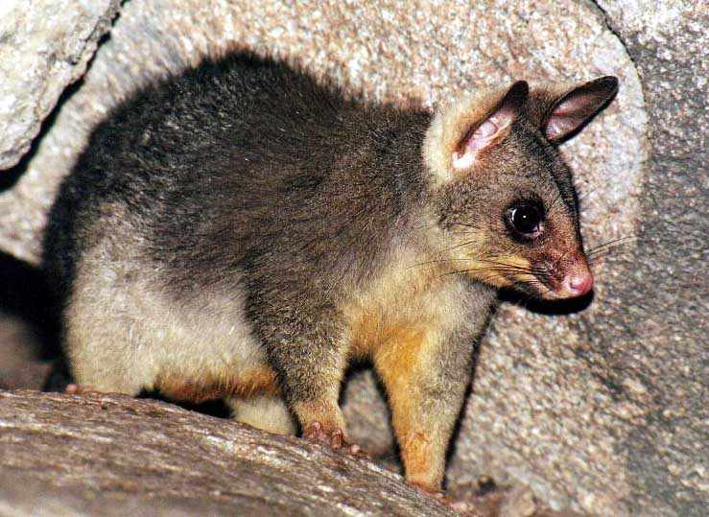
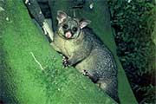
Pest Species (Invasive Species)
Possum from Australia

Slide 11
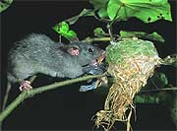
Pest Species (Invasive Species)
Rat Attacking Fantail Nest

Slide 12
Biodiversity Strategy
Created in 1992, U.N. Rio Conference
In 2000, New Zealand came up with their “biodiversity strategy”
One strategy: protect native species on public and private lands
Private land is important to focus on
A great deal of land is owned by farmers

Slide 13
Maungatautari Mainland Island

Slide 15
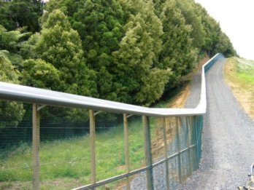
The Fence

Slide 16
General Info About the Park
Fence Size | 47 km
Park Area | 3400 hectares
Cost for fencing and first 5 years | $18 million NZ$

Slide 17
Previous economic NZ bird research
Fahy and Kerr’s (1991) study on Albatross
Mortimer, Sharp and Craig’s (1996) study on offshore islands

Slide 18
Method
Telephone survey questionnaire
Survey contained 13 items, lasting around 5-10min. Calls placed during evenings and weekends.
Questions
Knowledge of birdlife and conservation in Waikato
Well-being and opinions towards birdlife
Hypothetical question on Willingness to pay

Slide 19
Phone Survey Response Rates
Survey Sample Statistics | Number of Residents | Percentage
Agreed to Participate/Answered the Phone Call | 200/309 | 64.72%
Completed survey/ Agreed to Participate | 200/200 | 100.00%

Slide 20
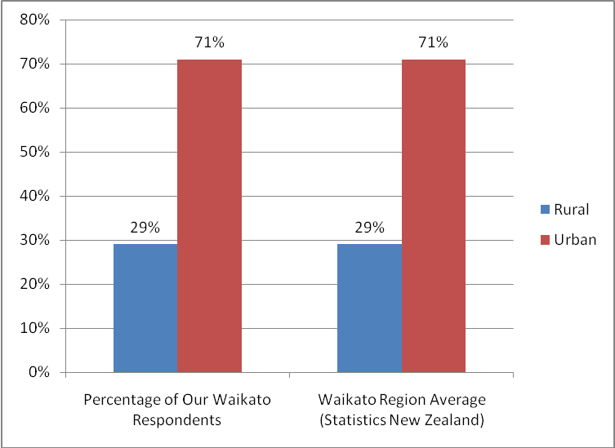
Percentage of rural and urban respondents vs. region

Slide 21
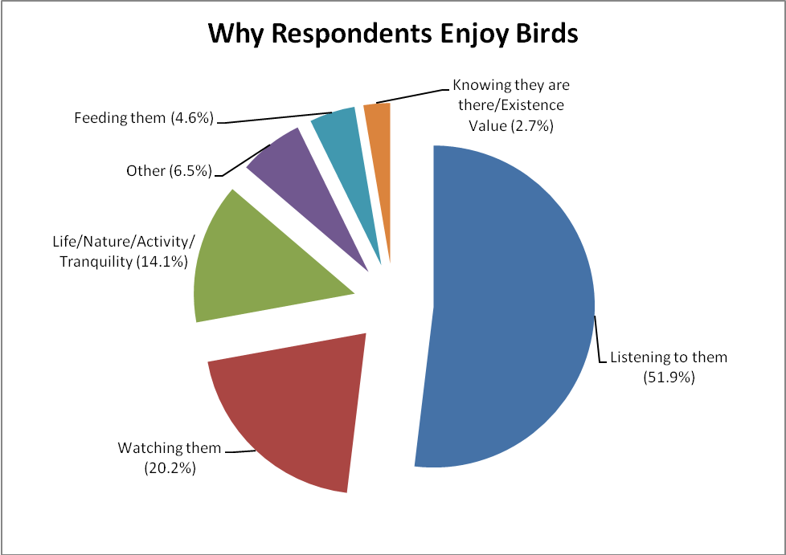
Attitudes to Birdlife
97% enjoyed having birdlife in their local area
99% provided reasons for why they enjoy birds

Slide 22
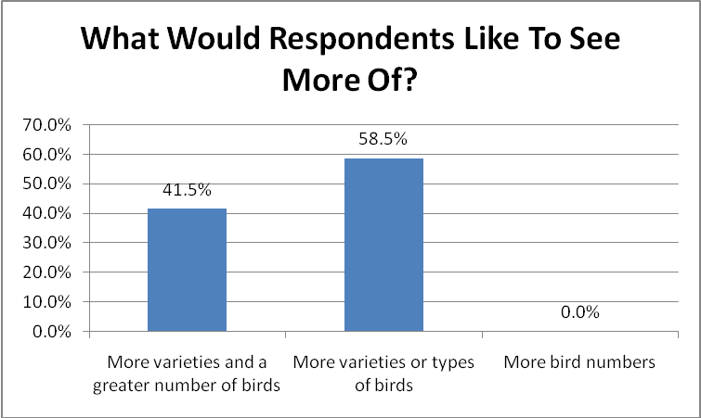
Wellbeing
79% of respondents indicated they would be happier with more birds in their local area
Of these, 41.5% would like a greater number and variety, 58.5 a greater variety only and 0% a greater number only.
Participant indicated they would be happier if there were more birds in their area.

Slide 23
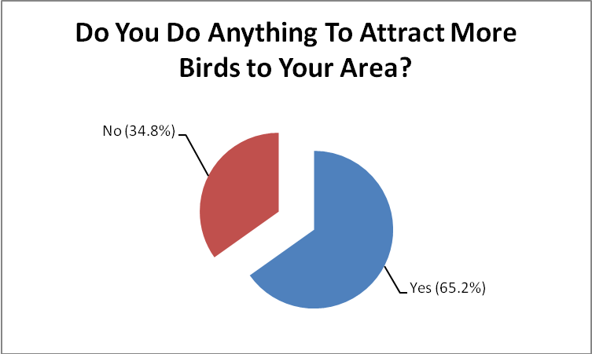

Slide 24
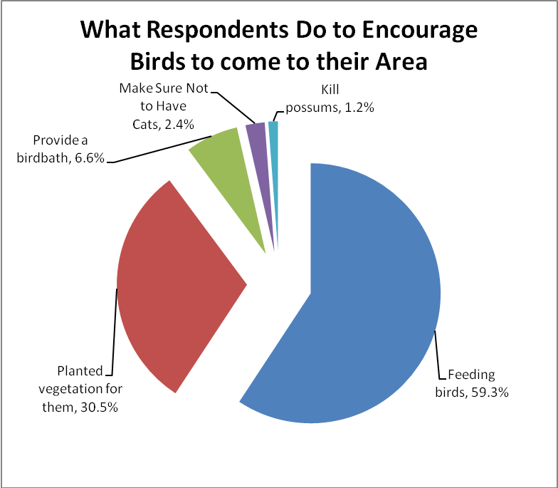

Slide 25
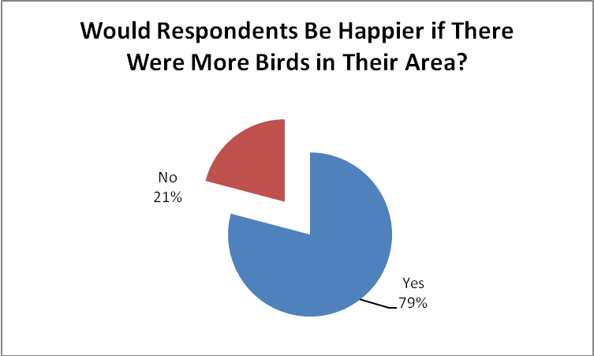

Slide 26
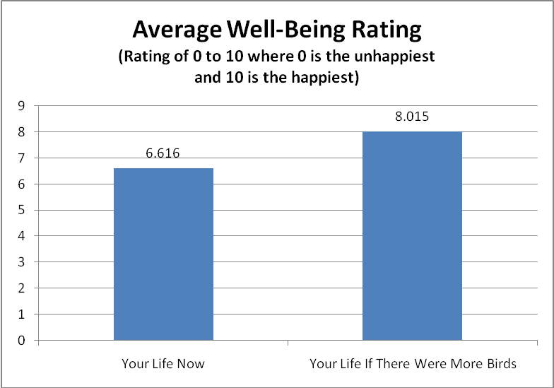
Well-Being

Slide 27
Willingness to pay
Dichotomous choice Contingent Valuation Method question
Question
“If part of your rates were dedicated to supporting a programme to increase native bird populations or reintroduce birds into the Waikato region, would you be willing to pay an additional $___ in your annual rates? Please note all funding would go towards this program and not administrative fees”

Slide 28
Valuation results
‘Yes’ responses by bid amount

Slide 29
Willingness to Pay Estimates for Bird Conservation Programmes in the Waikato Region of New Zealand
 | Conservative Estimate (Annual Value per Household) | Total Value of Conservation for all Households in the Waikato Region
Willingness-to-Pay | $95.65 | $13,231,551

Slide 30
Logit results of the probability of supporting a programme for native bird conservation in the Waikato Region of New Zealand
Variable | Coefficient | Std. Error
C | 0.0228 | 0.8616
BID AMOUNT | -0.0218 | 0.0035
AGE | 0.5181 | 0.2881
INCOME | 0.9755 | 0.3330
EUROPEAN | 0.9870 | 0.5712
MORE HAPPY | 0.9937 | 0.5731
FEMALE* | -0.7742 | 0.5274
*Not significant at the 90% level. All other variables significant at the 99% level.

Slide 31
Conclusions
Native bird populations are valued by residents, and contribute to their well-being.
Respondents are willing to pay an annual fee in their rates (taxes) for bird conservation programs
Emphasis on protecting native species, and maintaining variety rather than increasing overall populations

Slide 32
Thank you !
Contact Details:
Pamela Kaval
pam98k@yahoo.com

