Slide 1
On the Development of a Community Resilience Index
Nina Lam
Margaret Reams
Department of Environmental Sciences
Louisiana State University
CNREP 2010
May 26-28
New Orleans

Slide 2
Acknowledgements
Funding Agencies:
Mineral Management Services (MMS)
National Science Foundation (NSF)
Gulf of Mexico Sea Grant Program
U.S. Forest Service
National Institute of Environmental Health
Sciences (NIEHS)

Slide 3
Resilient Communities Research Group
Prior Graduate Research Assistants:
Ariele Baker and Lauren DeFrank
Current Graduate Research Assistants:
Helbert Arenas
Katie Bowers
Mo Chen
Corrinthia Hinton
Danielle LaRock
Kenan Li
Wei Liang
Alison Martin
Ashby Nix
Kasey Pattan
Maria Belen Toscano

Slide 4
MMS Project objectives
How can community resilience best be measured?
Are OCS (offshore continental shelf) communities more resilient to natural threats than coastal communities less involved in OCS activities?

Slide 5
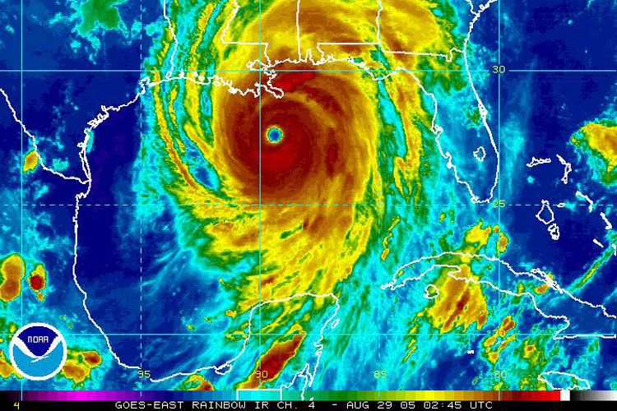

Slide 6
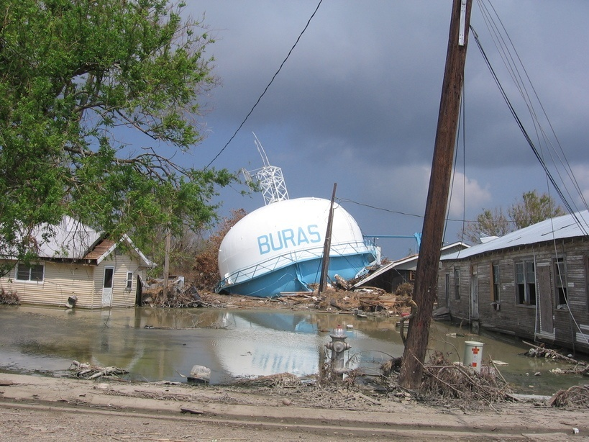

Slide 7
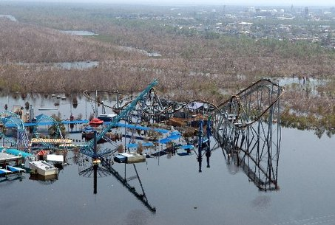

Slide 8
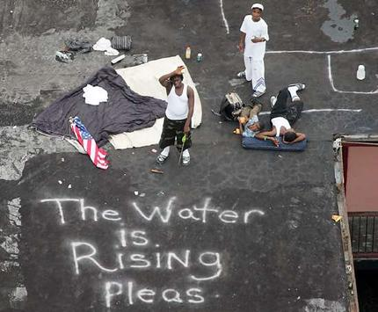

Slide 9
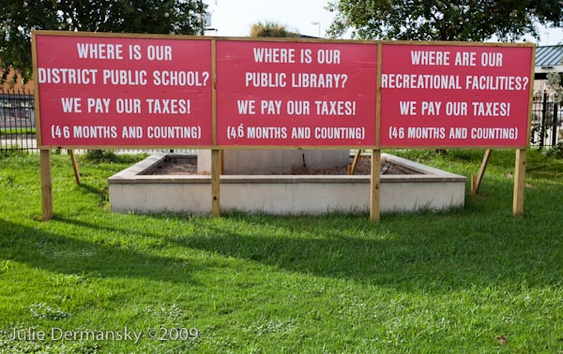

Slide 10
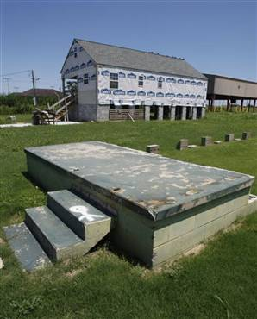

Slide 11
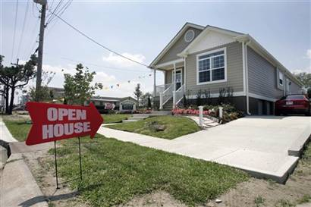

Slide 12
Difficulties in defining resilience
Many definitions; mixed with other similar concepts - Vulnerability, sustainability, adaptability
The need to consider both social and natural aspects: social-ecological resilience
Concepts of coupling
(e.g. high social resilience could mean low ecological resilience)

Slide 13
Some definitions
“Resilience reflects the degree to which a complex adaptive system is capable of self-organization and the degree to which the system can build capacity for learning and adaptation.”
“The capacity of linked social-ecological systems to absorb recurrent disturbances such as hurricanes or floods so as to retain essential structures, processes, and feedbacks.”
(From Adger et al., 2005, Science Vol. 309)

Slide 14
Related definitions
Vulnerability = f(exposure, sensitivity, adaptive capacity);
exposure: “the nature and degree to which a system is exposed to significant climatic variations”;
sensitivity: “the degree to which a system is affected, either adversely or beneficially, by climate-related stimuli”
adaptive capacity: “the ability of a system to adjust to climate change…., or to copy with its consequences
(from IPCC , 2001, p. 995;
Yusuf and Francisco, 2009)

Slide 15
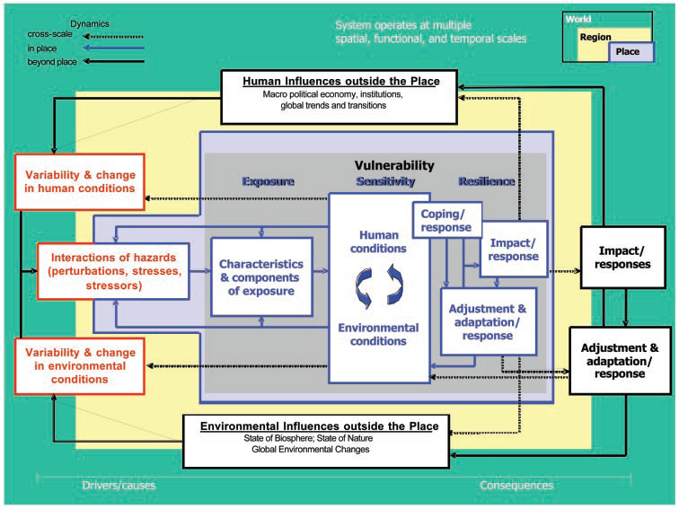
The vulnerability framework by Turner et al. 2003

Slide 16
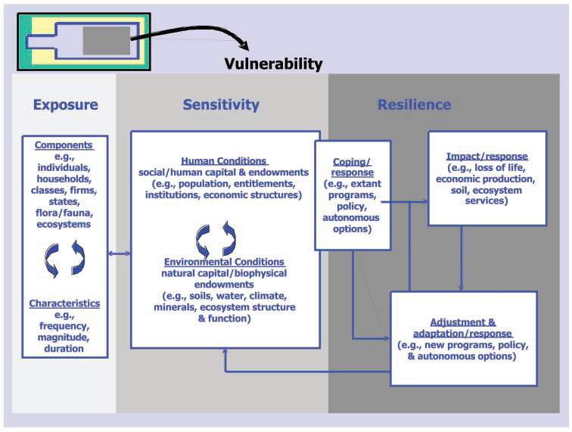
Exposure, sensitivity, and resilience components of the vulnerability framework by Turner et al., 2003

Slide 17
The hazards-of-place model of vulnerability
(Source: Cutter, 1996)

Slide 18
Related definitions
“Social vulnerability is a measure of both the sensitivity of a population to natural hazards and its ability to respond to and recover from the impacts of hazards”
(from Cutter and Finch, 2008)
The above definition already implies resilience; it considers resilience as a subset of vulnerability

Slide 19
How to measure resilience?
No such index in the literature, but there are related measures of vulnerability
Cutter’s social vulnerability index
- uses principal component analysis
- from 42 variables to 11 components
- sum all component scores for each county

Slide 20
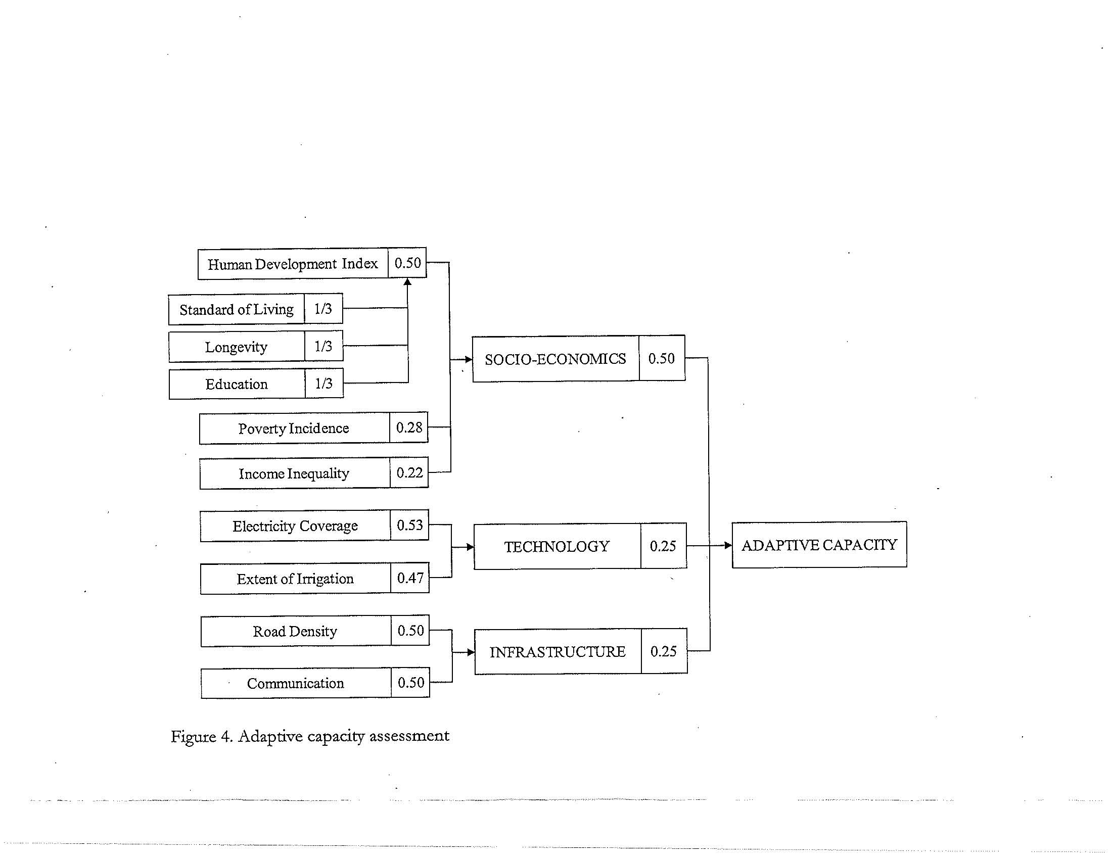
How to measure resilience?
Additive weighting method for measuring a component of vulnerability
(Yusuf and Francisco, 2009)

Slide 21
How to measure resilience? -Issues
No empirical validation
Some attempts: e.g., Cutter’s index: low r (-0.099) with #presidential disaster declarations
Why additive model?
Why certain weights?
Difficult to generalize:
e.g., PCA is not an inferential statistics
Important implications to policy and planning!

Slide 22
Resilience in Natural Systems (Adger, et al. 2000)

Slide 23
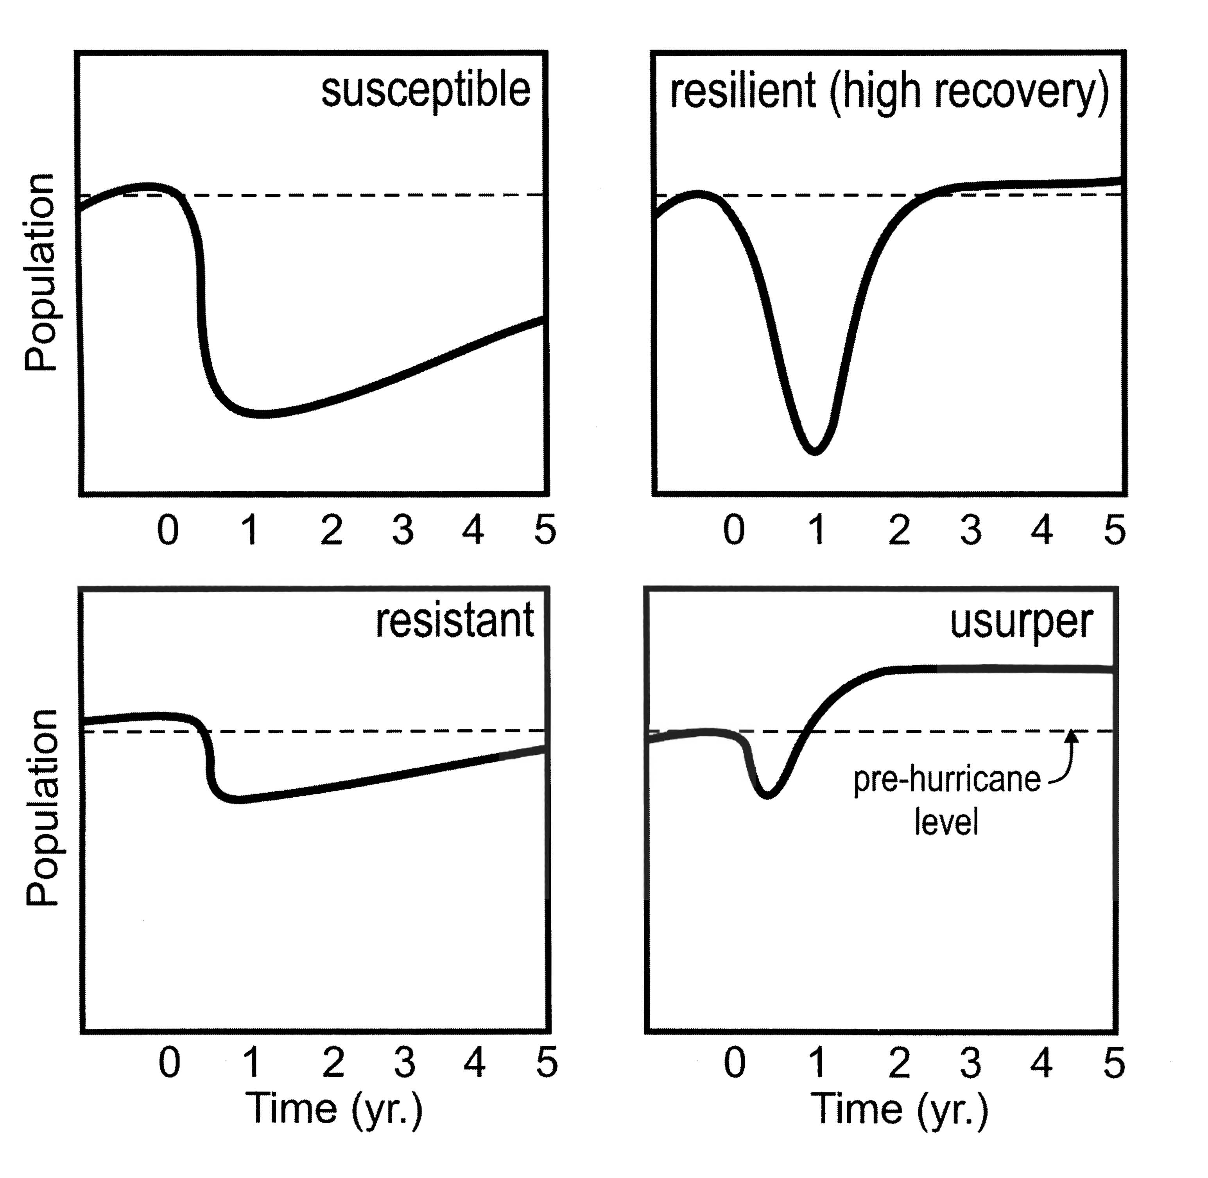
The four states of vulnerability and resilience (modified from Liu et al. 2006)

Slide 24
Do Natural-System Concepts of Resilience Apply to Human Communities?

Slide 25
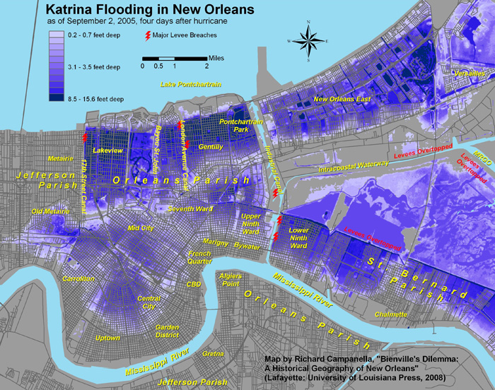

Slide 26
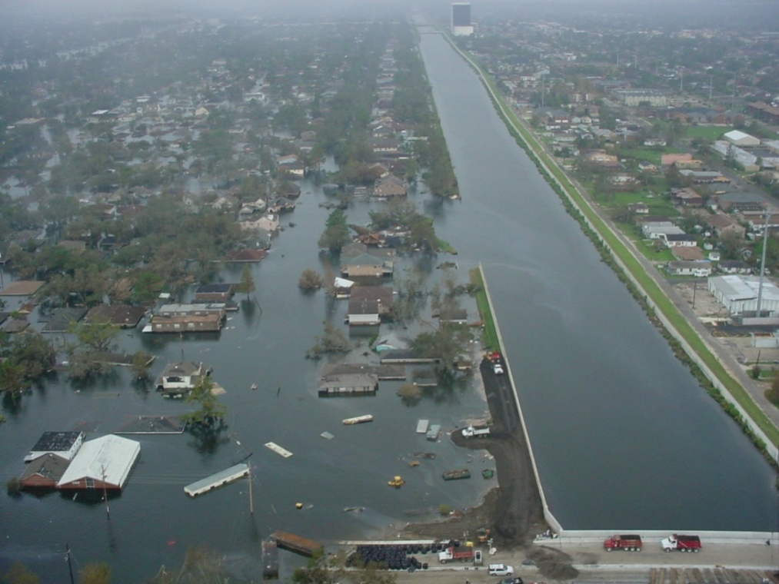
).
View of 17th Street Canal levee breach. The flooded Lakeview neighborhood is on the left of the canal.
Courtesy of the U.S. Army Corps of Engineers (Source: http://www.mvd.usace.army.mil/hurricane/KatrinaImages/Misc/DSC00033.JPG

Slide 27
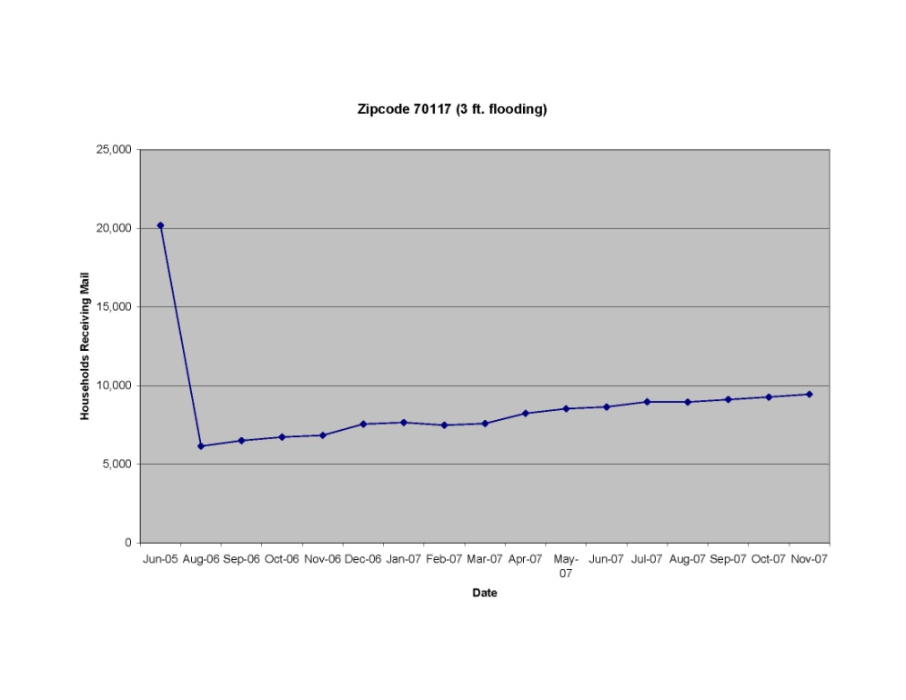
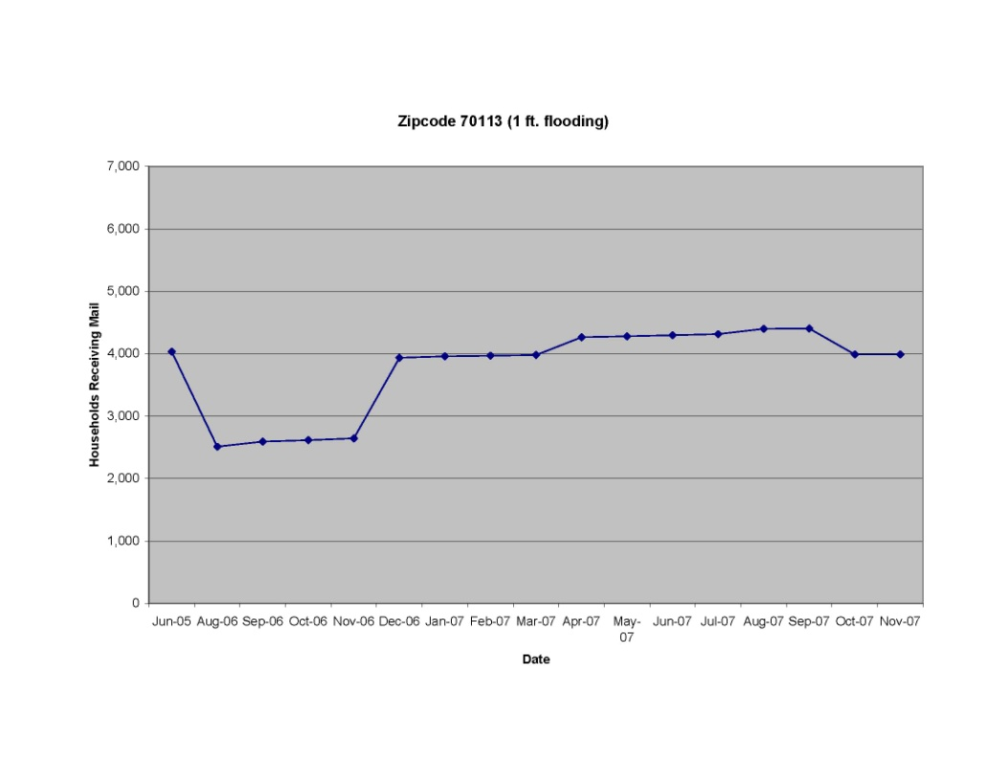
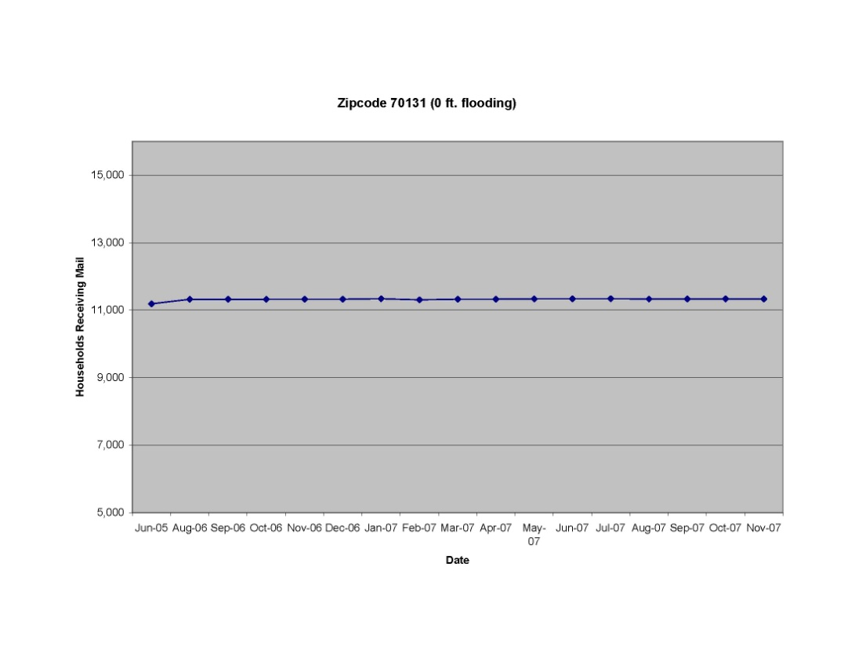
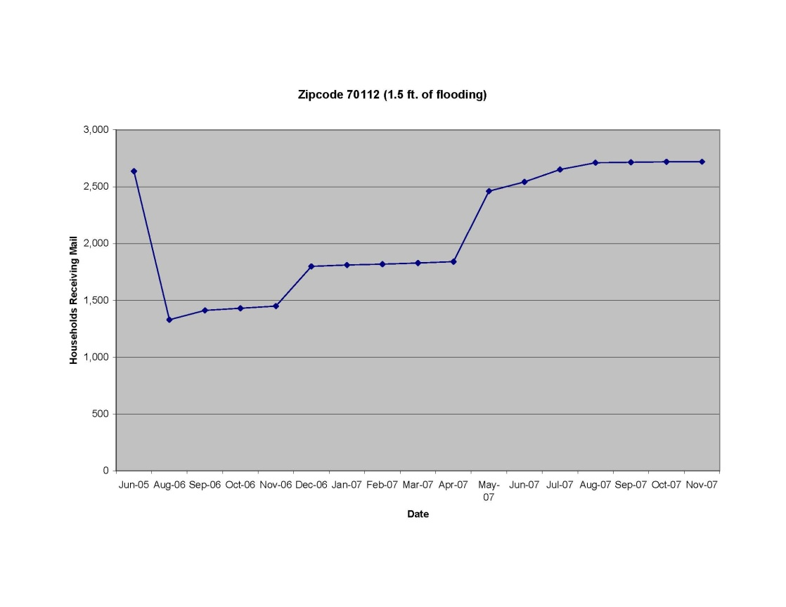
New Orleans: Households Receiving Mail
Susceptible
Resilient
Resistant
Usurper

Slide 28
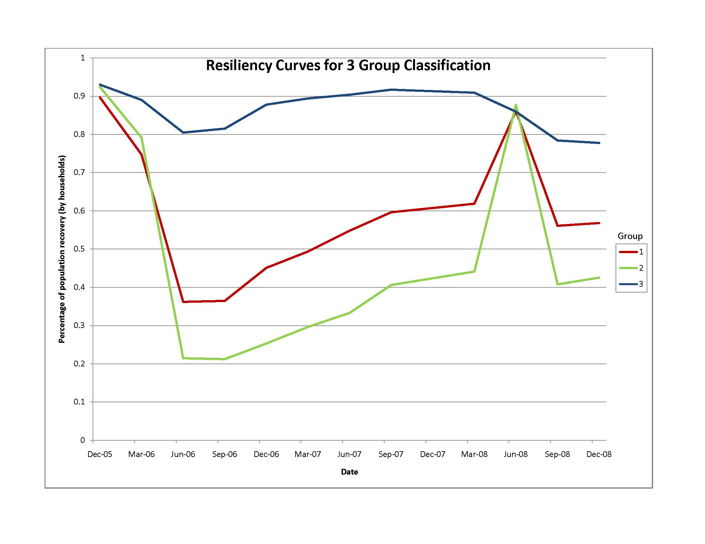
Resistant
Resilient
Susceptible
Where is usurper?
Derived from K-means cluster analysis (census tract level)

Slide 29
Our simplified framework
Exposure
Hazard intensity
Vulnerability
Low
High
Resilience
Resistant
(Low vulnerability;
high/low adaptability)
Resilient (high vulnerability;
high adaptability)
Susceptible
(high vulnerability;
low adaptability)
Adaptability
Low
High

Slide 30
How to Quantify these Concepts?
Exposure – Physical Disturbances
Vulnerability – Socio-Economics
Adaptations – Public Functions
Resilience – Population Levels

Slide 31
Discriminant Analysis
New Orleans Census Tracts

Slide 32
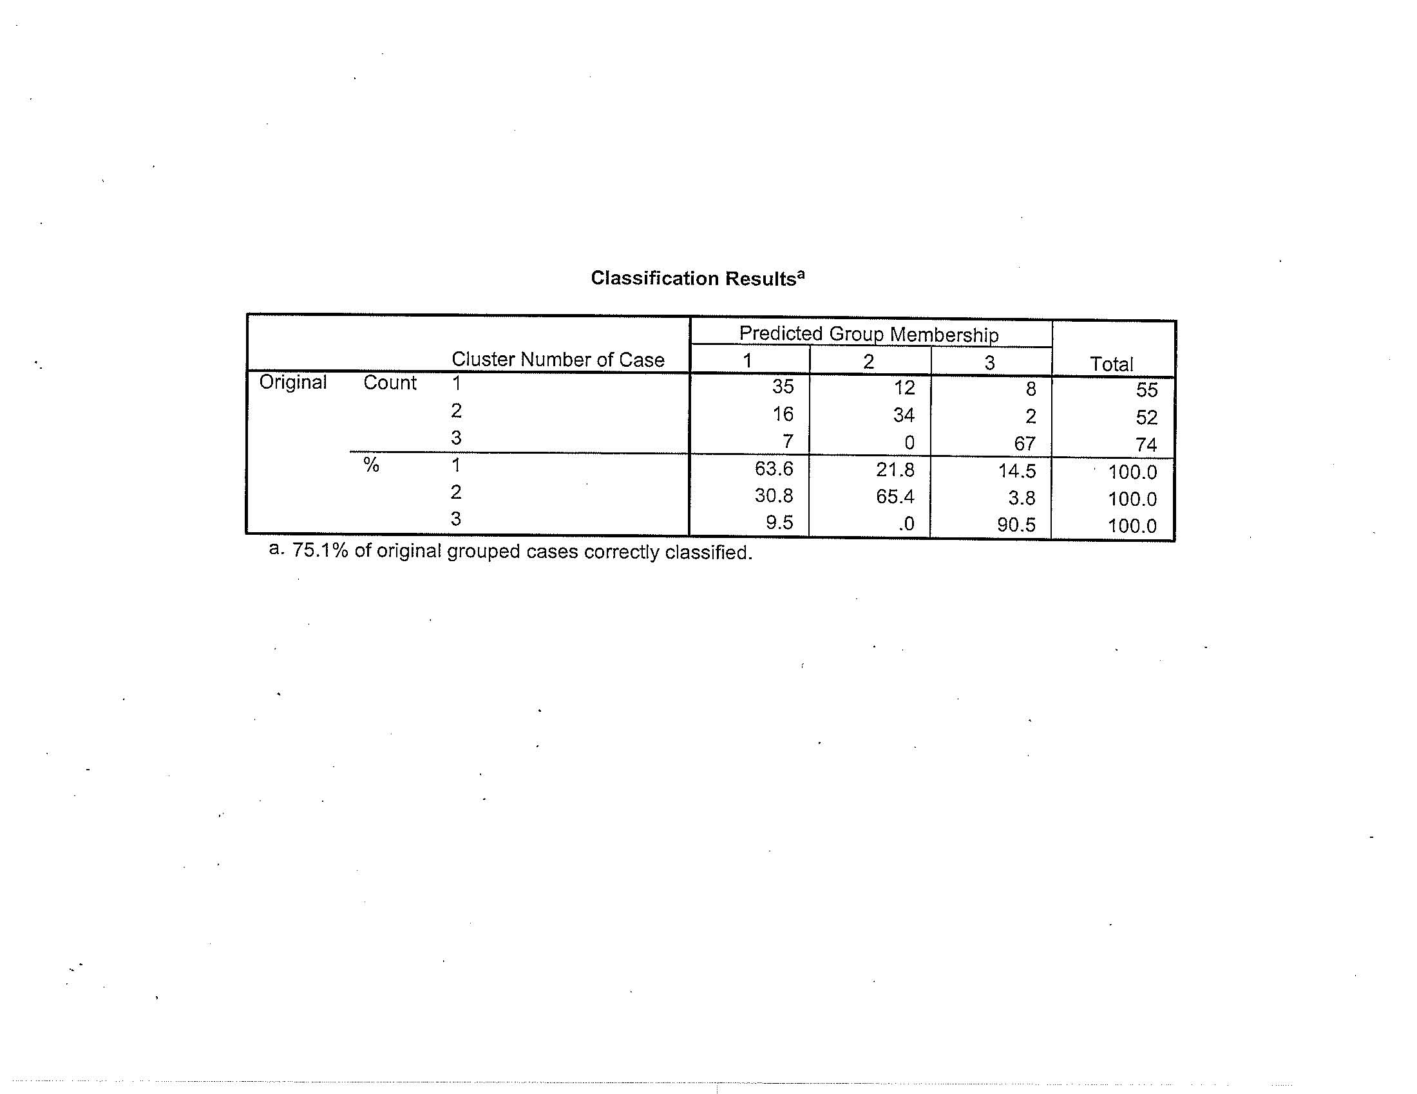

Slide 33
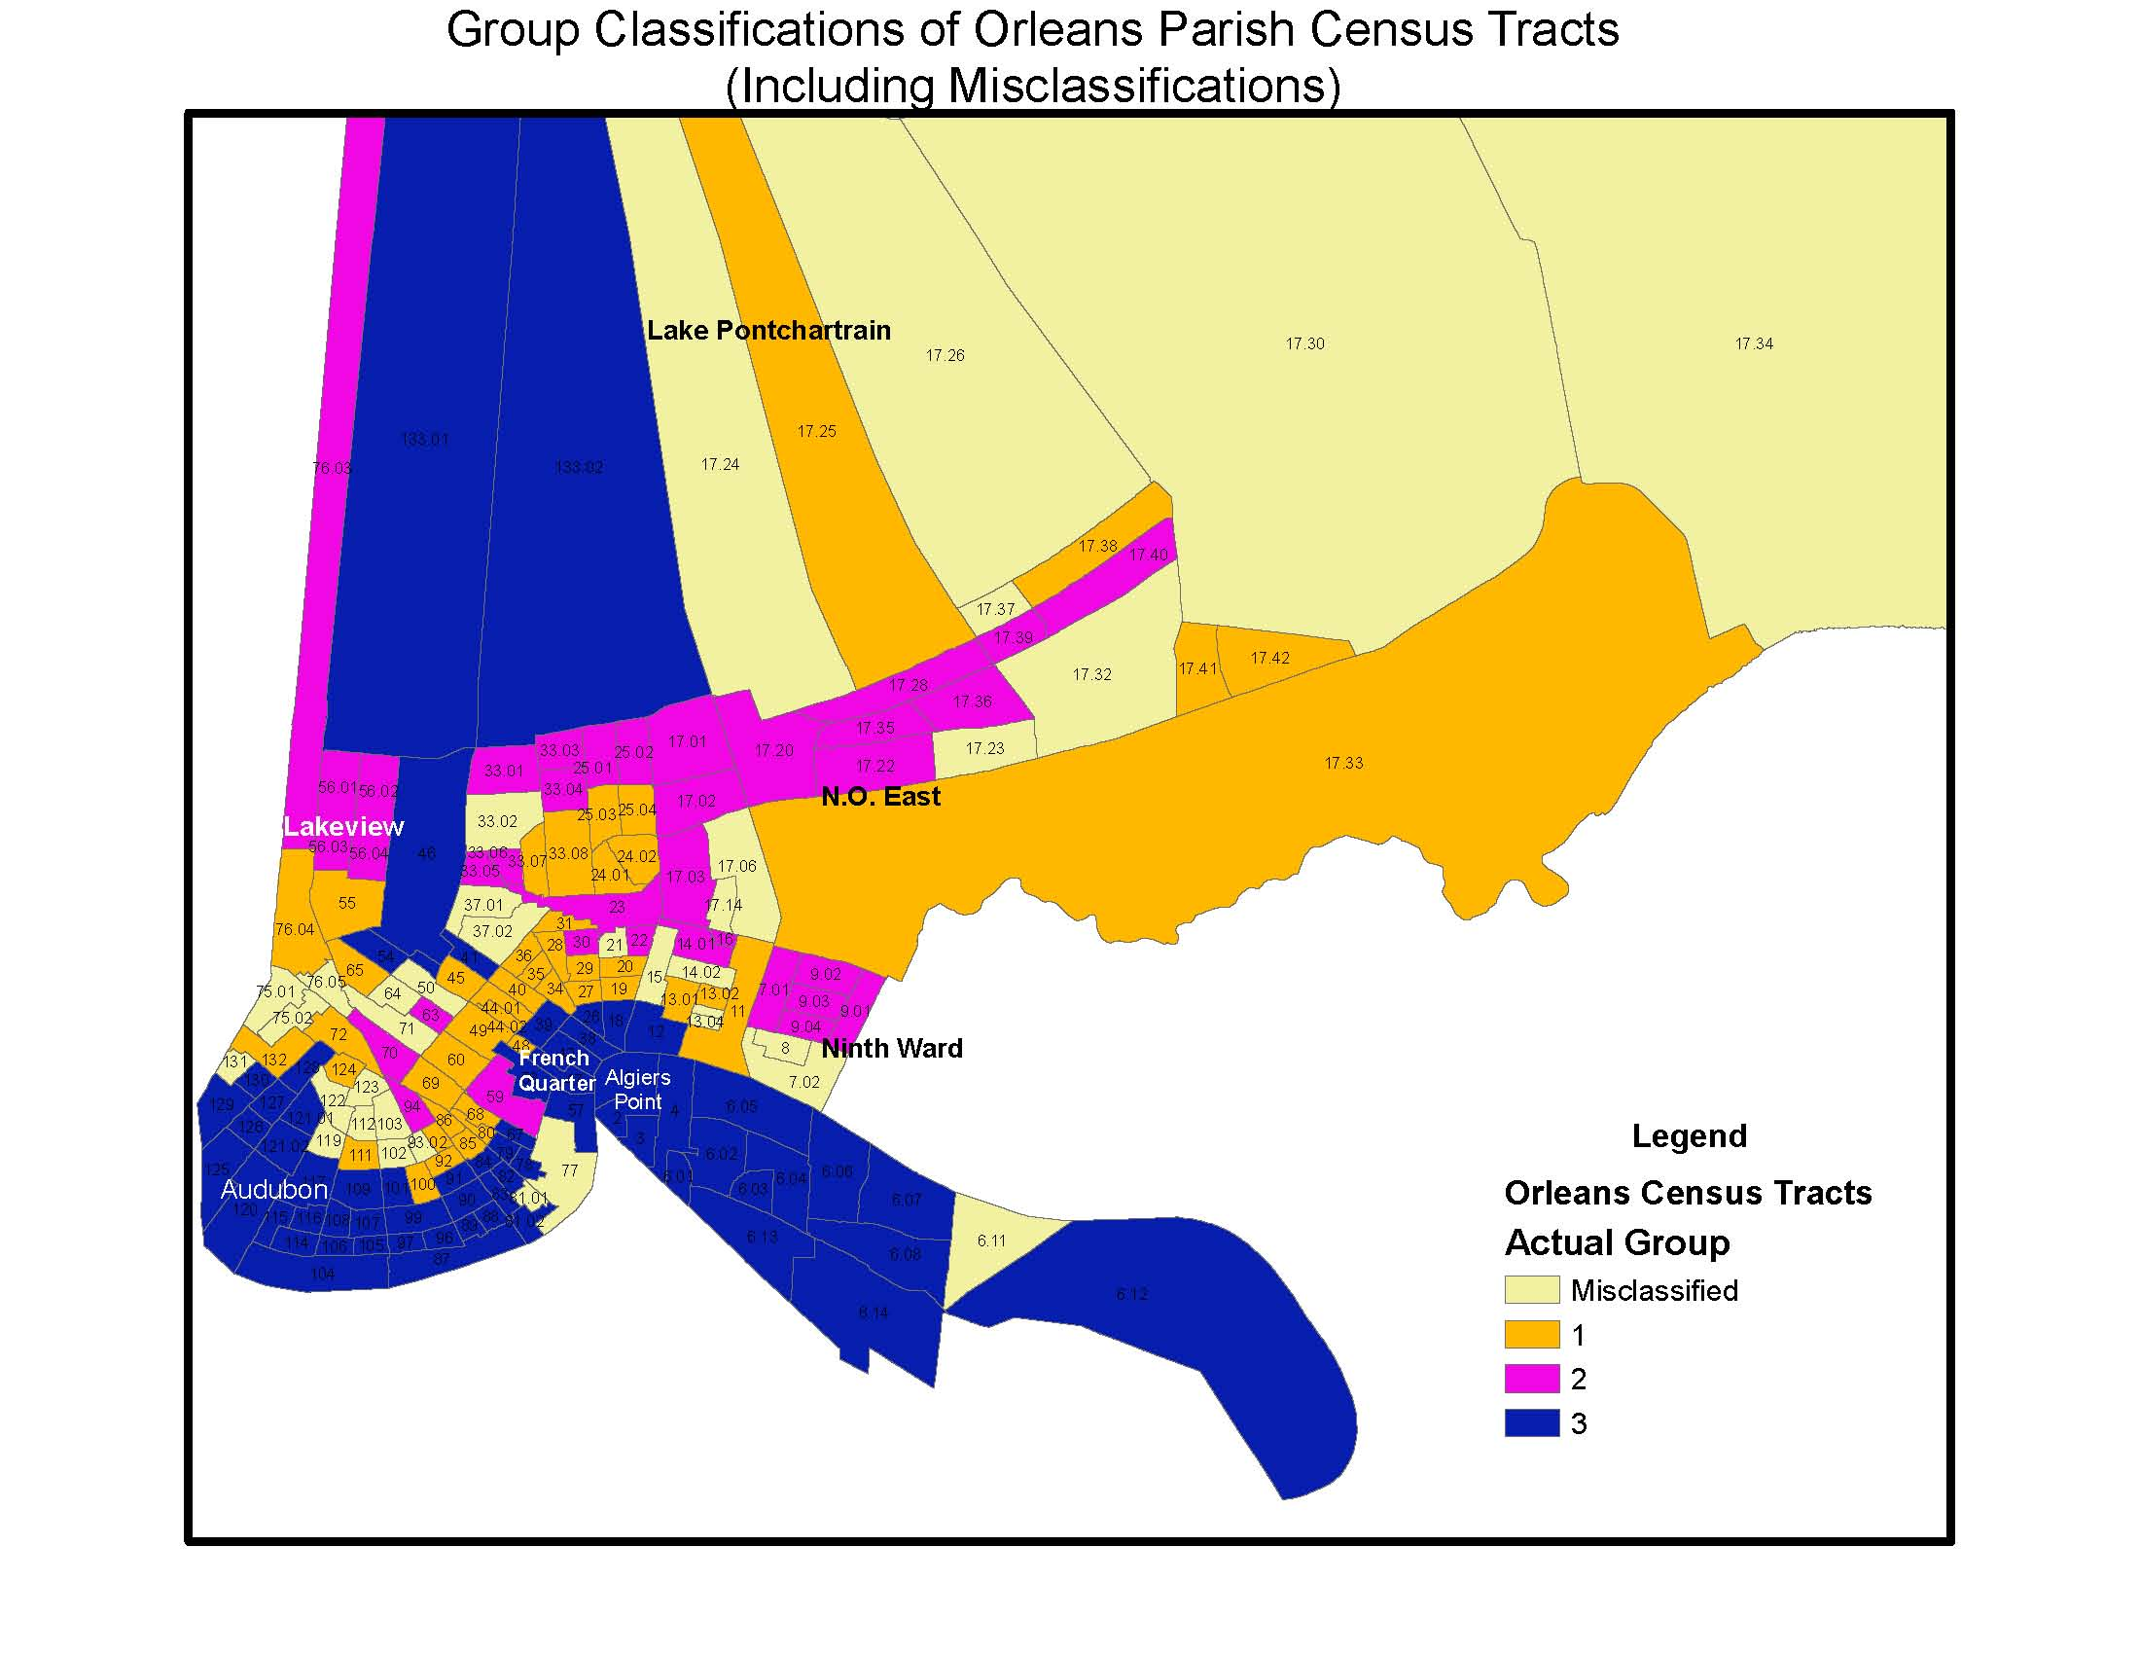
Group1-resilient; Group2-susceptible; Group3-resistant

Slide 34
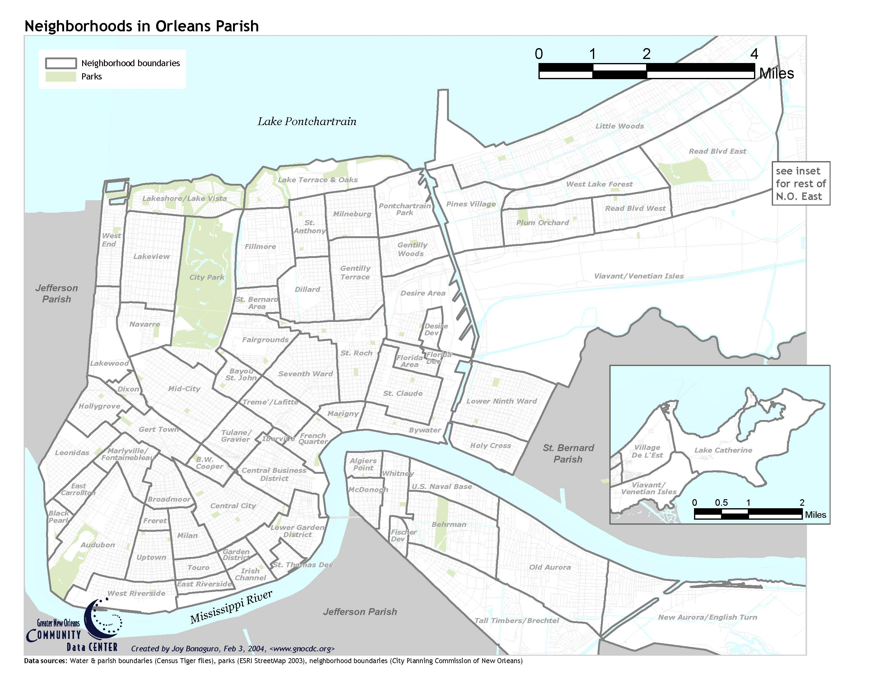

Slide 35
Discriminant analysis results – census tract level (from L. DeFrank)
Of the 181 census tracts classified into 3 groups from K-means analysis, 75% were correctly classified by discriminant analysis.
Key variables discriminating the three groups: mean flood depth and mean elevation; followed by age 25 and over with degree and % black
A neighborhood effect is observed when mapped

Slide 36
Discriminant analysis results – county level (from A. Baker)
52 coastal counties along the Gulf of Mexico
Classified into 4 groups according to # coastal hazards, property damage, population growth (“resilience”)
24 variables representing demographic, social capital, economic, government, and environmental
Discriminant analysis led to 94% counties correctly classified

Slide 37
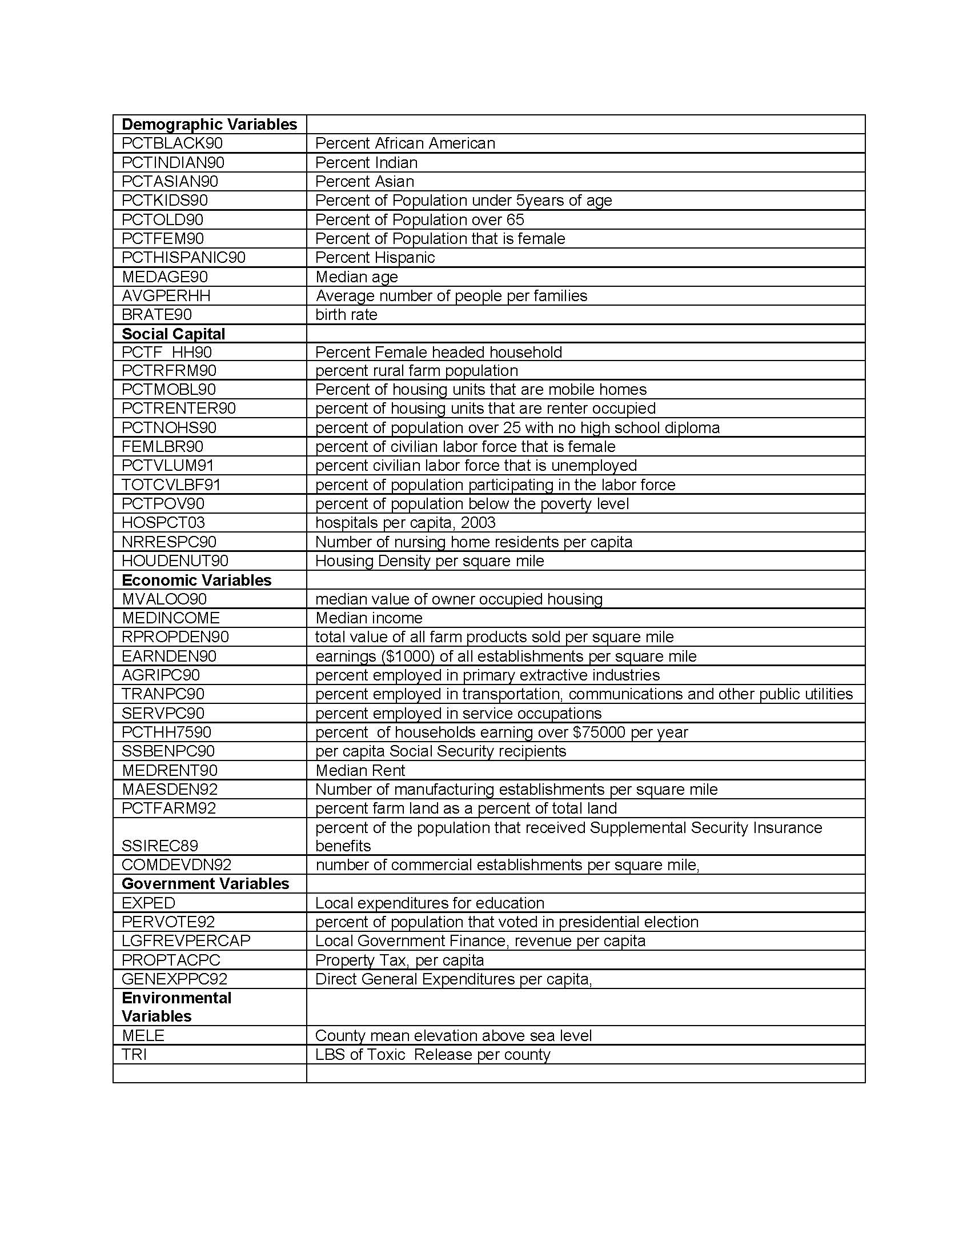

Slide 38
County | Hazard | Damage | PopGrowth | Total | Rank | “resilience” grouping
Santa Rosa, FL | 4 | 4 | 4 | 12 | 4 | most resilient
Charlotte, FL | 3 | 4 | 4 | 11 | 4 | most resilient
Baldwin, AL | 3 | 3 | 4 | 10 | 4 | most resilient
Jefferson, LA | 4 | 4 | 1 | 9 | 3 | moderate resilient
Lafourche, LA | 4 | 4 | 1 | 9 | 3 | moderate resilient
Jackson, MS | 2 | 4 | 2 | 8 | 3 | Moderate resilient
Orleans, LA | 3 | 4 | 1 | 8 | 3 | moderate resilient
St. Bernard, LA | 3 | 4 | 1 | 8 | 3 | moderate resilient
Orange, TX | 1 | 3 | 1 | 5 | 2 | low resilient
Kenedy, TX | 1 | 1 | 1 | 3 | 1 | least resilient
Kleberg, TX | 1 | 1 | 1 | 3 | 1 | least resilient

Slide 39
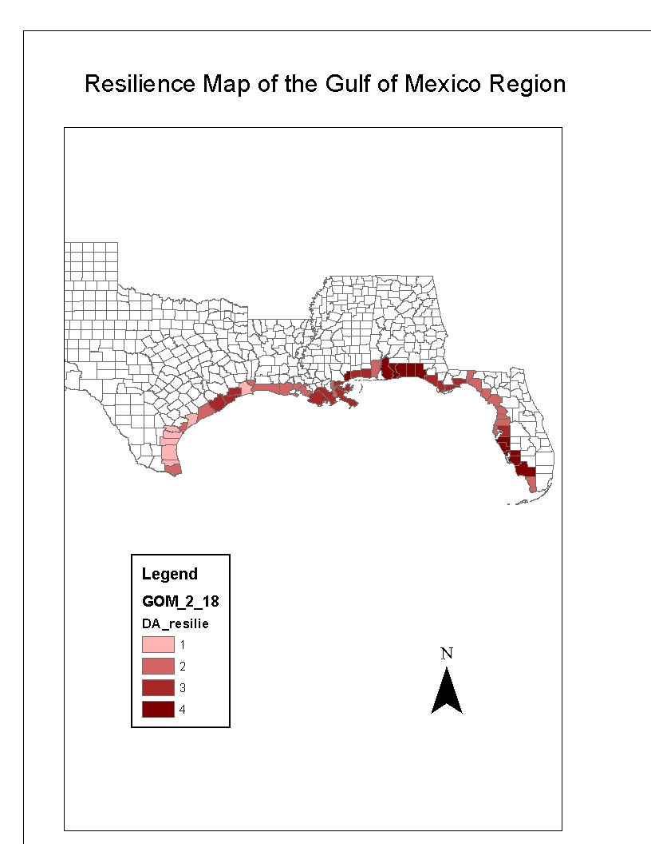
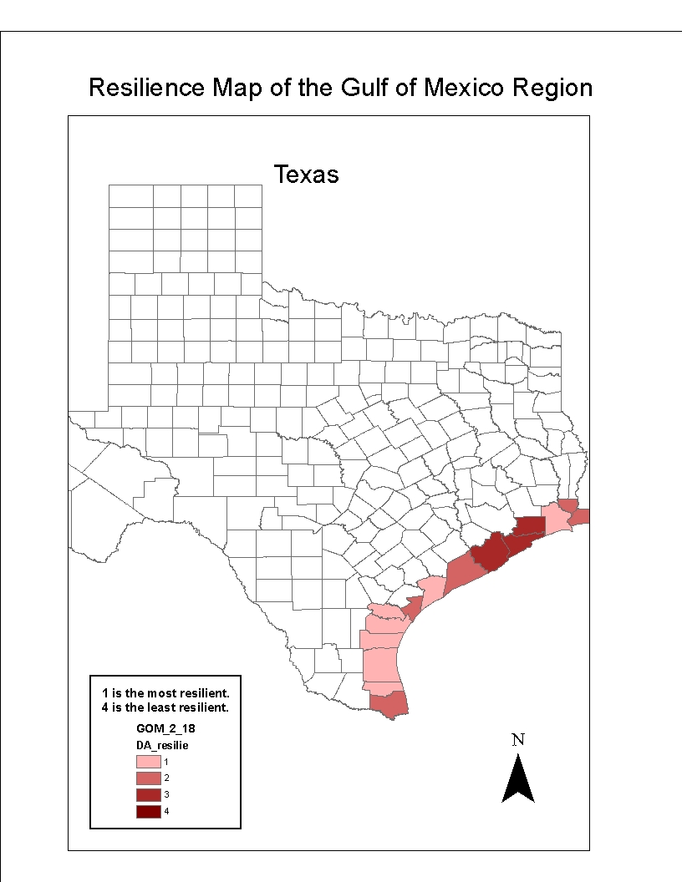
Kleberg
Kenedy

Slide 40
Conclusions
Obviously need refinements, but a promising approach
From discriminant analysis, an index can be computed based on the probability of group membership; the technique can be used to predict the resilience group of other counties
Usurper seldom exists or hard to detect in a social system
Resilience needs to incorporate a temporal dimension
A meaningful, empirically-tested resilience index can help identify aspects of activities that will increase or decrease resilience, thus a useful tool for sustainable planning and management

Slide 41
