Slide 1
Oyster Demand Adjustments to Alternative Consumer Education and Post Harvest Processes in Response to Vibrio vulnificus
William Huth, University of West Florida
Greg Martin, Northern Kentucky University
Ash Morgan, Appalachian State University
Richard Sjolander, University of West Florida
John Whitehead, Appalachian State University
Challenges of Natural Resource Economics & Policy
New Orleans, LA, May 26, 2010

Slide 2
Research Presentation Outline
Vibrio vulnificus and oyster economics research
Current project funded by National Sea Grant, Gulf Oyster Industry Program (GOIP), a continuation of a Florida research project that was funded by Florida Sea Grant
Research design updated from Florida pilot study
Survey methodology change (Consumer Panel)
Contingent behavior (Economics: WTP for PHP)
Protection motivation theory (Behavioral)
Added new video information treatment

Slide 3
Literature Background
Researcher has examined economic impacts from various “health scares” on consumer demand (Contingent behavior)
Marketing and social psychology research also has examined consumer behavior with respect to health issues (Protection motivation theory)

Slide 4
Florida Project Review
Florida Sea Grant-funded an exploratory pilot study in 2007
Results from that are in the Journal of Agricultural and Applied Economics (JAAE, V. 41, No.3, 2009) “Oyster Demand Adjustments to Counter-Information and Source Treatments in Response to Vibrio vulnificus.”
Measured how news of a V. vulnificus-related death impacted the demand for oysters using Florida consumers
Quantified “economic losses” associated with demand change where economic loss was in terms of “consumer surplus,” the difference between willing to pay and actual payment; a measure of individual consumer value or satisfaction

Slide 5
Florida Project Review (cont.)
Also measured change in oyster demand from providing consumers with a counter-information brochure (varied by source) to mitigate surplus losses.
Do consumers distrust information disseminated by a government source? Apparently so.
What about third party, ngo or nfp information? Better received.
The research also quantified the differences in risk perceptions contingent on oyster PHP alternatives and associated price points.
Do consumers of raw versus cooked oysters behave differently? Yes.

Slide 6
Economic Model
Oyster demand was measured as a function of perceived risk and considered differences between raw and cooked oyster consumers
Measured demand change following health scare news (a media reported death from raw oysters)
Measured mitigating impacts of a counter-information brochure that was varied by source
Measured impact of PHP treatment and price premium on consumer behavior

Slide 7
Main Florida Pilot Study Results
Raw and cooked oyster consumers responded differently to the V. vulnificus health scare
Cooked oyster consumers reduced demand for oysters
Consumers exhibited risk aversion
Incurred a $4.12 per-meal per-consumer surplus loss
Raw oyster consumers did not change their behavior
Exhibited optimistic bias or maladaptive coping behavior
They were fully informed about consumption risks

Slide 8
Main Florida Results (cont.)
Counter-information brochure with no source or sourced to ISSC/FDA had no impact on demand
Brochure sourced to a not-for-profit/non-governmental organization increased demand
Reaffirmed the importance of consumer education information in oyster markets
Established source credibility is an important component of educational treatment efficacy

Slide 9
Main Florida Results (cont.)
Consumers do not respond favorably to PHP-treated oysters…Why?
Perhaps because they perceive a reduction in quality due to taste and texture changes from PHP
Policy implications for mandated PHP
PHP-treated oysters with an associated price premium had a significant demand reduction effect (reduced willingness to pay)

Slide 10
Florida Pilot Study Concluding Remarks
Raw and cooked oyster consumers behaved differently following a health scare event
Substantial surplus losses due to health scare news (Cooked oyster consumers only)
Brochure source credibility was important in mitigating consumer surplus losses
PHP product reflects a degree of consumer “unwillingness” to pay

Slide 11
Current Research Overview and Update
NOAA/GOIP-funded research grant to change the population sampled to primary oyster-producing and consumption states
Increase data collection to core oyster reporting states (Southern California, Texas, Florida, Louisiana) and, additionally, Mississippi and Georgia)
Added sourced video as an additional information treatment with 2 different threat levels (PMT)
Changed to an internet based consumer panel sample
Incorporated a theoretical behavioral base (PMT)
Update previous ISSC surveys (Flattery and Bashin, 2002 and ORC-Macro, 2005).

Slide 12
Project Status
Survey redesigned and implemented
Data collection vendor:
Online Survey Solution (M/A/R/C Research)
Survey completed April 22, 2010, just after the Deepwater Horizon event began.
Other vendors who provided bids:
Carbonview (MVL Group)
Decision Analyst
Knowledge Networks

Slide 13
New Research Design I
Consumption
intention change
Educational
information
Brochure/ No source
Brochure/ FDA~ISSC
Brochure/ Foundation
Video/ No source
Video/ FDA~ISSC
Video/ Foundation
Health/Safety
knowledge & beliefs
Eaters
Ex-eaters
WTP for
reducing deaths
Demand function –
consumption baseline
Reasons for
stopping
consumption

Slide 14
New Research Design II
Death treatment
& behavior change
Change in Health/Safety
knowledge & beliefs
Respondent
health status
Eaters
PHP treatment &
behavior change
PMT pilot items
Ex-eaters

Slide 15
Willingness to Pay Scenario
Suppose that in order to minimize the risks from eating raw oysters the U.S. Food and Drug Administration (FDA)proposes a federal law to ensure that all oysters are specially processed before going to market. It is believed that this will reduce the average annual number of deaths in the U.S. from eating raw oysters from the current 16 to 20 people to [1-5, 6-10, 11-15] people. However, because of the additional costs incurred by oyster producers to process their product the program will result in an increase in the price of an average oyster meal for all consumers. Imagine that you have the opportunity to vote on this proposed law. If more than 50% of those voting vote for the federal law, the FDA would put it in practice.

Slide 16
Questions:
If you could vote today and you knew that the price of your average oyster meal would go up by [$X] but the price of all other food would stay the same, would you vote for or against the proposed law? 1=for, 2=against, 3=undecided
How sure are you about your choice to vote for the proposed law? 1=very sure …4=Not sure at all 5=Don’t Know
Now suppose the proposed processing law could reduce illness and the number of deaths to 0 (zero). Would you vote For or Against the proposed law? 1=For, 2=Against 3=Undecided

Slide 17
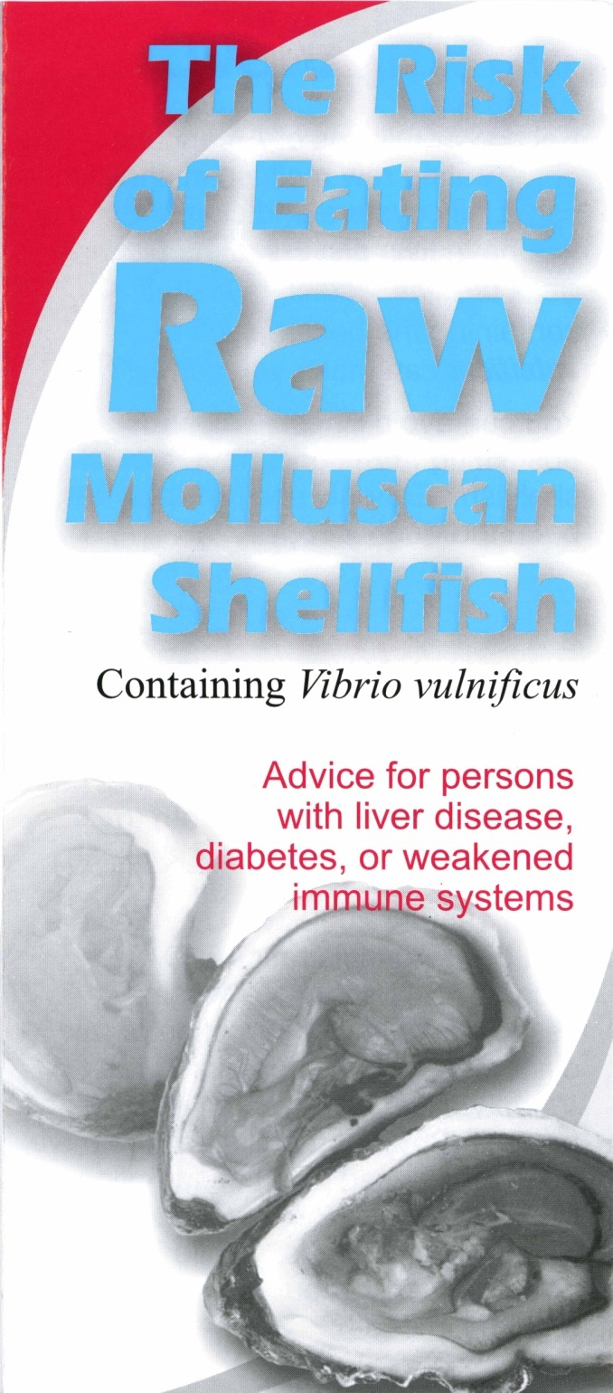
Treatment View 1

Slide 18
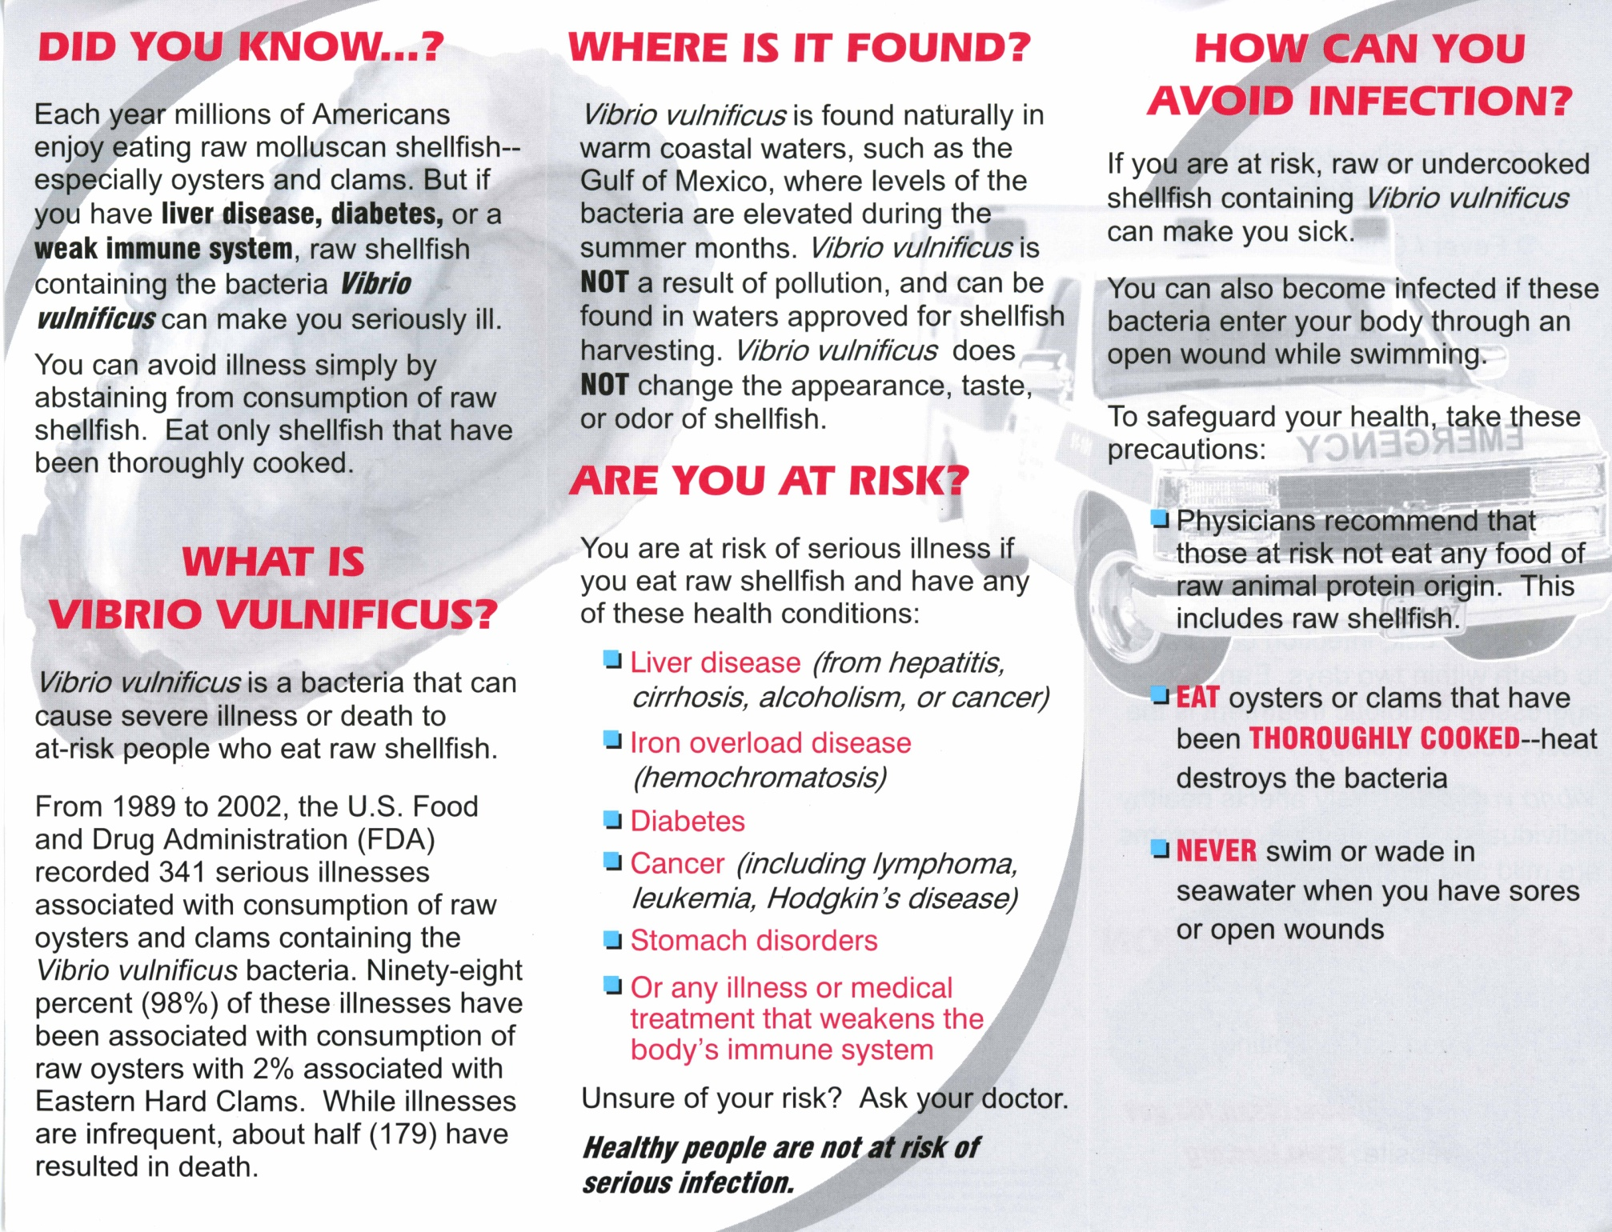
Treatment View 2

Slide 19
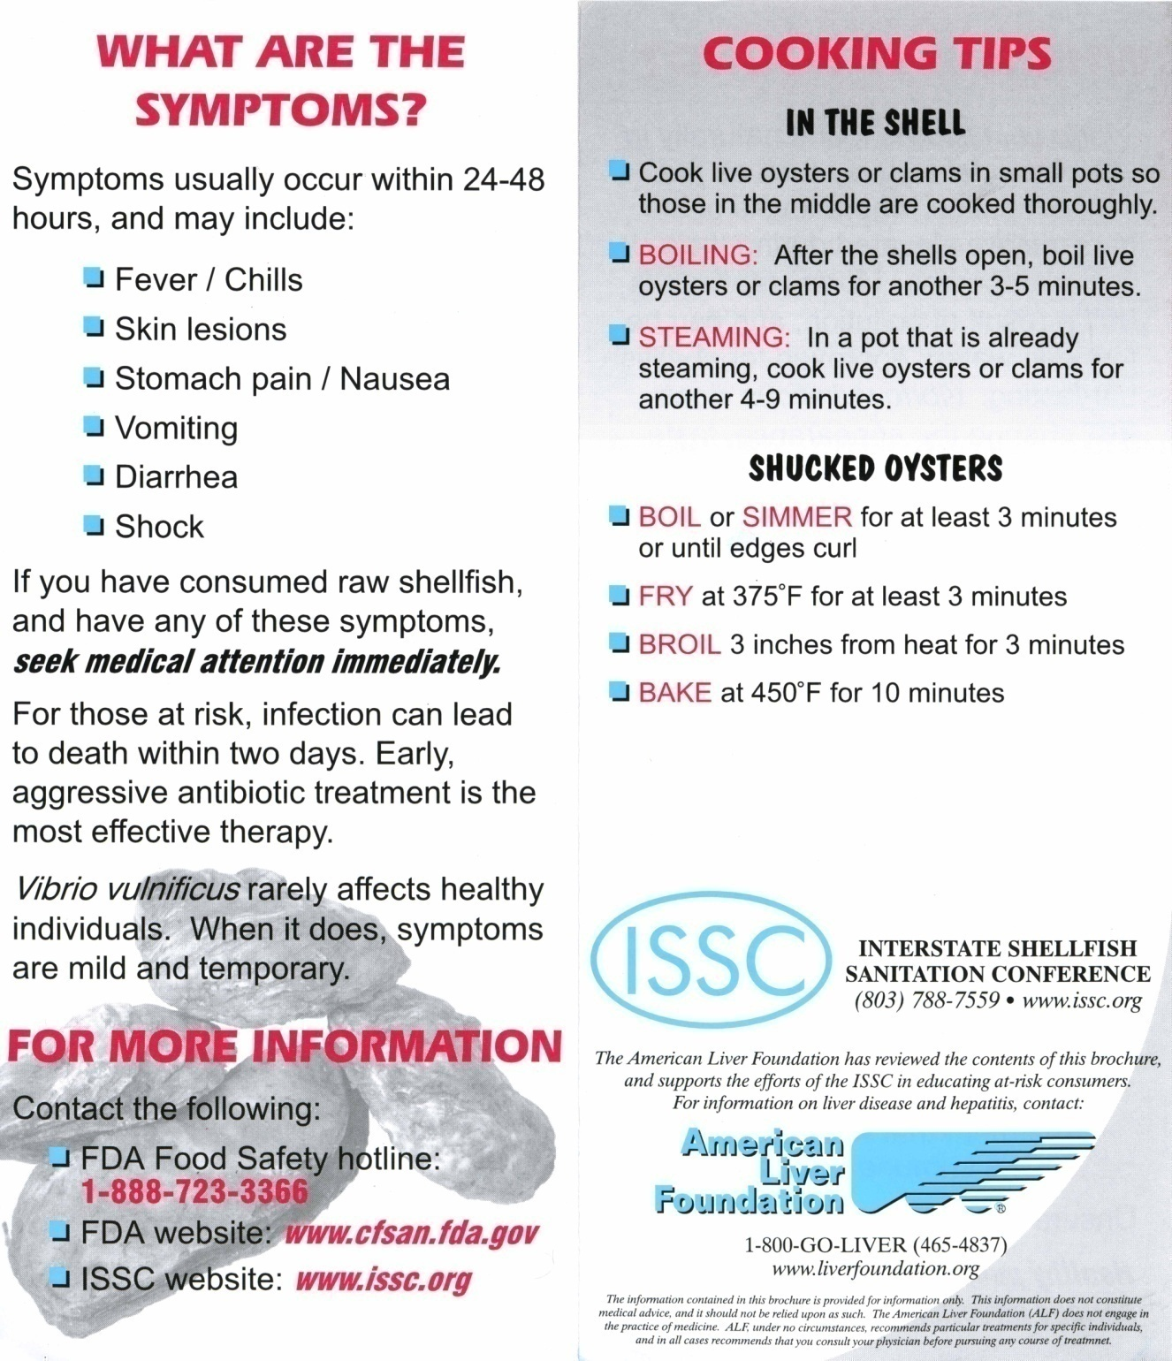
View 3 Unedited

Slide 20
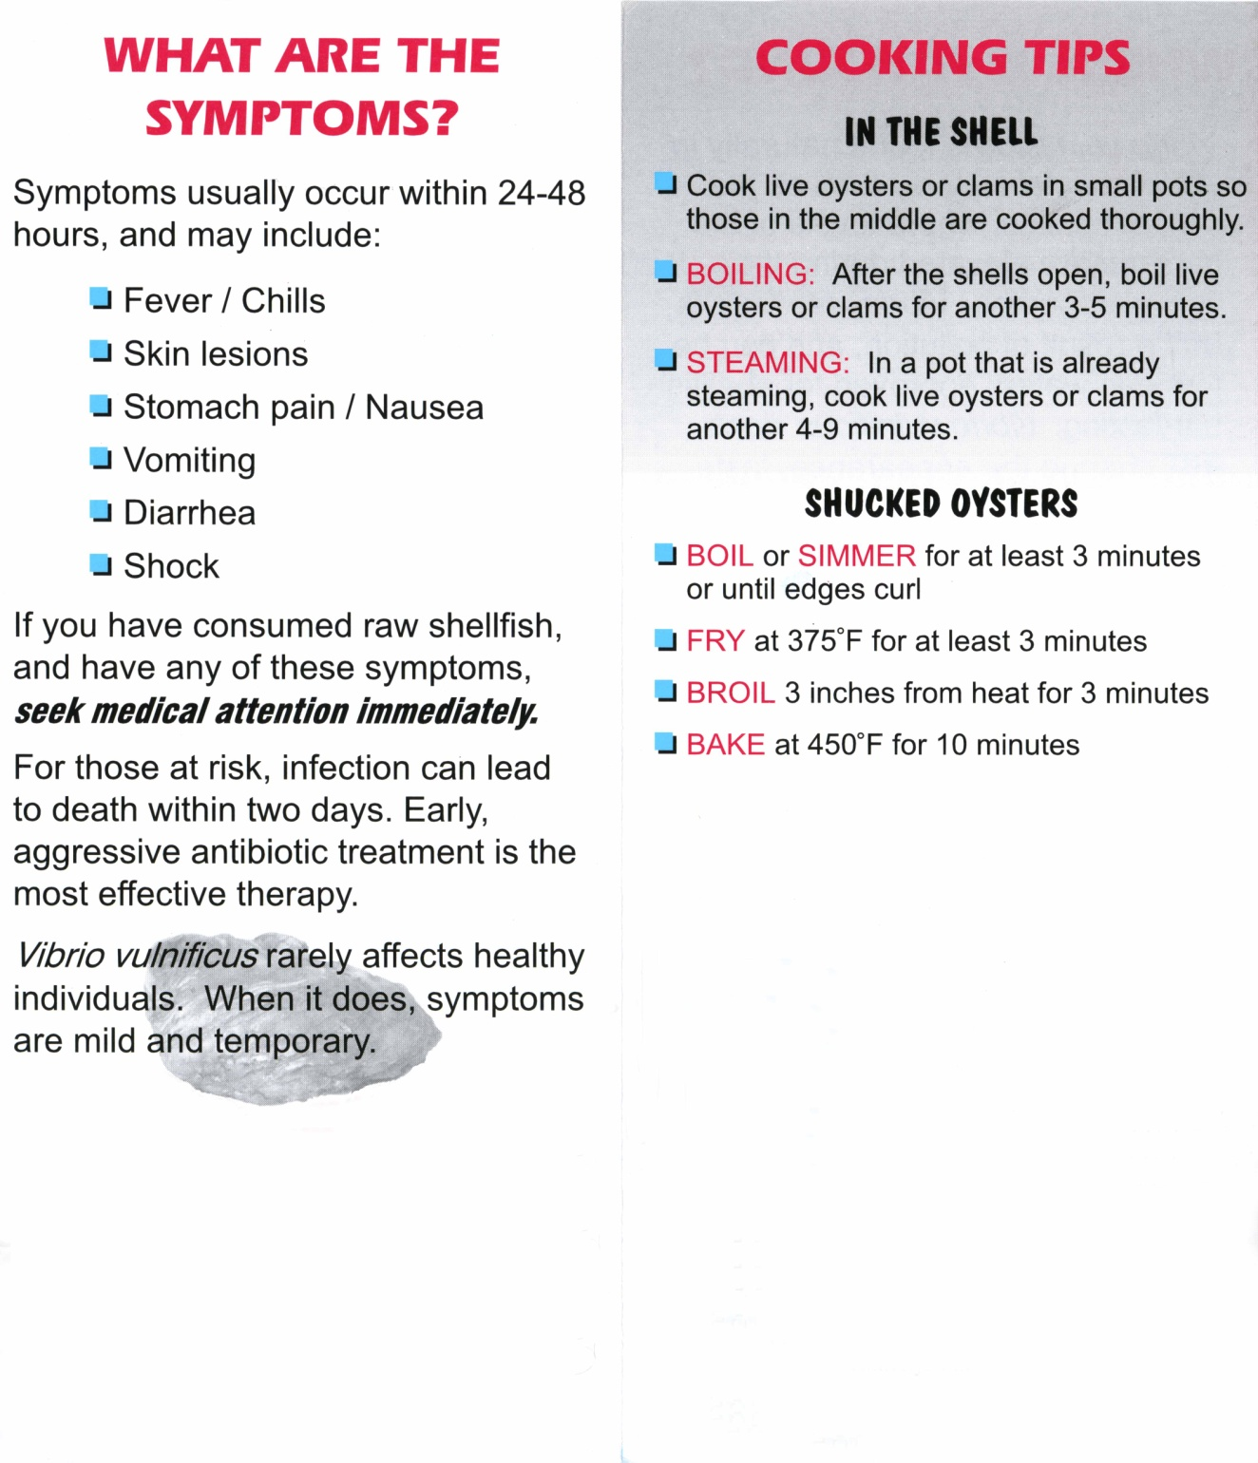
Treatment View 3
CONTROL Condition

Slide 21
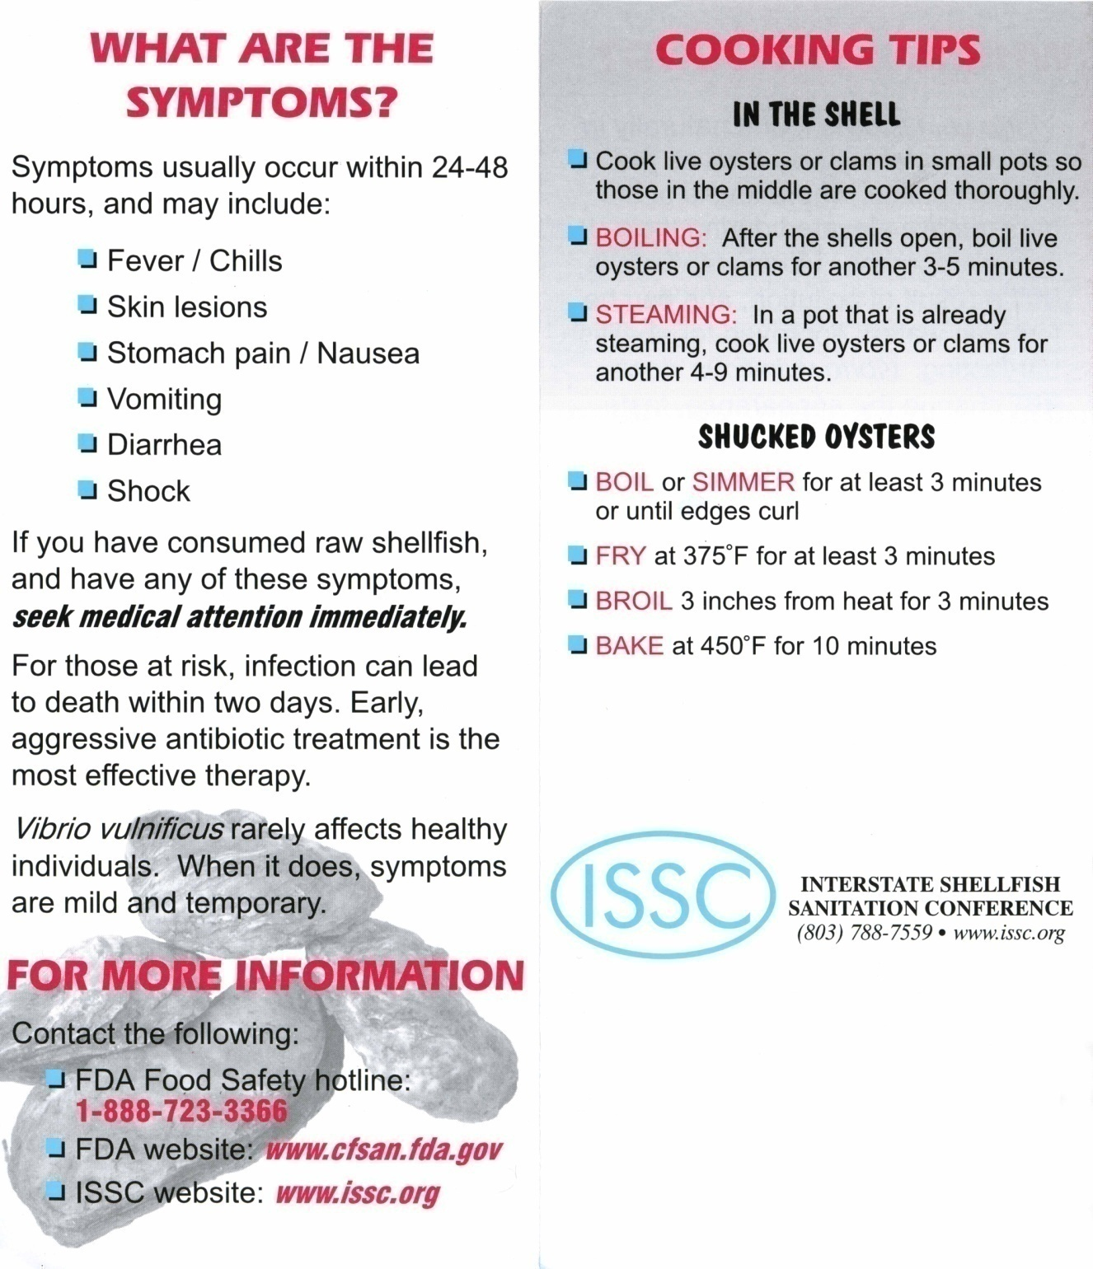
Treatment View 3
ISSC Condition

Slide 22
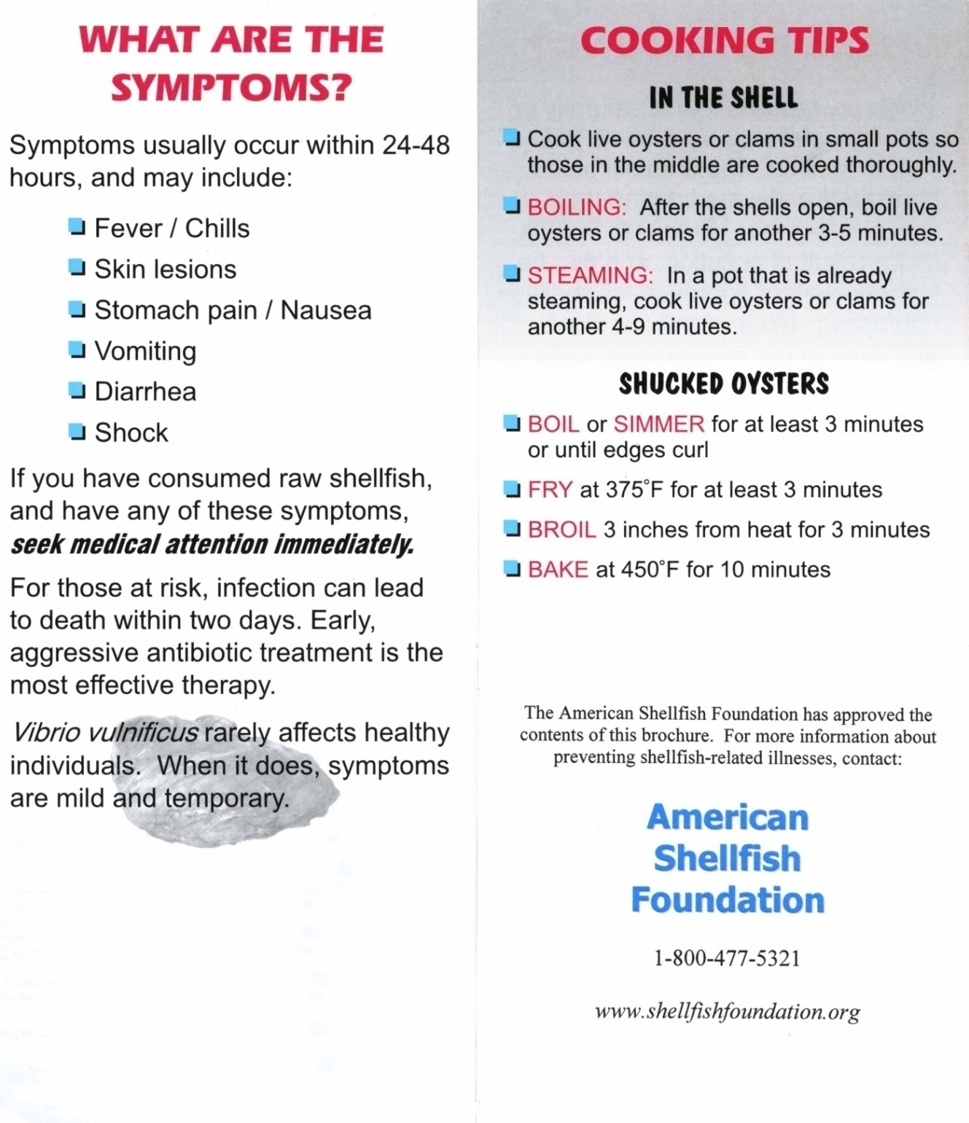
Treatment View 3
FOUNDATION Condition

Slide 23
Video stimulus

Slide 24
Generic PHP Treatments
4 FDA-approved PHP systems
Pressurization
Pasteurization
Individual Quick Freezing
High Energy Gamma Irradiation

Slide 25
Economic Model
Oyster demand is measured as a function of perceived risk
Differences in raw vs. cooked oyster consumers are also considered
Changes in demand following health scare news are measured
Mitigating impacts from counter-information media, varied by source are also measured
The impact of PHP treatment and a price premium on consumer behavior is also measured

Slide 26
Mitigating Impact of Counter Information?
$
c
$P₁
D₁
D₂
D₃
Q

Slide 27
Demand after Death Article
$
a
b
$P₁
D₁
D₂
Q

Slide 28
Survey Respondents (Current Oyster Consumers)
1,990 Current Oyster Consumers
FL = 363 (18.2%) Male 951 (47.8%)
MS = 262 (13.2%) Female 1,039 (52.2%)
LA = 375 (18.8%)
TX = 363 (18.2%) 18-34 31.3%
GA = 260 (13.1%) Age 35-54 40.0%
CA = 367 (18.4) 55-65+ 28.7% Mean = 45.1

Slide 29
Oyster Consumer Characteristics
In General, thinking of risks to your personal health, do you consider eating oysters to be …
 | Before | After
Unsafe | 13.4 | 26.8
Neither | 19.5 | 20.1
Safe | 67.1 | 53.1
How many Oyster Meals ?
Mean of 4.6 months out of the year
Mean of 4.1 meals in a typical month
18.9 oyster meals consumed per year
6.8 raw meals (61.1% of respondents consume raw product)
3.8 prepared at home

Slide 30
Consumer Characteristics (Cont.)
Gender and risk significantly related
PHP Consumption: Only 7.5% had consumed a PHP oyster and of those 50.4% said they tasted the same.
Average number of annual oyster deaths?
21.8% said zero
37.6% said 100 or more
9.4% said 1,000 or more
5.6% said 15 to 20
Mean 1,518, Median 15

Slide 31
WTP FDA PHP Law Vote:
If you could vote today and you knew that the price of your average oyster meal would go up by [$X] but the price of all other food would stay the same, would you vote for or against the proposed law?
For: 33.7%, Against: 36.2%, Undecided: 28.6%
How sure are you about your choice to vote for the proposed law?
Sure: 94.4% Not sure 4.3% Don’t Know 1.3%
Now suppose the proposed processing law could reduce illness and the number of deaths to 0 (zero). Would you vote For or Against the proposed law?
For: 38.4%, Against: 32.3, Undecided: 29.3%

Slide 32
Preliminary Results Poisson Model with Random Effects
Variable | Coefficient | p-Value
Broc_control | -0.674 | 0.012
Broc_fda | -0.106 | 0.000
Broc_issc | -0.095 | 0.000
Broc_asf | -0.061 | 0.005
Vid_control | -0.104 | 0.000
Vid_fda | -0.083 | 0.016
Vid_issc | -0.053 | 0.004
Vid_asf | -0.134 | 0.000
Alt_control | -0.078 | 0.005
Alt_fda | -0.038 | 0.038
Alt_asf | -0.106 | 0.000

Slide 33
Preliminary Results Continued…..
Variable | Coefficient | p-Value
Price | -0.043 | 0.000
Death_in_state | -0.172 | 0.000
Death_out_state | -0.096 | 0.000
SP | 0.064 | 0.000
PHP | -0.153 | 0.000
PHP_price_increase | -0.064 | 0.000
Age | 0.002 | 0.288
House | 0.036 | 0.024
Inc | 0.002 | 0.002

Slide 34
Primary Results
No brochure or video treatment increased demand
In line with a majority of the information conveyance literature that positive information has negligible effect on behavior
Coefficient on an “in state” death is greater than an “out of state” death
Protection Motivation Theory (vulnerability)

Slide 35
Primary Results
Consumers do not respond favorably to PHP-treated oyster
Perhaps consumers perceive PHP as reducing the taste and texture of the product
Policy implications for oyster processing companies that invest substantial funds into PHP equipment
PHP-treated oysters with an associated price premium have a significant demand reduction effect.

Slide 36
Future Effort
Further develop modeling technique
Examine behavior across states
Consider raw v. cooked oyster consumer behavior
Protection Motivation Theory

Slide 37
Protection Motivation Theory
Motivating people through persuasive communications
to act to protect themselves by changing selected health
attitudes and behaviors…
Information Sources
Cognitive Mediating Processes
Coping Behaviors
Threat Appraisal:
Evaluation of
Maladaptive Behaviors
Environmental:
Observational
Verbal
Individual:
Personality
Experience
Adaptive
Protection
Motivation
Coping Appraisal:
Evaluation of
Adaptive Behaviors
Maladaptive
Adapted from Rogers and Prentice-Dunn (1997)

Slide 38
PMT – Experimental Design
Information Sources
Cognitive Mediating Processes
Coping Behaviors
Vv-related death stimulus
Media X source educational stimuli
Print medium
Audio-visual medium
X
Control (no named source)
Government/trade (FDA/ISSC)
NGO (“Health” foundation)
PHP stimulus
Environmental:
Observational Learning
Verbal Persuasion
Individual:
Personality Variables
Prior Experience
Measured variables

Slide 39
PMT – Experimental Design (cont.)
Information Sources
Cognitive Mediating Processes
Coping Behaviors
Maladaptive behavior threat appraisal:
Perceived rewards of mal. behavior
Perceived severity of consequences
Perceived vulnerability to consequences
Perceptions measured both pre
and post exposure to information
treatments
Health “at risk” assessment
Beliefs measured post exposure
to information treatments
Adaptive behavior coping appraisal:
Belief that PHP or cooking is effective
Belief that one can successfully perform
the adaptive behavior
“Costs” of adopting the behavior
“Economic” costs measured post
exposure and compared with
baseline demand data

Slide 40
PMT – Experimental Design
Information Sources
Cognitive Mediating Processes
Coping Behaviors
Protection
Motivation
Imputed – not directly measured
Intentions measured:
stop eating oysters
eat only PHP treated oysters
eat only cooked oysters
Adaptive Behavior
Intentions measured:
continue eating untreated raw oysters
Maladaptive Behavior

Slide 41
Extensions and Future work
Additional states to measure “national demand”
Additional questions focused on PHP consumer demand
PMT testing of brochure and video content and menu warnings (LA, TX, FL, CA)
Experimental economic market and taste test to measure willingness to pay for PHP oysters. Current proposal to ISSC with University of Florida.

Slide 42
Questions, Suggestions, Comments..…

