Slide 1

Legal Issues in Sea Level Rise Adaptation
Property Rights/Government Responsibilities

Slide 2
Sea Level Rise and Property Rights: A Gulf Of Mexico Regional Sea Grant Legal Project
  Funded by:
  Gulf of Mexico Sea Grant Programs
  EPA Gulf of Mexico Office
  Northern Gulf Institute
  U.S. Geological Survey
Notes:
Florida Cases “known dangerous conditions”,” foreseeable zone of risk”,” substantial zone of risk”

Slide 3
Takings Law
Takings Law-5th Amendment U.S. Constitution
  Original Interpretation-Physical Occupation
  Regulating the Use of Property
  Sea Level Rise Adaptation
    Setbacks
    No Build Zones
    Protect Life and Property
    Allow Natural Systems to Migrate
  Local Government Fears

Slide 4
Takings Law
Physical Occupation of Private Property
Requiring Quid Pro Quo for Development Permits (Dedication and Exaction conditions)
Diminishing Economic Value of Property
  Loss of Some Value
  Loss of All or Most Value
  Prevention of Harm or Noxious Use
Reasonable expectations?

Slide 5
Reverse Government Liability-
Duty to Prevent Harm/Warn?
The Other Pincer
Planning and Zoning Authority
Liability for Failure to Control Risky Development
Foreseeable Consequences
Special Knowledge
  NFIP is Not Enough
  Conditions Will Worsen

Slide 6
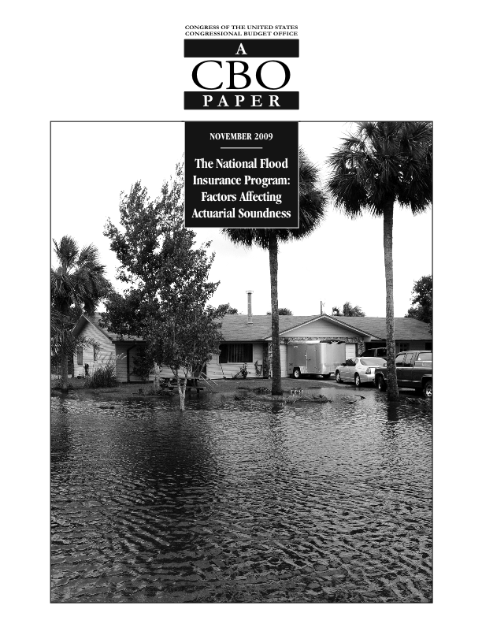
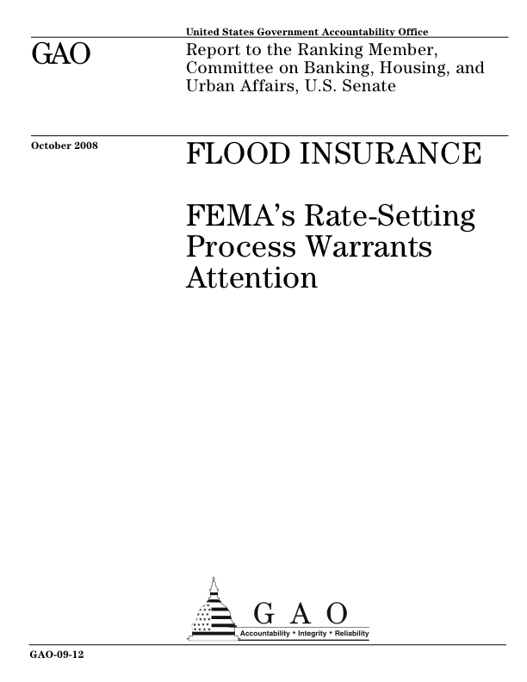

Slide 7
Reverse Government Liability-
Duty to Prevent Harm/Warn?
Knowledge
  Sea Grant Focus Area-Sustainable Coastal Communities, Hazard Resiliency
  Workshops and Seminars for Public Officials
  Public Meetings
  Louisiana Coastal Hazard Mitigation Guidebook

Slide 8
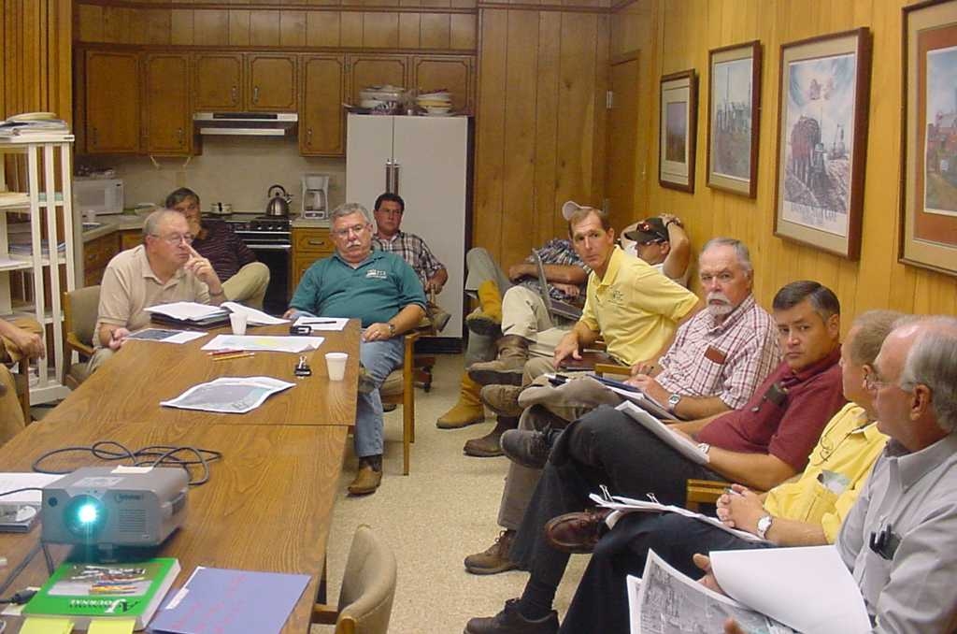

Slide 9
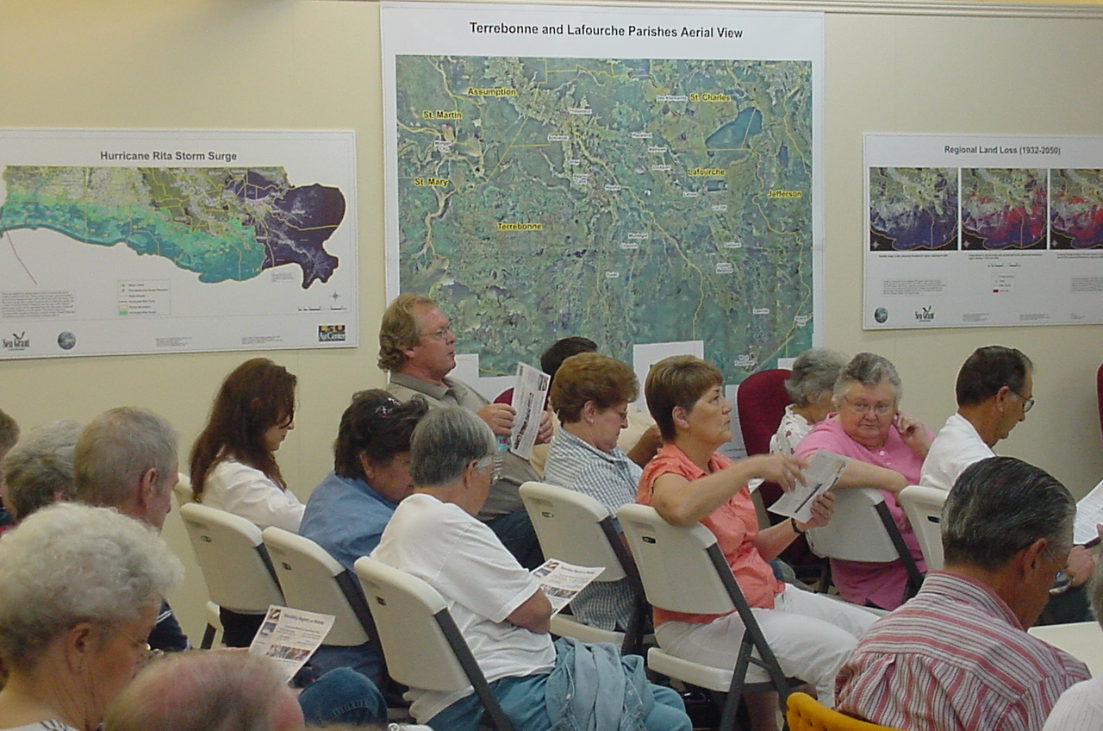

Slide 10
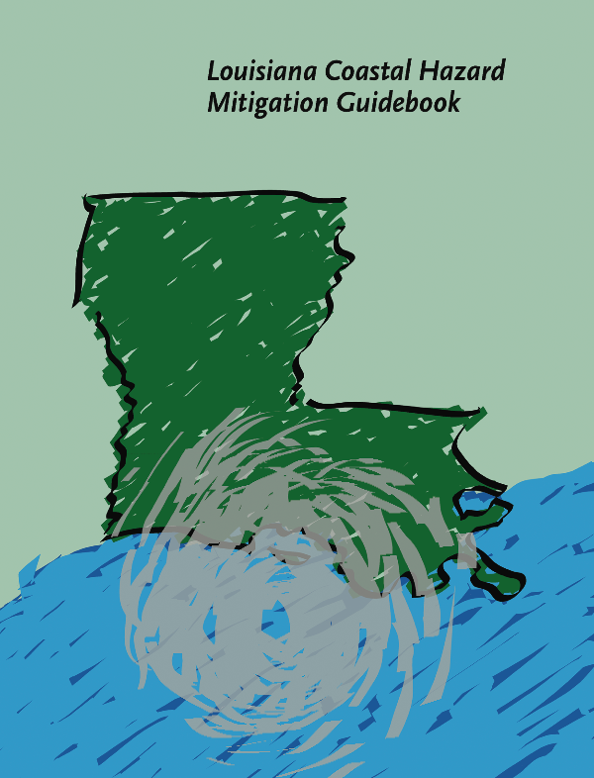

Slide 11
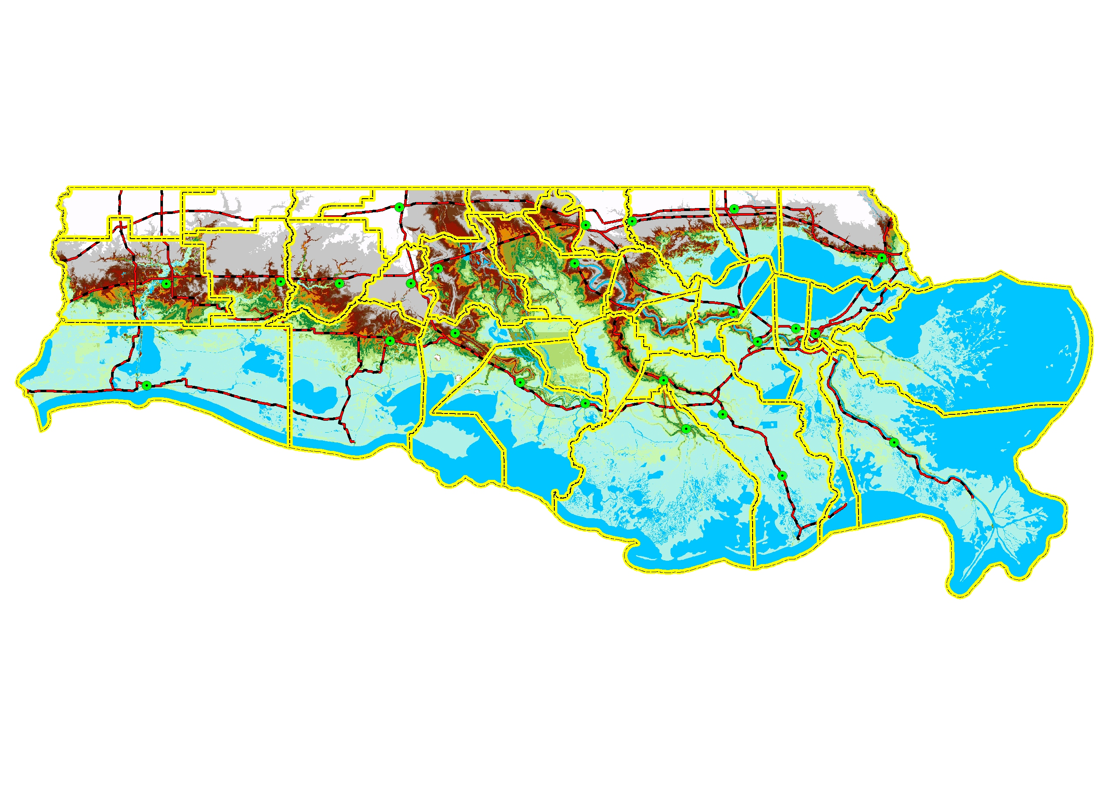
ELEVATION – COASTAL LA. IS LOW
LIDAR SURFACE ELEVATION
Beauregard
Allen
Evangeline
Saint
Landry
E.B.R.
Saint
Tammany
W.B.R.
Livingston
Jeff
Davis
Acadia
St
Martin
Tangipahoa
Calcasieu
Iberville
Ascension
St
John
Iberia
Lafayette
St
James
Cameron
St Bernard
Vermilion
Assumption
St Charles
St Mary
Lafourche
Jefferson
Plaquemines
Terrebonne
Elevation - Feet
< 2
14 - 16
2 - 4
16 - 18
4 - 6
18 - 20
6 - 8
20 - 40
8 - 10
40 - 68
10 - 12
WATER
12 - 14

Slide 12
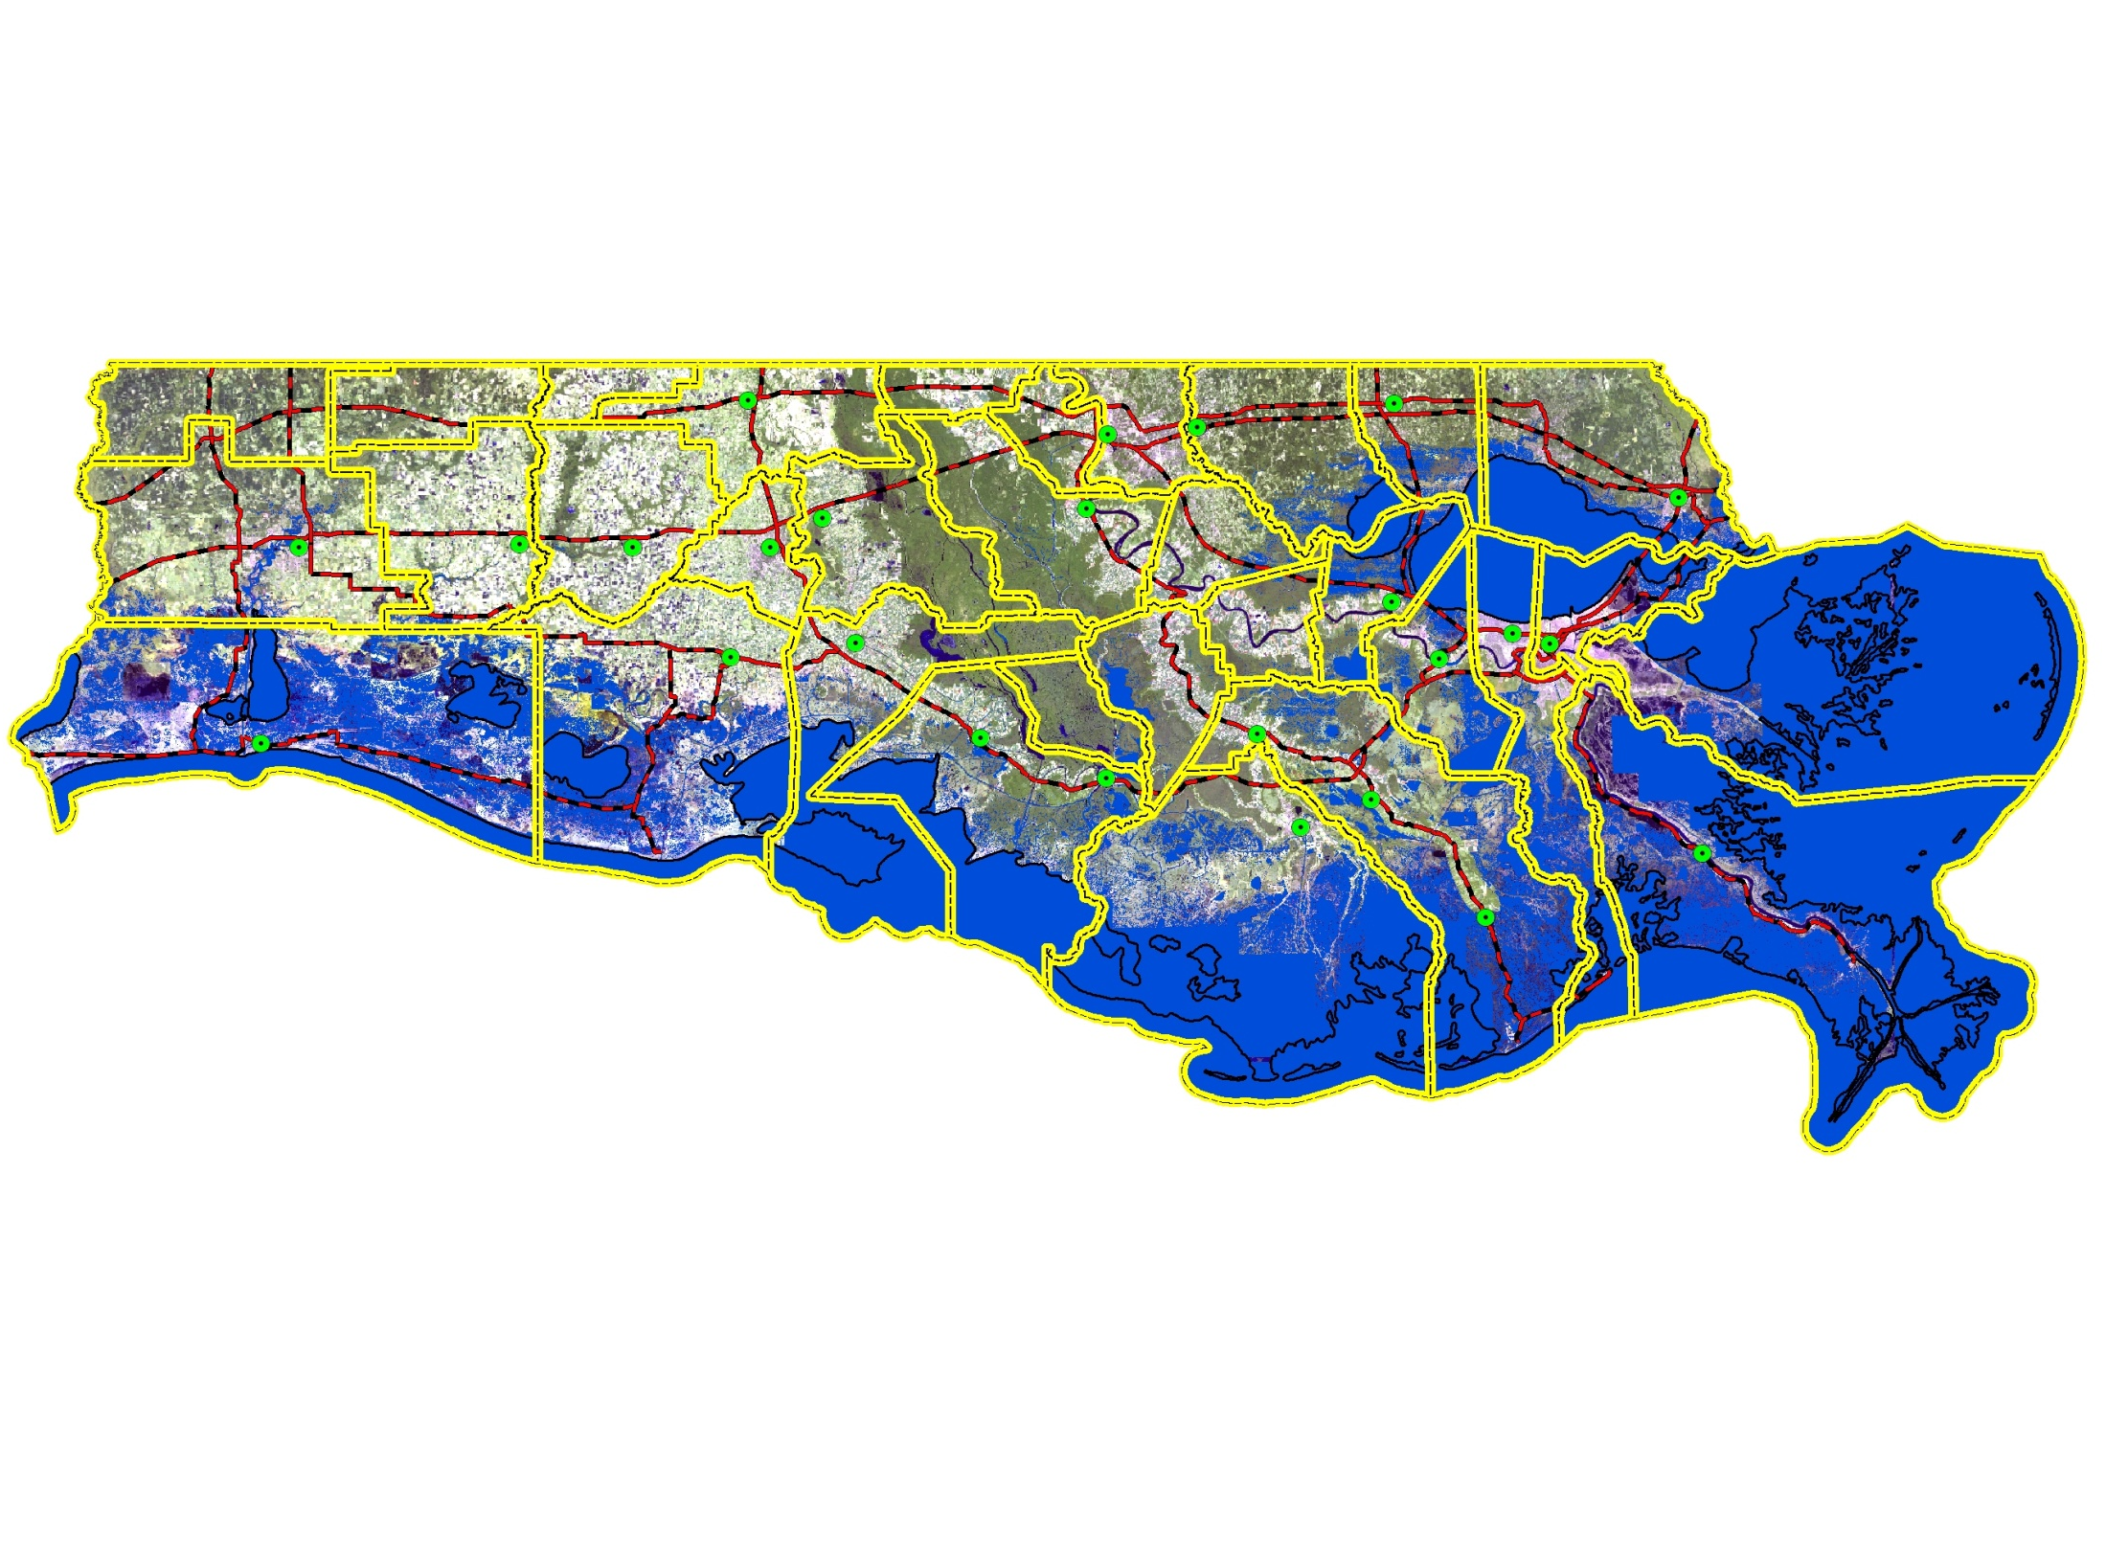
POTENTIAL IMPACTS OF SEA LEVEL RISE
Inundation to 1.0 ft. Elevation
LEGEND
CITIES
PRIMARY ROADS
PARISH BNDRY
WATER

Slide 13
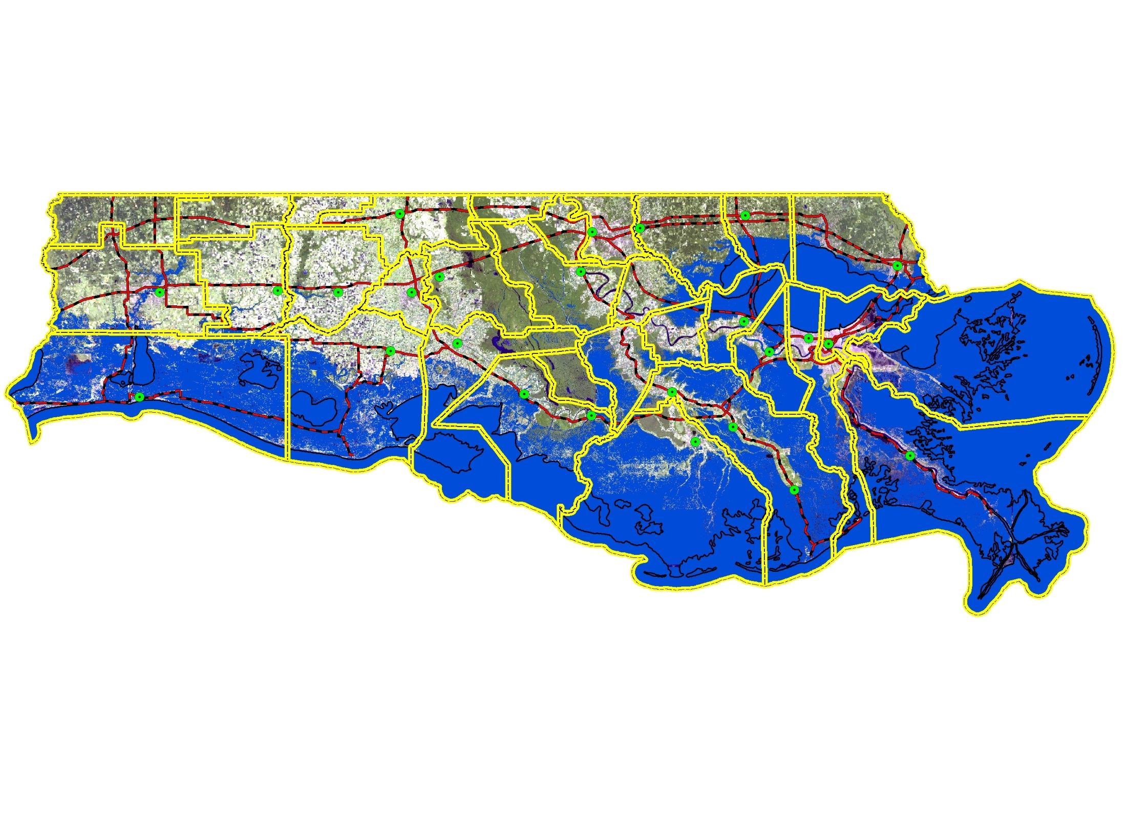
POTENTIAL IMPACTS OF SEA LEVEL RISE
Inundation to 2.0 ft. Elevation
LEGEND
CITIES
PRIMARY ROADS
PARISH BNDRY
WATER

Slide 14
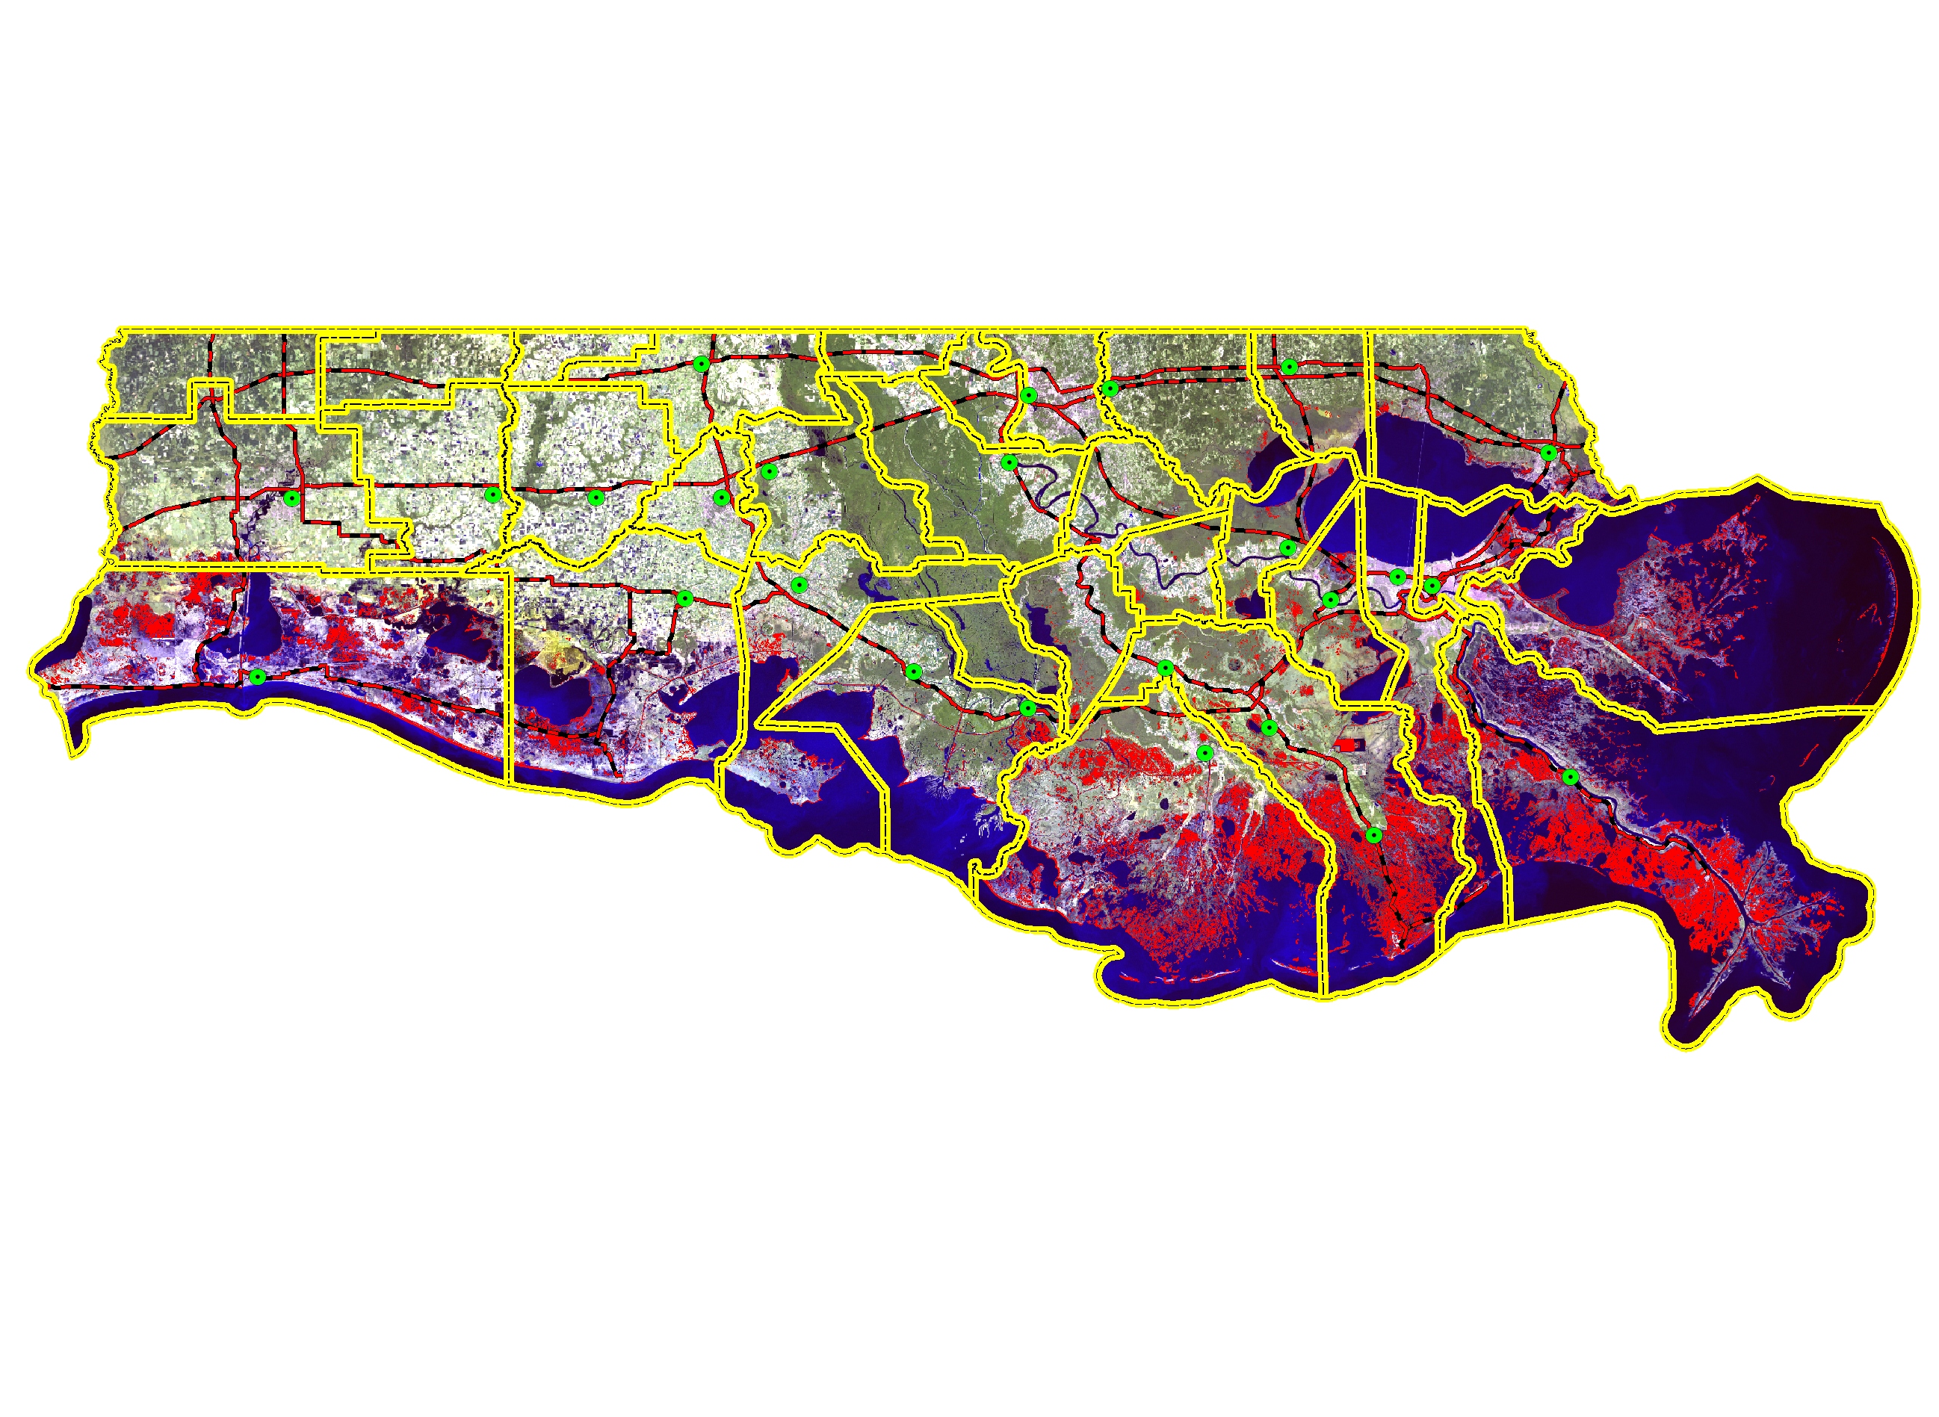
COASTAL LAND LOSS (1932 – 2050)
LEGEND
CITIES
PRIMARY ROADS
PARISH BNDRY
LAND LOSS
Source:
USGS
J. Barras
Notes:
THE AMOUNT OF LAND LOSS OBSERVED AND EXPECTED

Slide 15
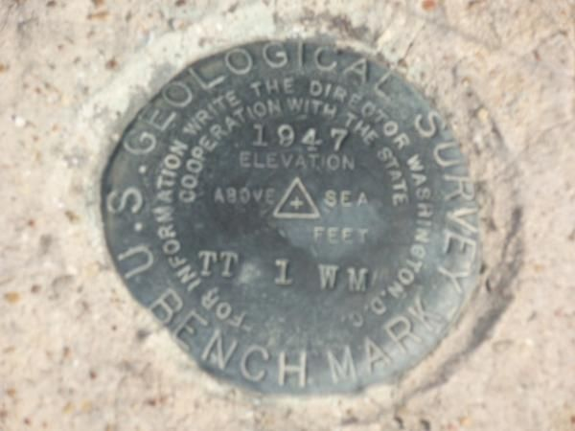
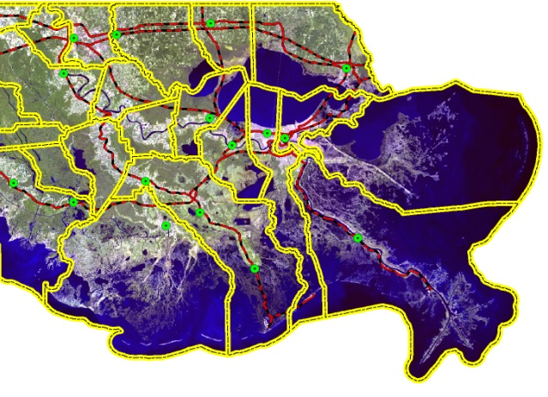
BM set in 1980. Marker ID – 1108 D 1980. 158 ft south of the south shore of Lost Bayou, 118 ft west of the west shore of a small freshwater pond, 46 ft north of the south shore of the island. The bench mark is set 0.21 m (0.7 ft) above ground level, crimped to a stainless steel rod driven19.5 m (64 ft) to substantial resistance, and encased in a 4-inch PVC pipe, and concrete kickblock.
NOAA – Gardene Bay

Slide 16
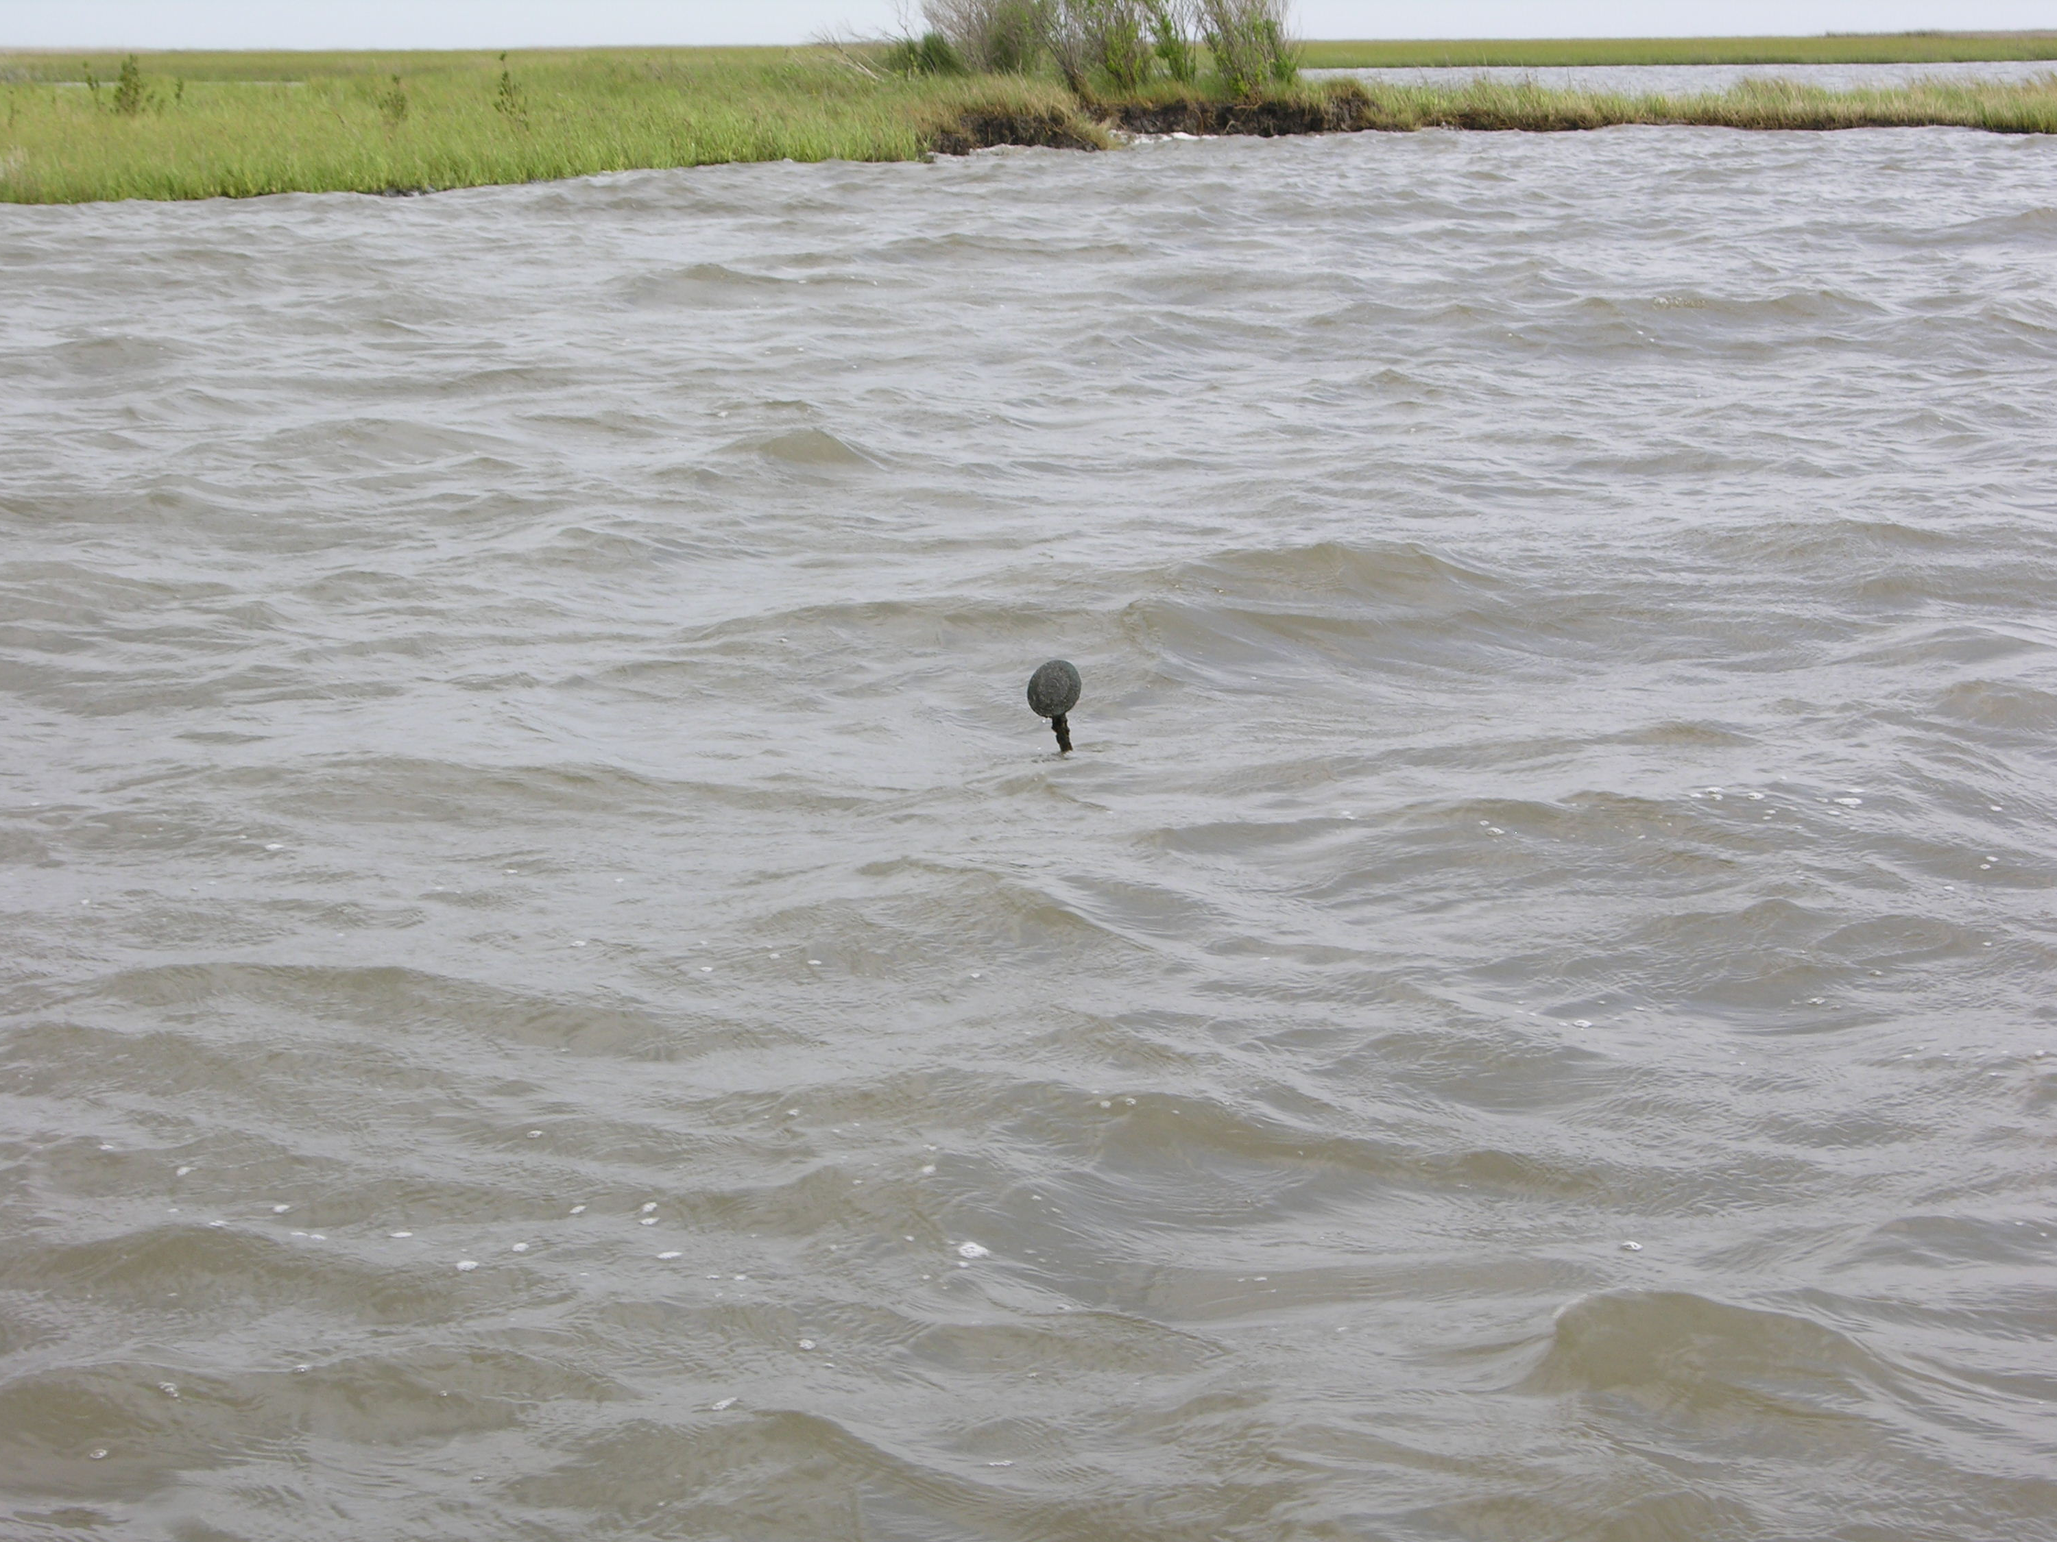
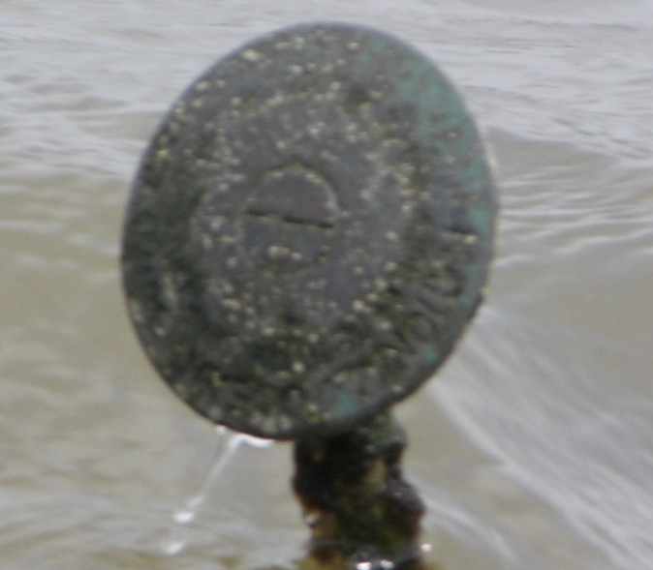

Slide 17
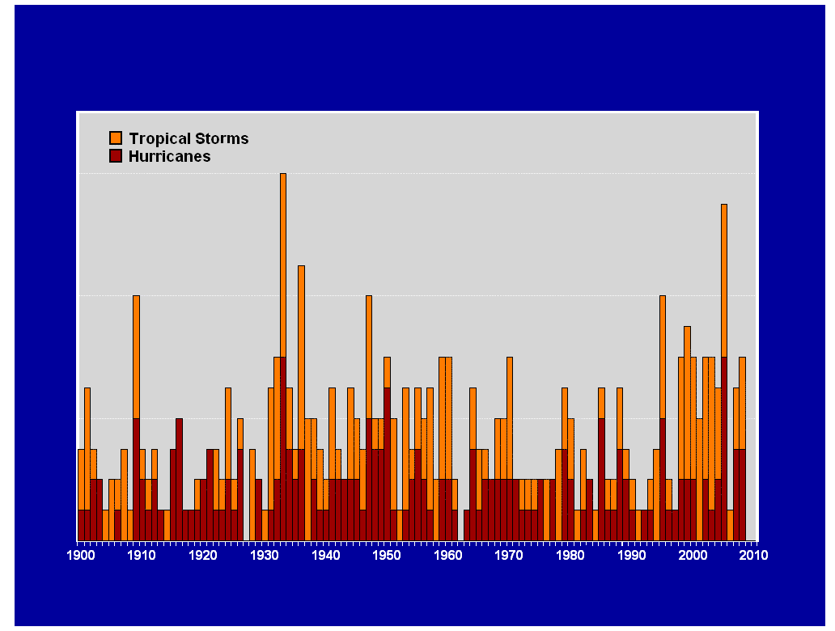
Gulf of Mexico Historical Storm Surge Activity
Hurricanes Producing 10’ + Storm Surge
Central Texas to Appalachicola Florida
Louisiana Landfall
Louisiana Impact
30
Other Gulf Landfall
30
Camille - LA
3
Katrina - Rita
25
5
25
Carla - TX
Ike - TX
20
Terrebonne Parish
St. Bernard Parish
4
20
Eloise - FL
2
TX Coast
Ivan - FL
Surge - Feet
St. Mary – Terrebonne Parish
Frederic - AL
3
4
Audrey - LA
3
Georges - MS
Surge - Feet
15
MS Coast
3
Betsy - LA
Opal - FL
3
15
Kate - FL
4
3
2
3
3
3
3
10
2
3
10
3
5
5
0
0
1900
1910
1920
1930
1940
1950
1960
1970
1980
1990
2000
2010

Slide 18
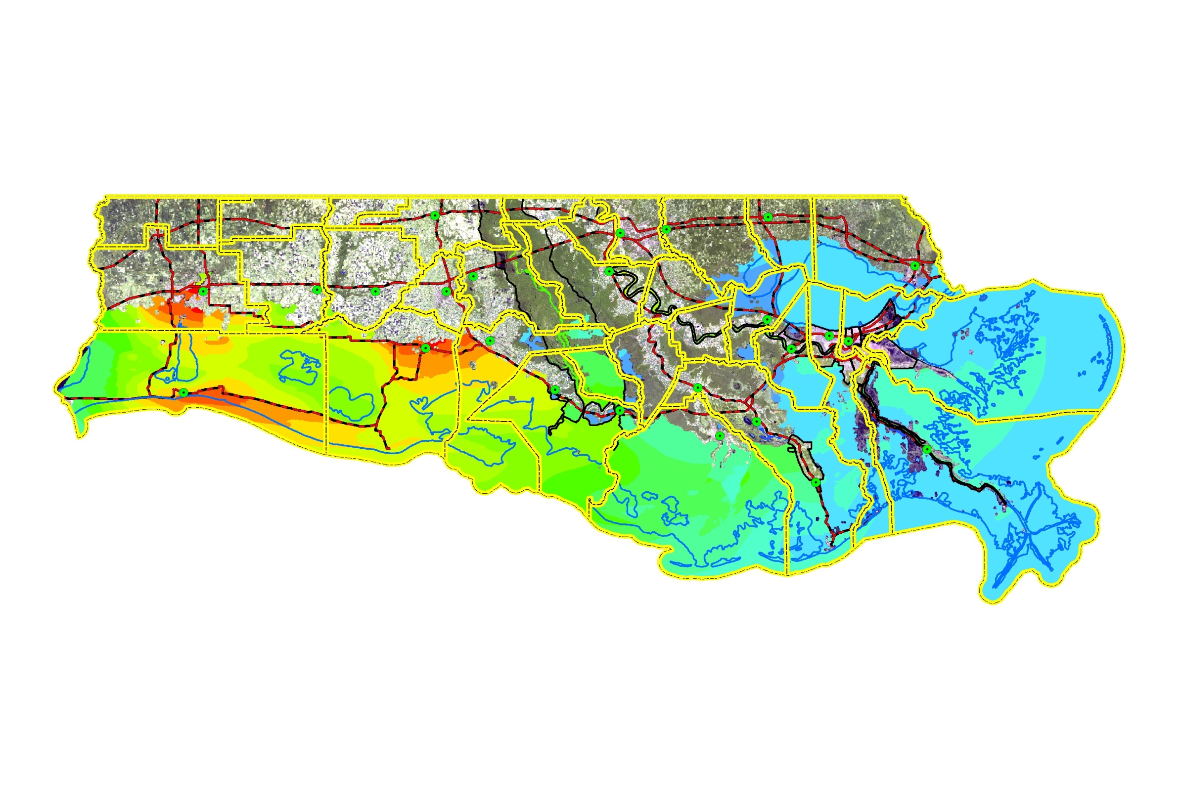
HURRICANE RITA
ADCIRC MODELED STORM SURGE ELEVATIONS
Lake Charles
New Iberia
New Orleans
Abbeville
Thibodaux
Morgan City
Houma
Golden Meadow
Surge Elevation (Ft)
>13
6 - 7
12 - 13
5 - 6
11 - 12
4 - 5
10 - 11
3 - 4
ADCIRC storm surge model data provided by: Dr. Hassan Mashriqui LSU AgCenter / LA Sea Grant
9 - 10
2 - 3
8 - 9
1 - 2
7 - 8
0 - 1
Notes:
HE THEN TALKS ABOUT THE ADCIRC MODEL AND HOW IT CAN PREDICT STORM SURGE FROM A HURRICANE OF KNOWN PARAMETERS

Slide 19
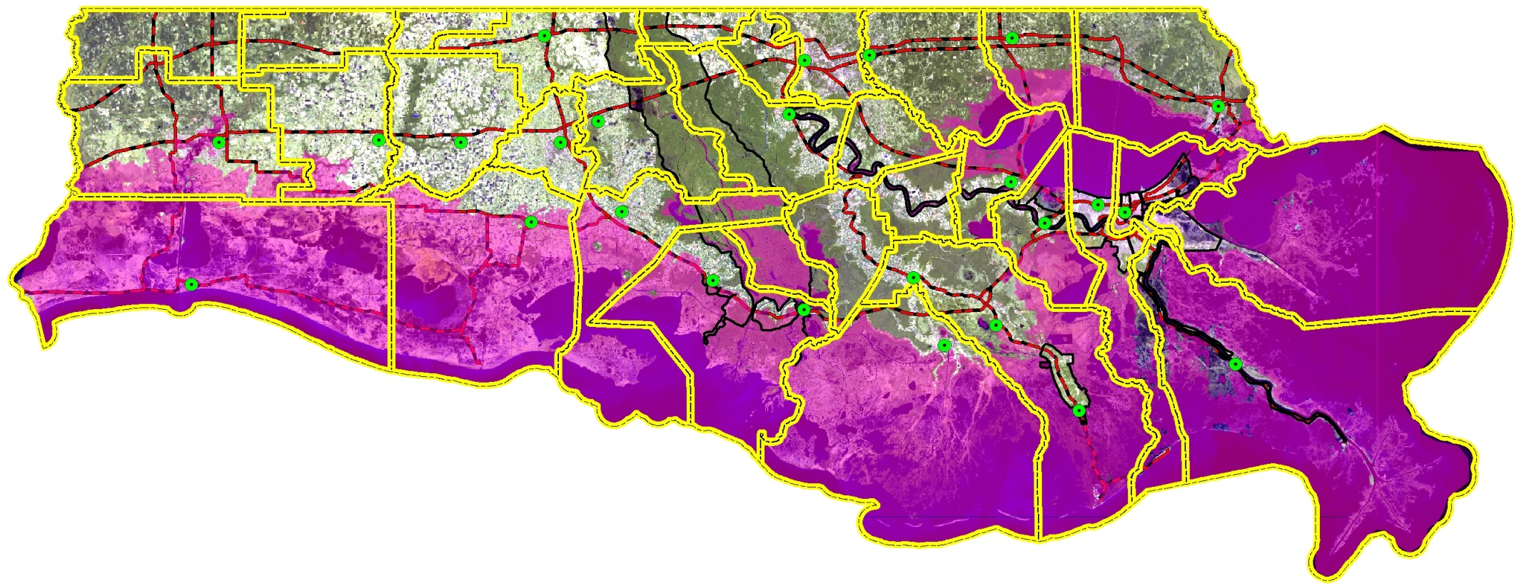
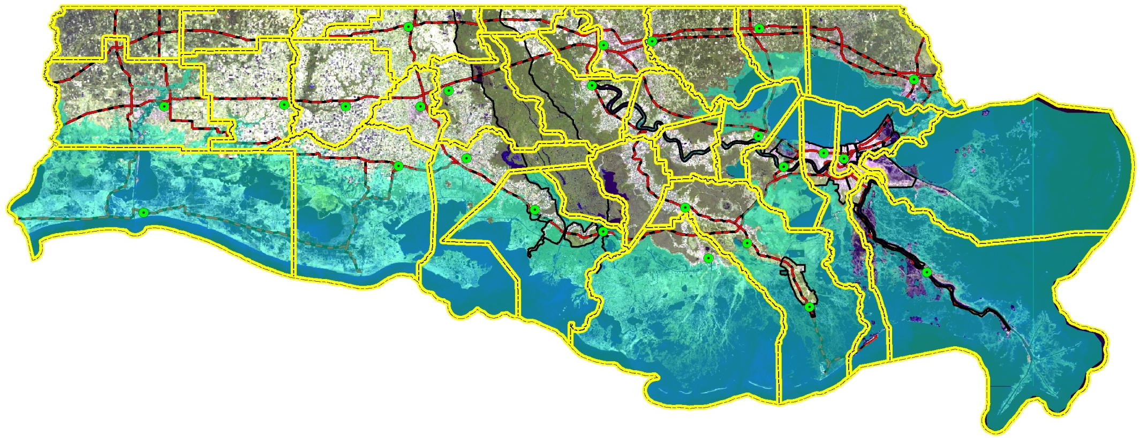
Rita ADCIRC Model Surge Inundation
Rita Actual Surge Inundation
Notes:
19
THIS SHOWS HOW ACCURATELY THE ADCIRC MODEL HINDCAST THE RITA STORM SURGE

Slide 20
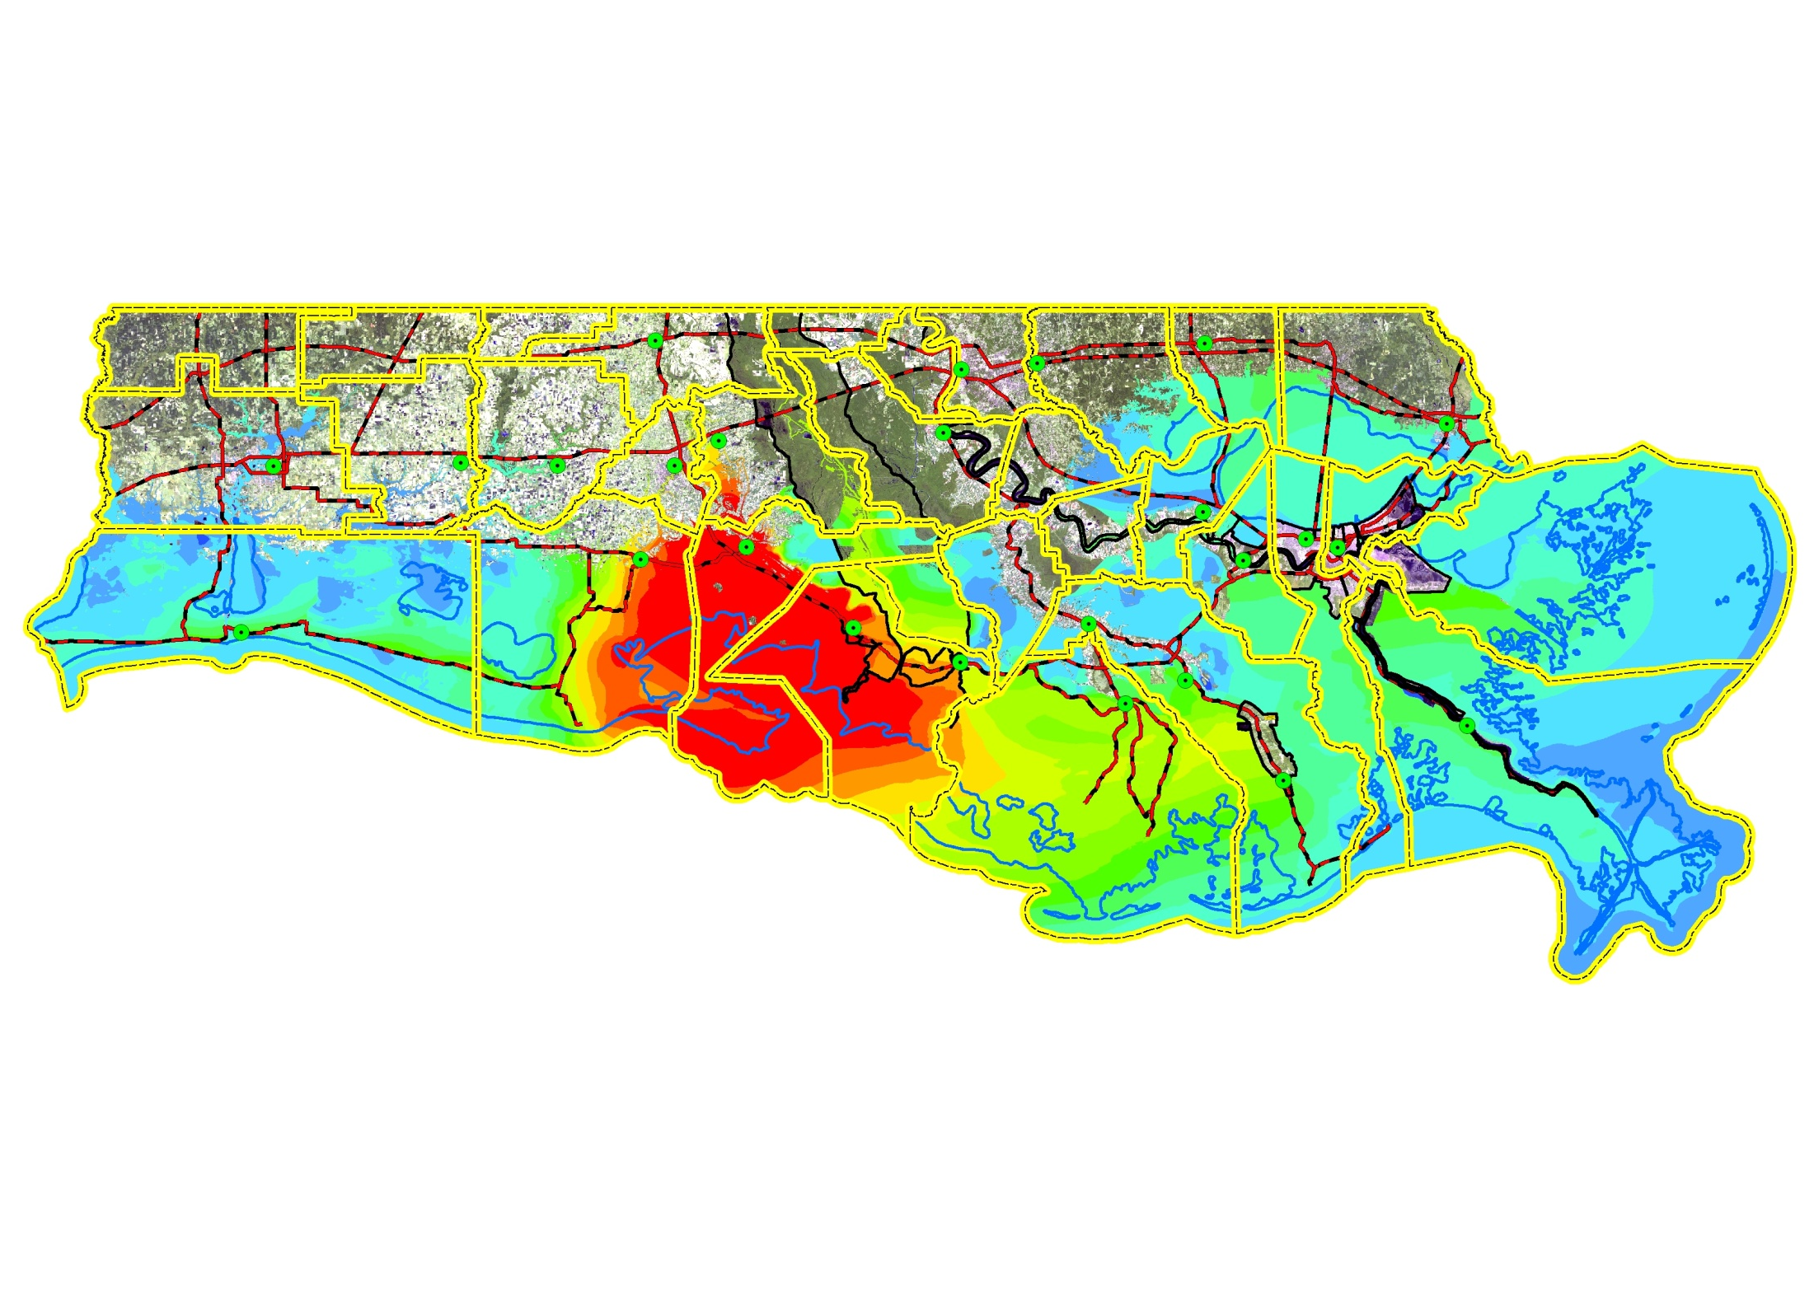
Vermilion – Iberia Region
Hypothetical Storm
Lake Charles
New Iberia
New Orleans
Abbeville
Thibodaux
Morgan City
Houma
Golden Meadow
Surge Elevation (Ft)
Speed: 7 mph (Rita 11 mph)
Intensity: 111 mph (Rita 128)
Size: Same as Rita
>13
6 - 7
12 - 13
5 - 6
11 - 12
4 - 5
10 - 11
3 - 4
9 - 10
2 - 3
8 - 9
1 - 2
7 - 8
0 - 1
Notes:
THEN HE SHOWS VARIOUS HYPOTHETICAL LANDFALLS

Slide 21
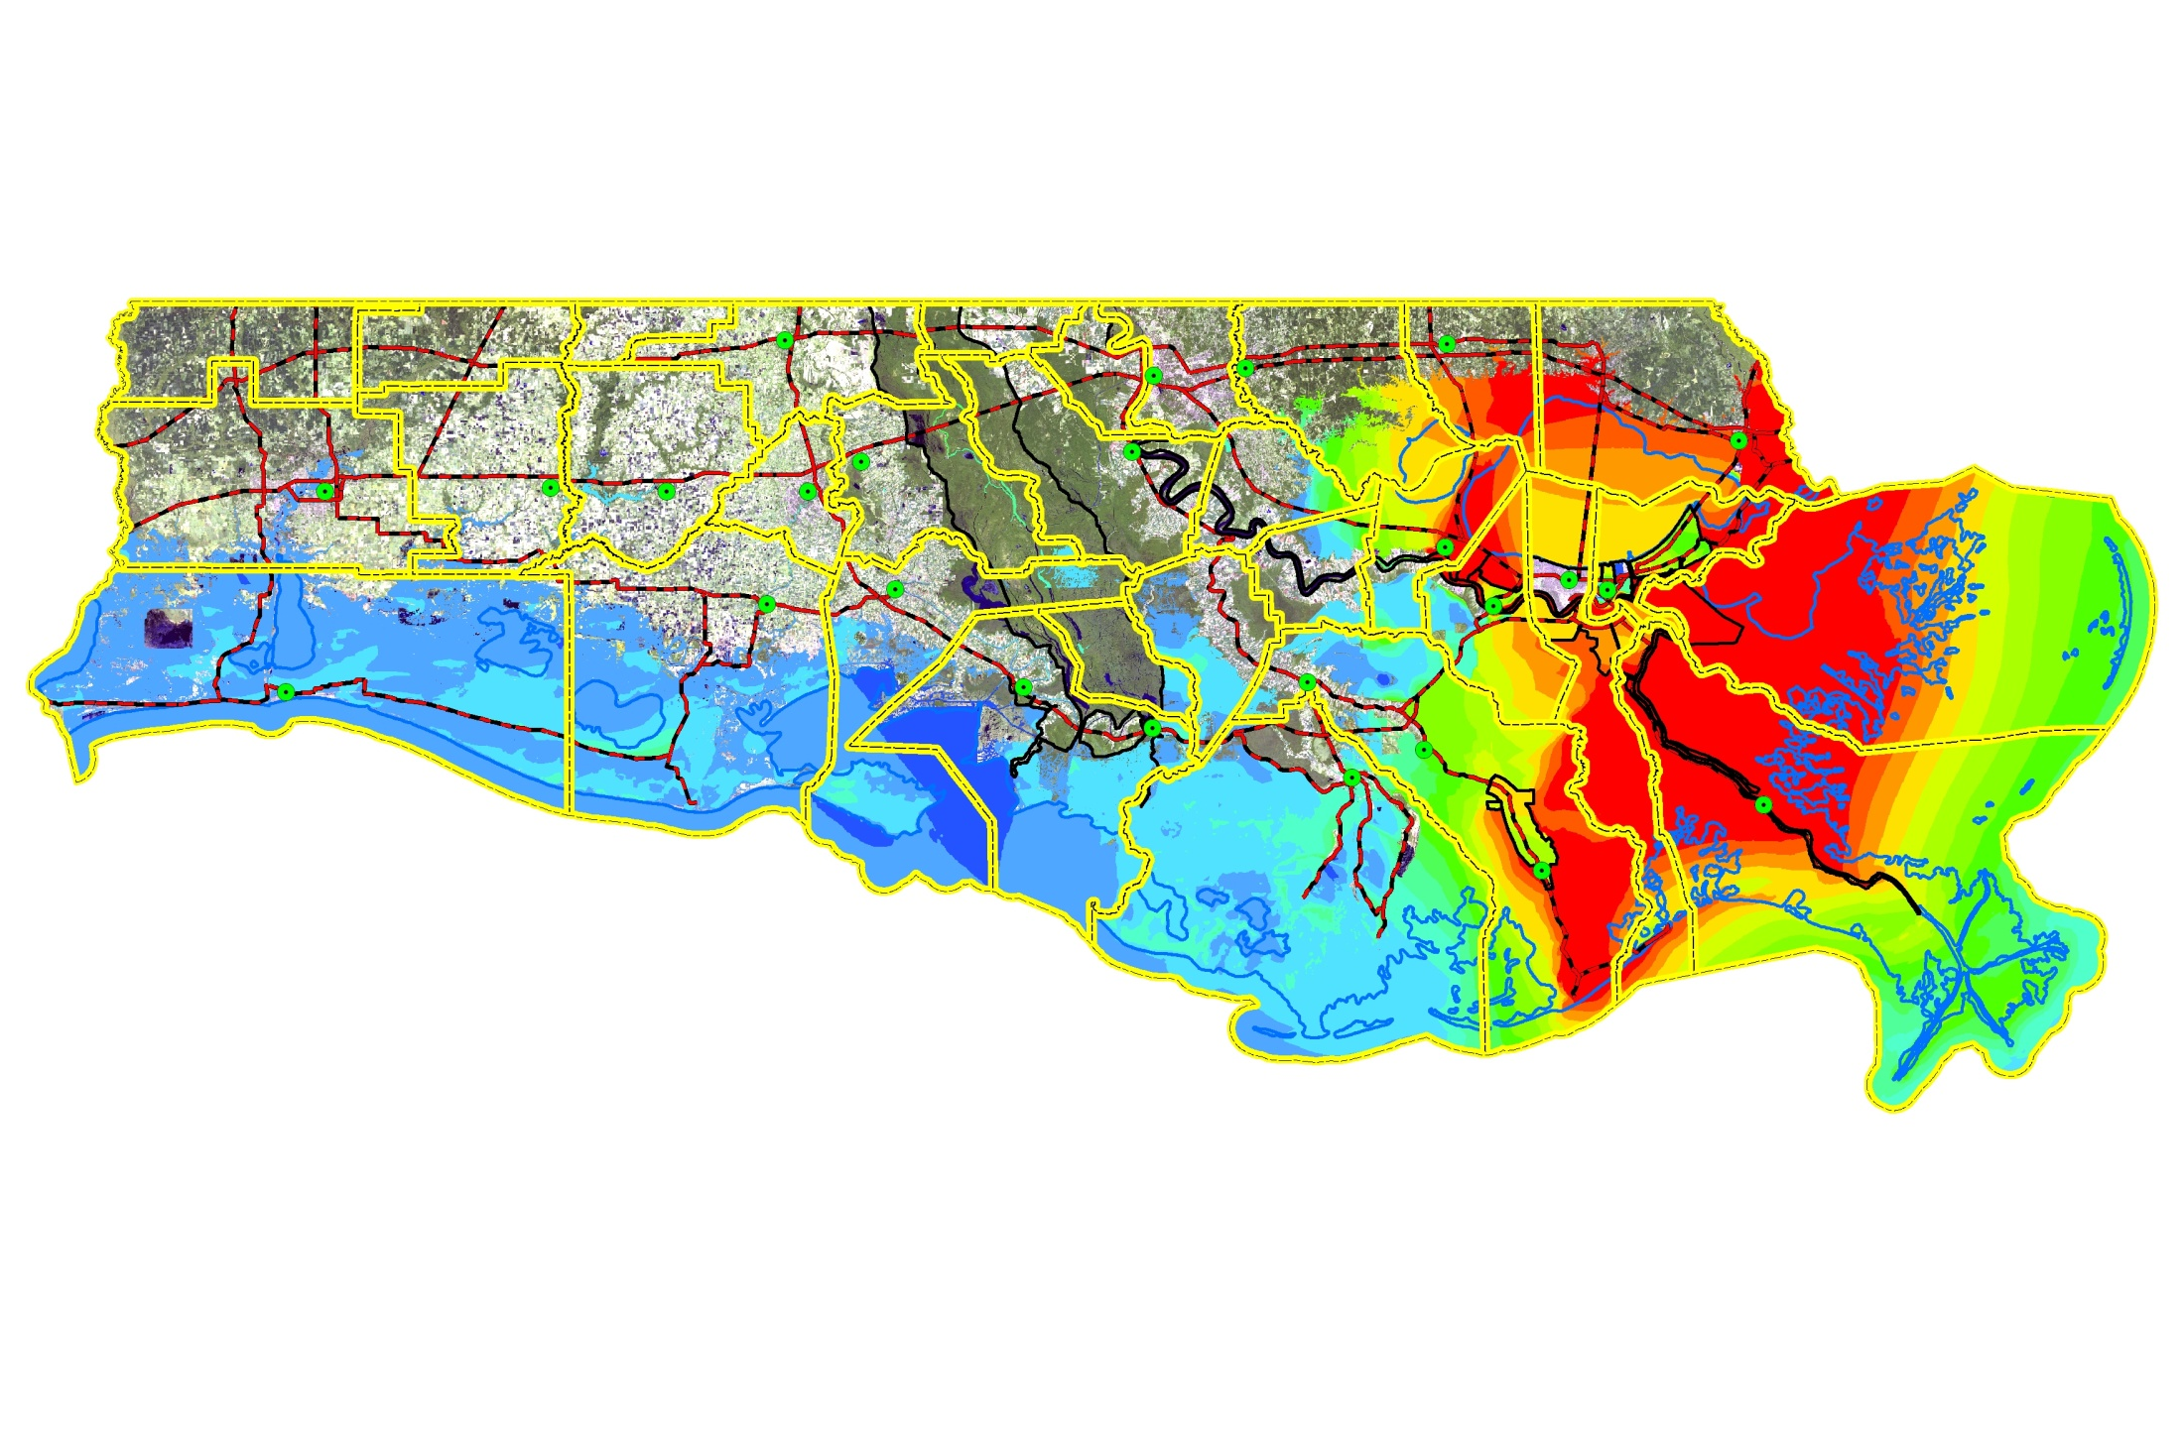
Lake Pontchartrain Area
Hypothetical Storm
Speed: 7 mph (Rita 11 mph)
Intensity: 126 mph (Rita 128)
Size: Slightly Smaller than Rita
Surge Elevation (Ft)
>13
6 - 7
12 - 13
5 - 6
11 - 12
4 - 5
10 - 11
3 - 4
9 - 10
2 - 3
8 - 9
1 - 2
7 - 8
0 - 1

Slide 22
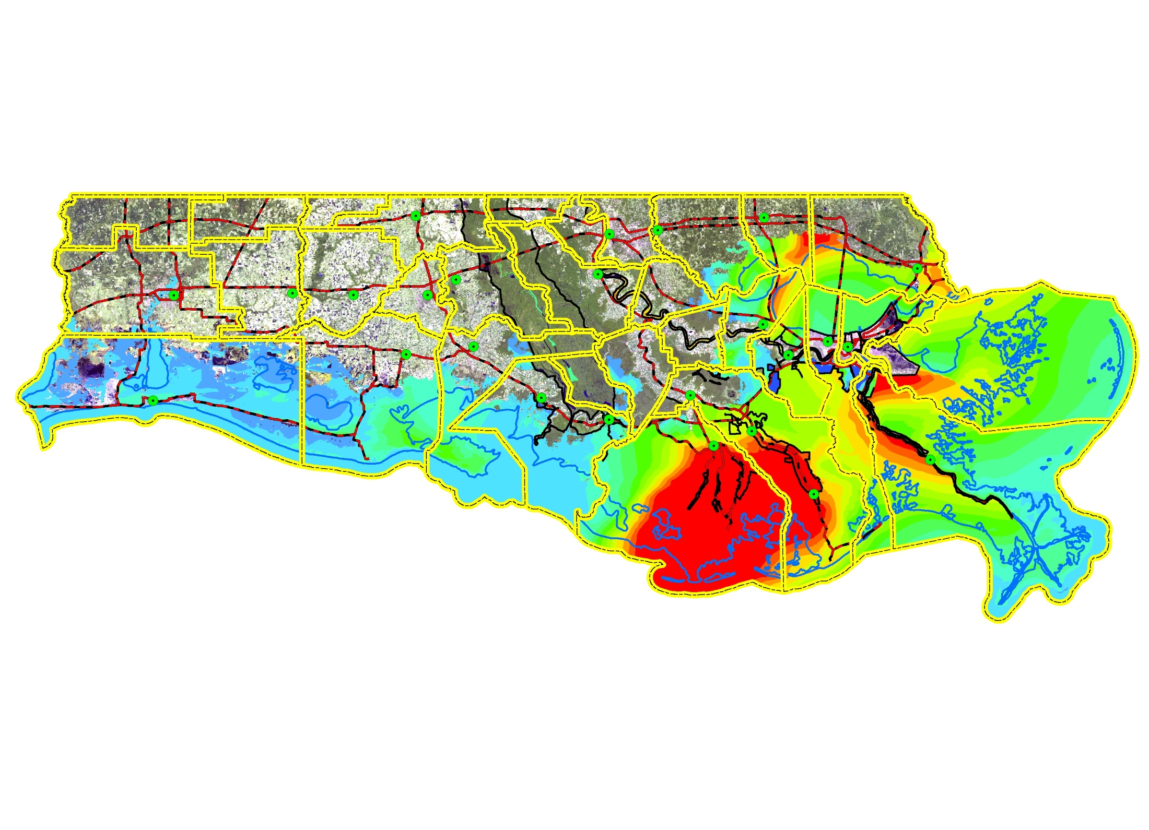
Terrebonne – Lafourche Region
Hypothetical Storm
Lake Charles
New Iberia
New Orleans
Abbeville
Thibodaux
Morgan City
Houma
Golden Meadow
Surge Elevation (Ft)
Speed: 13 mph (Rita 11 mph)
Intensity: 128mph (Rita 128)
Size: Same as Rita
>13
6 - 7
12 - 13
5 - 6
11 - 12
4 - 5
10 - 11
3 - 4
9 - 10
2 - 3
8 - 9
1 - 2
7 - 8
0 - 1
Notes:
THEN HE SHOWS MODELING RUNS OF HYPOTHETICAL STORMS, THIS ONE AS IF RITA HAD COME TO TERREBONNE PARISH

Slide 23
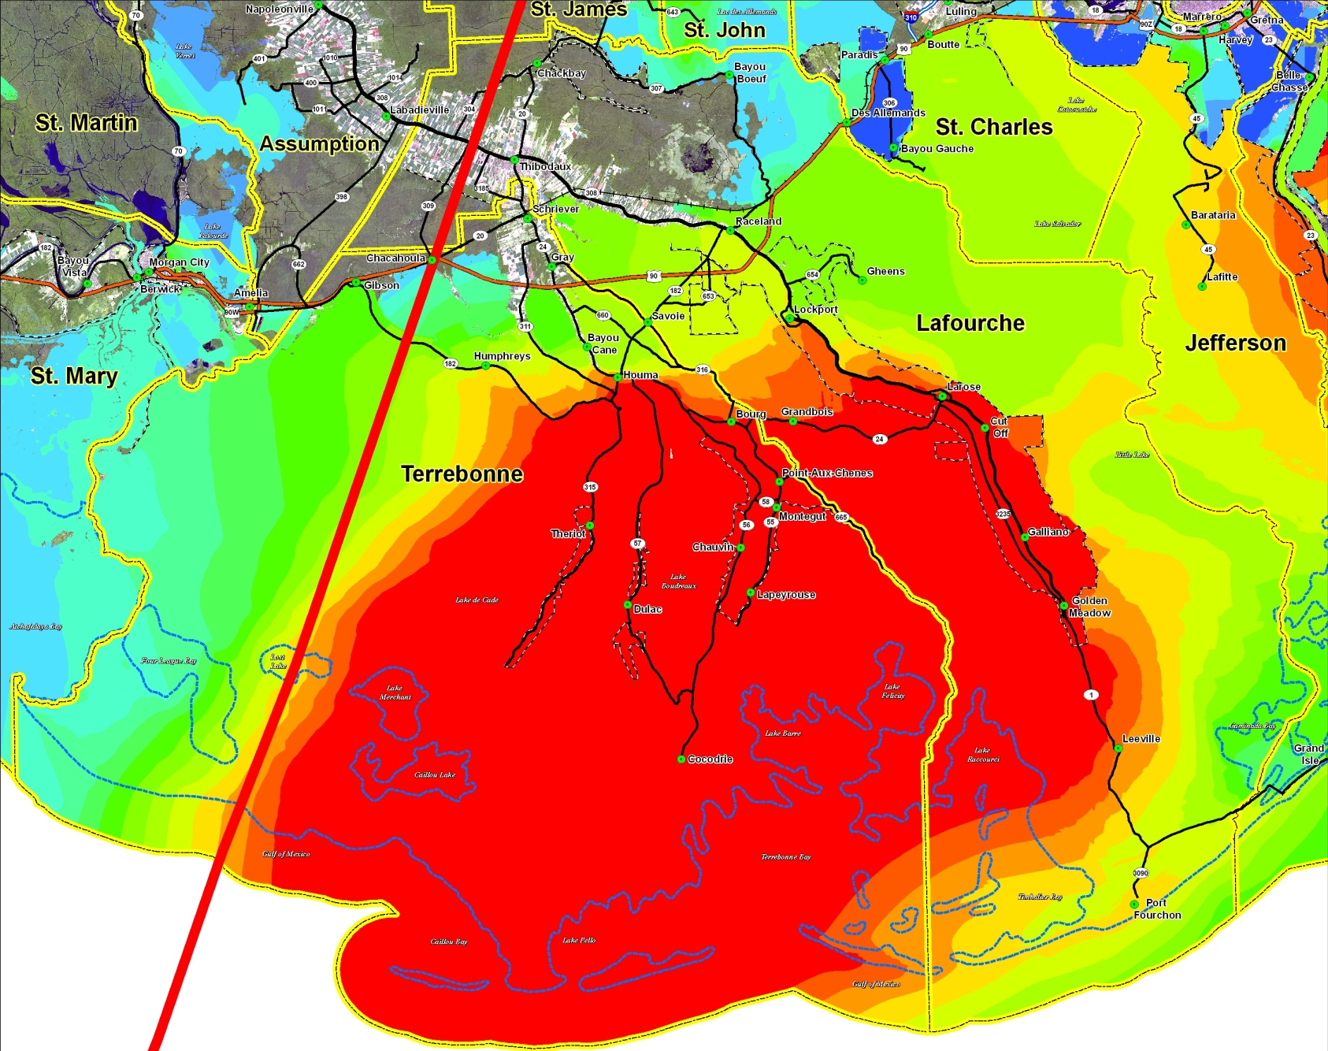
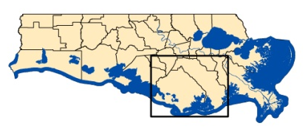
Terrebonne – Lafourche Region Storm # 3
ADCIRC Predicted Storm Surge Elevations
WS = 128 mph
FS = 13 mph
Surge Elevation
Feet
>13
12 - 13
11 - 12
10 - 11
9 - 10
8 - 9
7 - 8
6 - 7
5 - 6
4 - 5
3 - 4
2 - 3
1 - 2
0 - 1

Slide 24
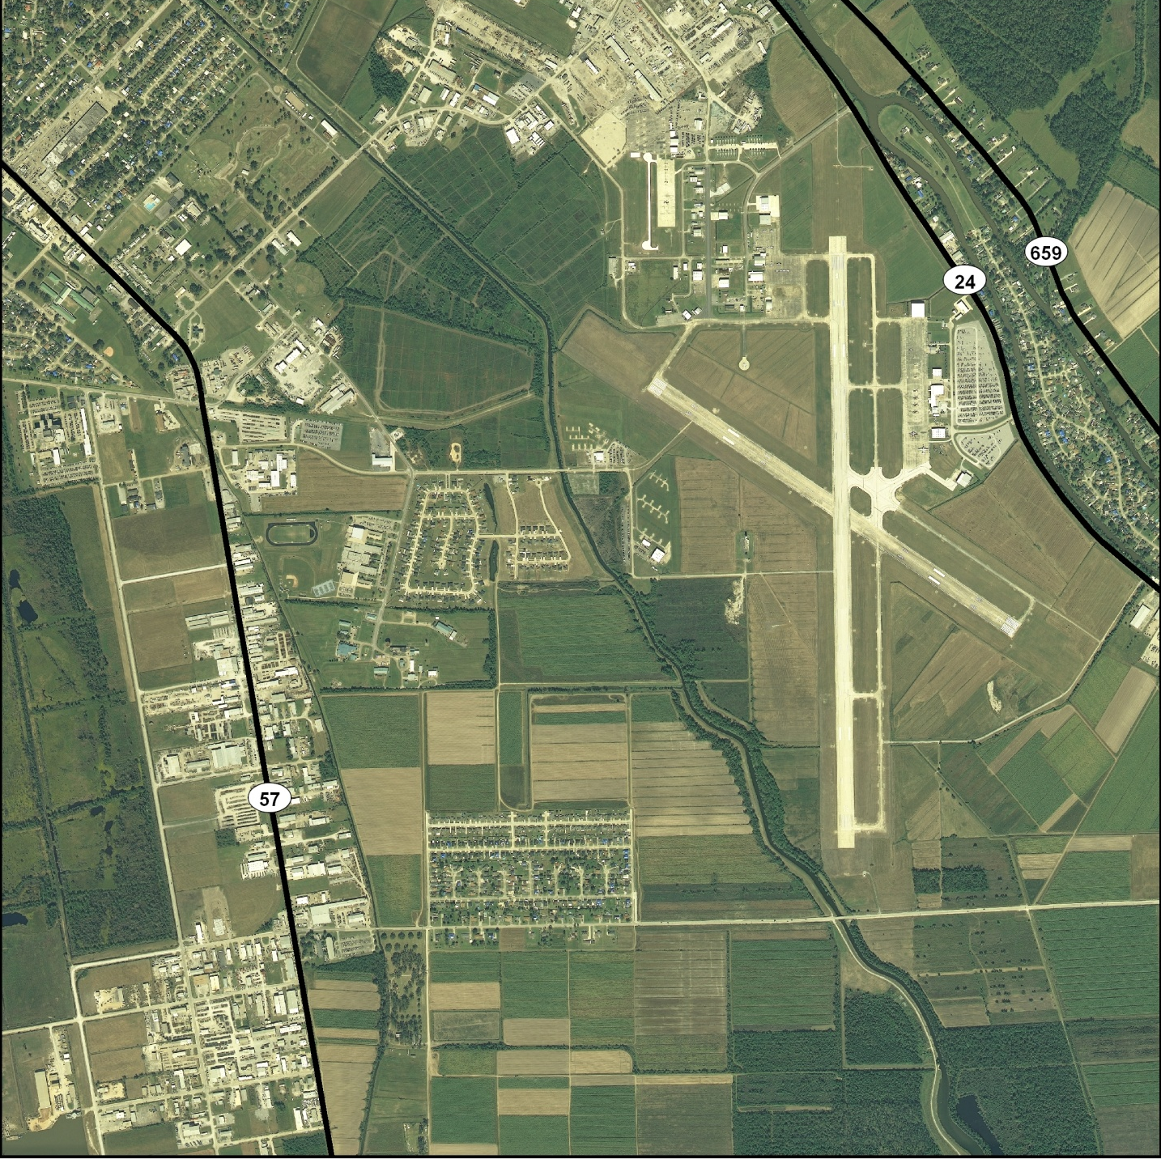
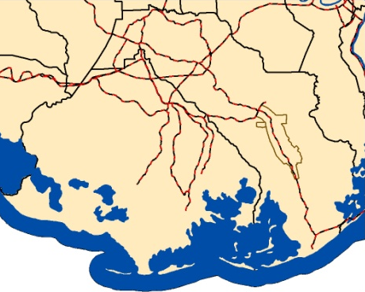
Terrebonne Parish – Houma Airport Area
LEGEND
Ellender HS
PLACES
INTERSTATE
U. S. HWY
STATE HWY
RAILROAD
LEVEE
Chabert Hospital
Houma Airport
PARISH BNDRY

Slide 25
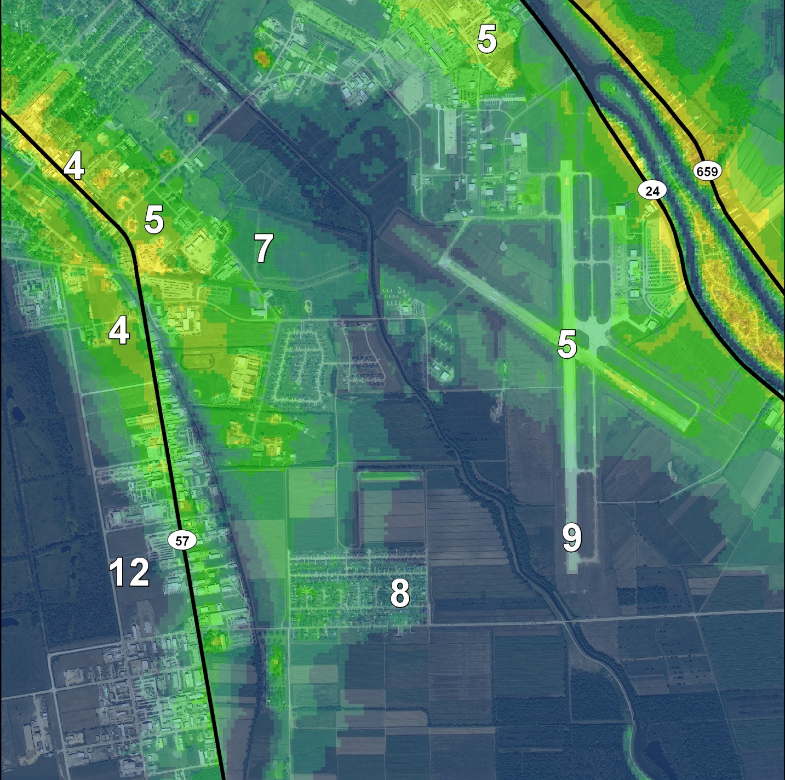
Houma Airport Area – Storm # 3
ADCIRC Predicted Flood Extent and Depth
Water Depth
Feet
< 1
1 - 2
2 - 3
3 - 4
Ellender HS
4- 5
5 - 6
6 - 7
7 - 8
8 - 9
9 - 10
Chabert Hospital
Houma Airport
> 10
WS = 128 mph
FS = 13mph

Slide 26
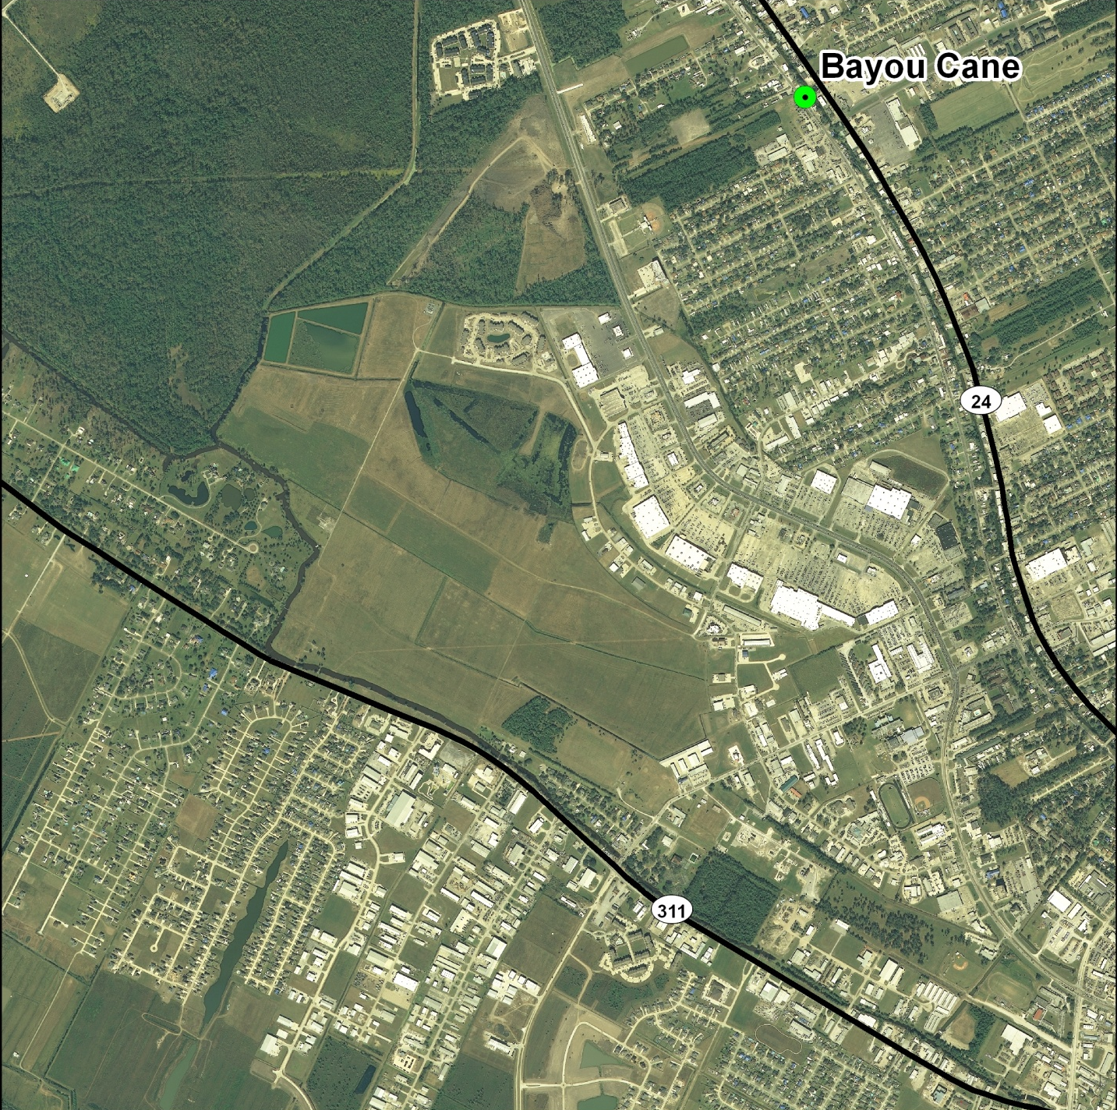
Terrebonne Parish – Bayou Cane Area
LEGEND
PLACES
INTERSTATE
U. S. HWY
STATE HWY
RAILROAD
LEVEE
PARISH BNDRY
Wal-Mart

Slide 27
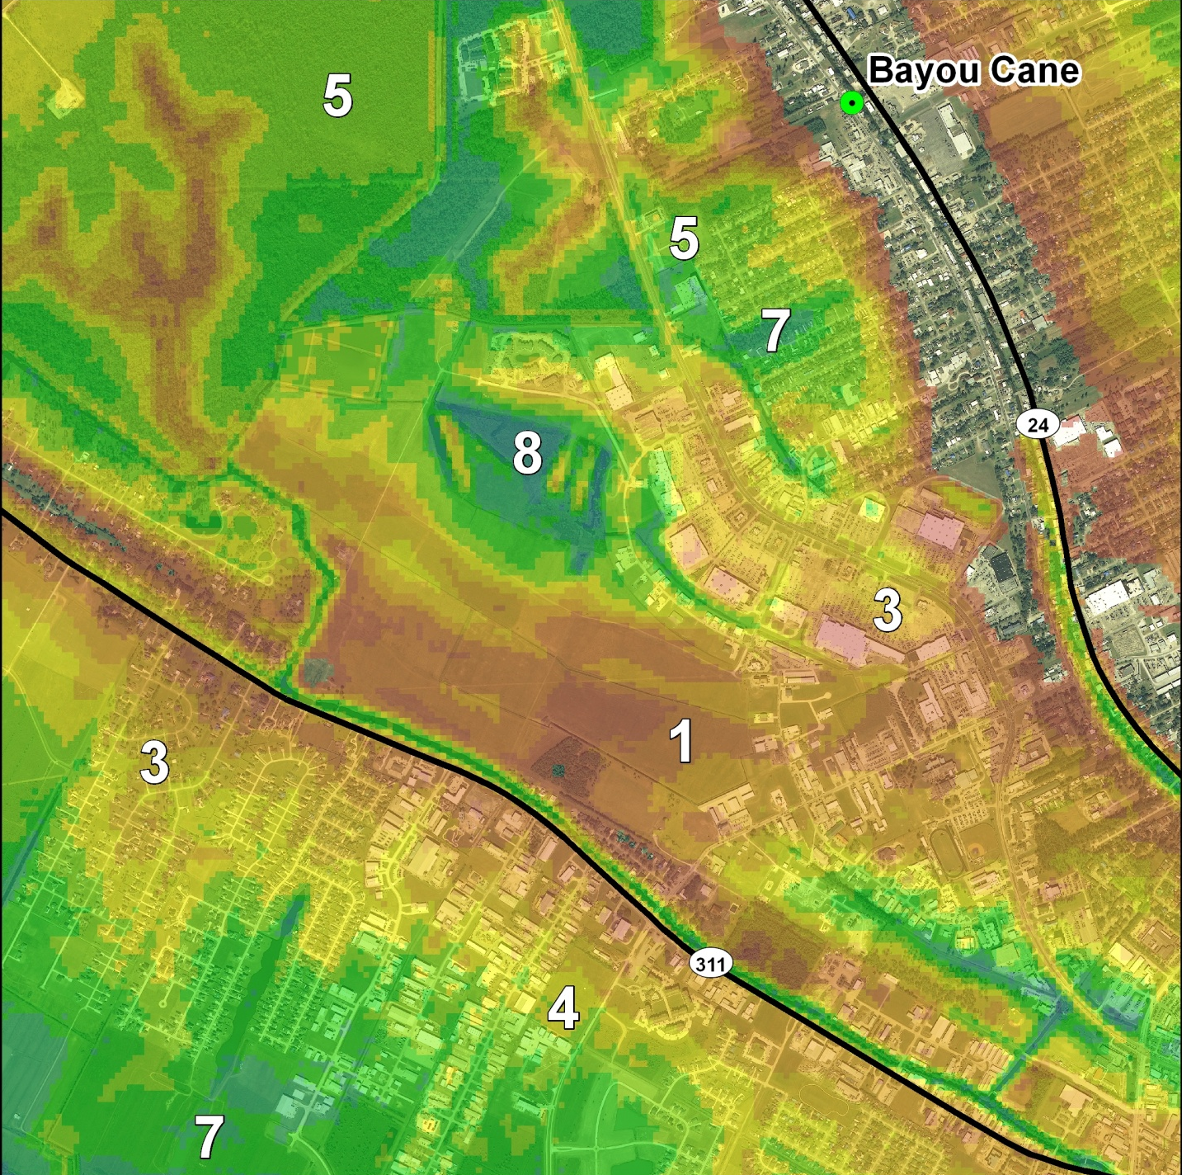
Bayou Cane Area – Storm # 3
ADCIRC Predicted Flood Extent and Depth
Water Depth
Feet
< 1
1 - 2
2 - 3
3 - 4
4- 5
5 - 6
6 - 7
7 - 8
8 - 9
9 - 10
> 10
Wal-Mart
WS = 128 mph
FS = 13mph
Notes:
THAT WALMART WOULD TAKE BETWEEN 2 AND 3 FEET OF WATER IF A RITA TYPE STORM MADE LANDFALL ON THIS TRACK

Slide 28
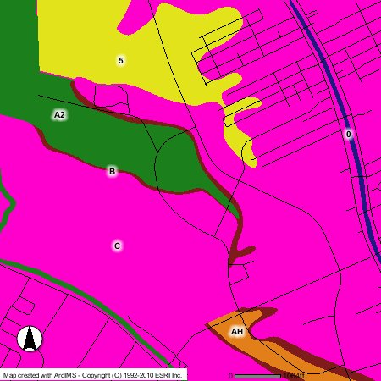

Slide 29
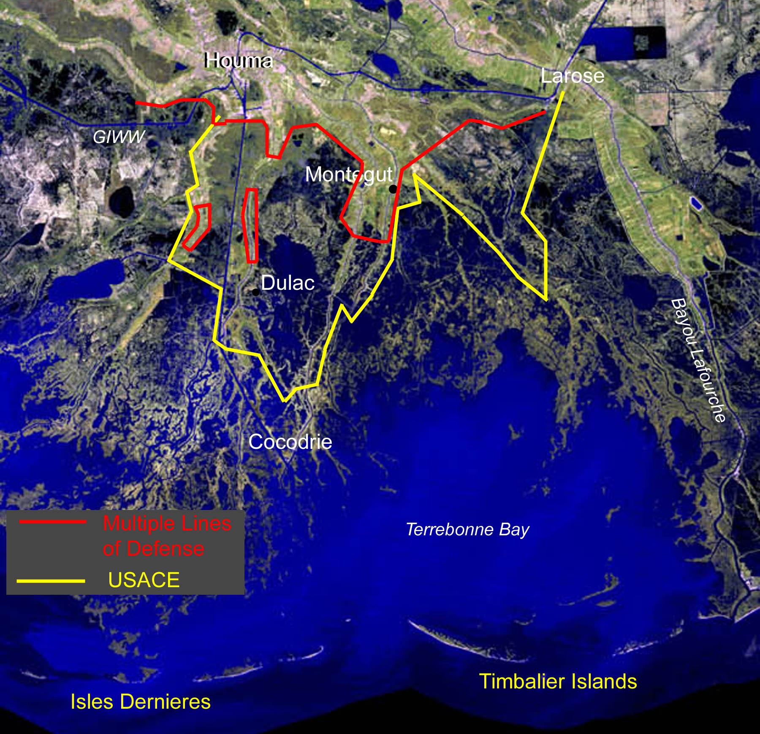
Notes:
A LOT OF PEOPLE IN THIS AREA THINK LEVEES ARE GOING TO SOLVE THEIR PROBLEM
THE YELLOW LINE IS A PROPOSED CORPS LEVEE THAT HAS A HOST OF PROBLEMS BOTH TECHNICAL AND FUNDING.
ONE OF THE TECHNICAL PROBLEMS IS THAT MUCH OF IT WILL BE BUILT IN OR VERY CLOSE TO OPEN WATER, EXPOSED TO THE FORCES OF THE GULF OF MEXICO.

Slide 30
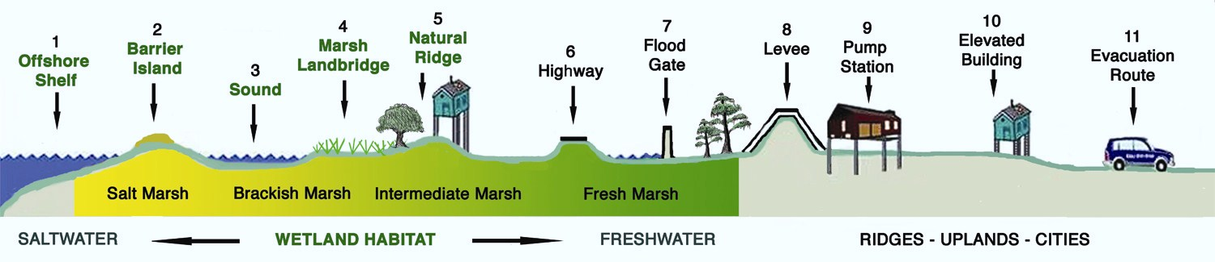


Slide 31
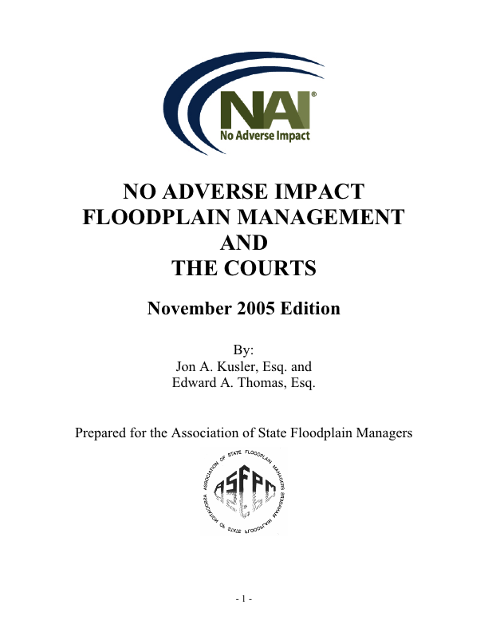

Slide 32
Government Responsibilities and Liabilities
Types of Government Action
  Public works projects
  Licenses and permits
Results of Government Action
  Causing or exacerbating flooding (Allowing construction in known flood hazard areas that causes flooding of neighboring property)
  Flooding from allowing risky development (flooding on the permitted property only)

Slide 33
Duty/Knowledge=Sliding Scale?
Duty
  Statutory Assumption of General Duty of Flood Control or Public Safety
  NFIP flood ordinance-probably underestimates risks
Knowledge
  Who is in the best position to know?
  Minimum responsibility-Informed consent?

Slide 34
Government Defenses
Sovereign Immunity
  Waiver-total or partial
Discretionary Function Immunity
  May be difficult to overcome in some jurisdictions
  Known hazardous conditions
  Foreseeable Zones of Risk
  Does deference decrease as knowledge increases?
Notes:
Florida Cases “known dangerous conditions”,” foreseeable zone of risk”,” substantial zone of risk”

Slide 35
Project Website
http://masglp.olemiss.edu/GOM/GOMProject.html

