Slide 1
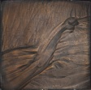
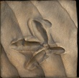
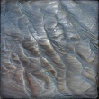
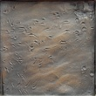
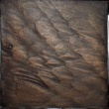
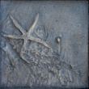
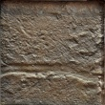
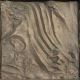
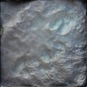
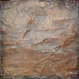
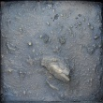
Harte Research Institute
for Gulf of Mexico Studies
A Multiparty Approach to Inventory and Valuation
of Ecosystem Services in the Coastal Zone of the
Gulf of Mexico
David W. Yoskowitz
Carlota Santos
Harte Research Institute for Gulf of Mexico Studies
Texas A&M University – Corpus Christi
CNREP 2010
New Orleans, LA
May 28, 2010

Slide 2
With Ecosystem Services, what are we
working towards?
“Decisions are incomplete and inefficient if
they do not include all benefits and costs...”
(Yoskowitz, 2009)
The question is: How do we begin to operationalize
the inclusion of ecosystem services into
decision making for the GoMx?

Slide 3
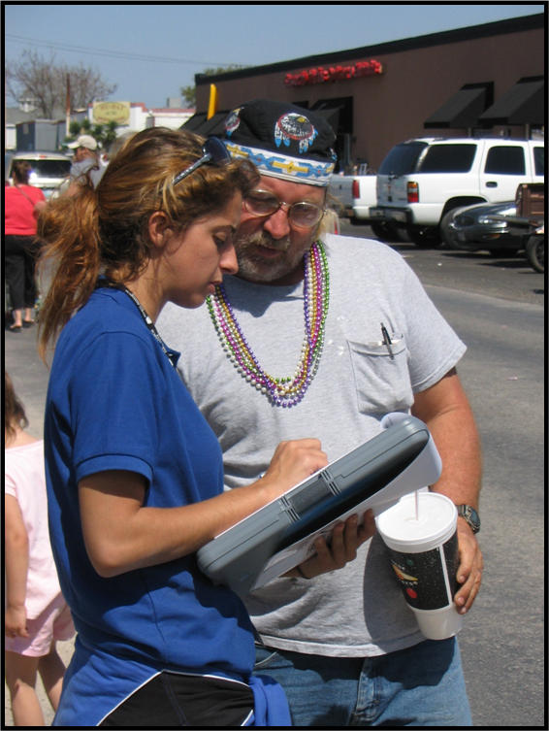
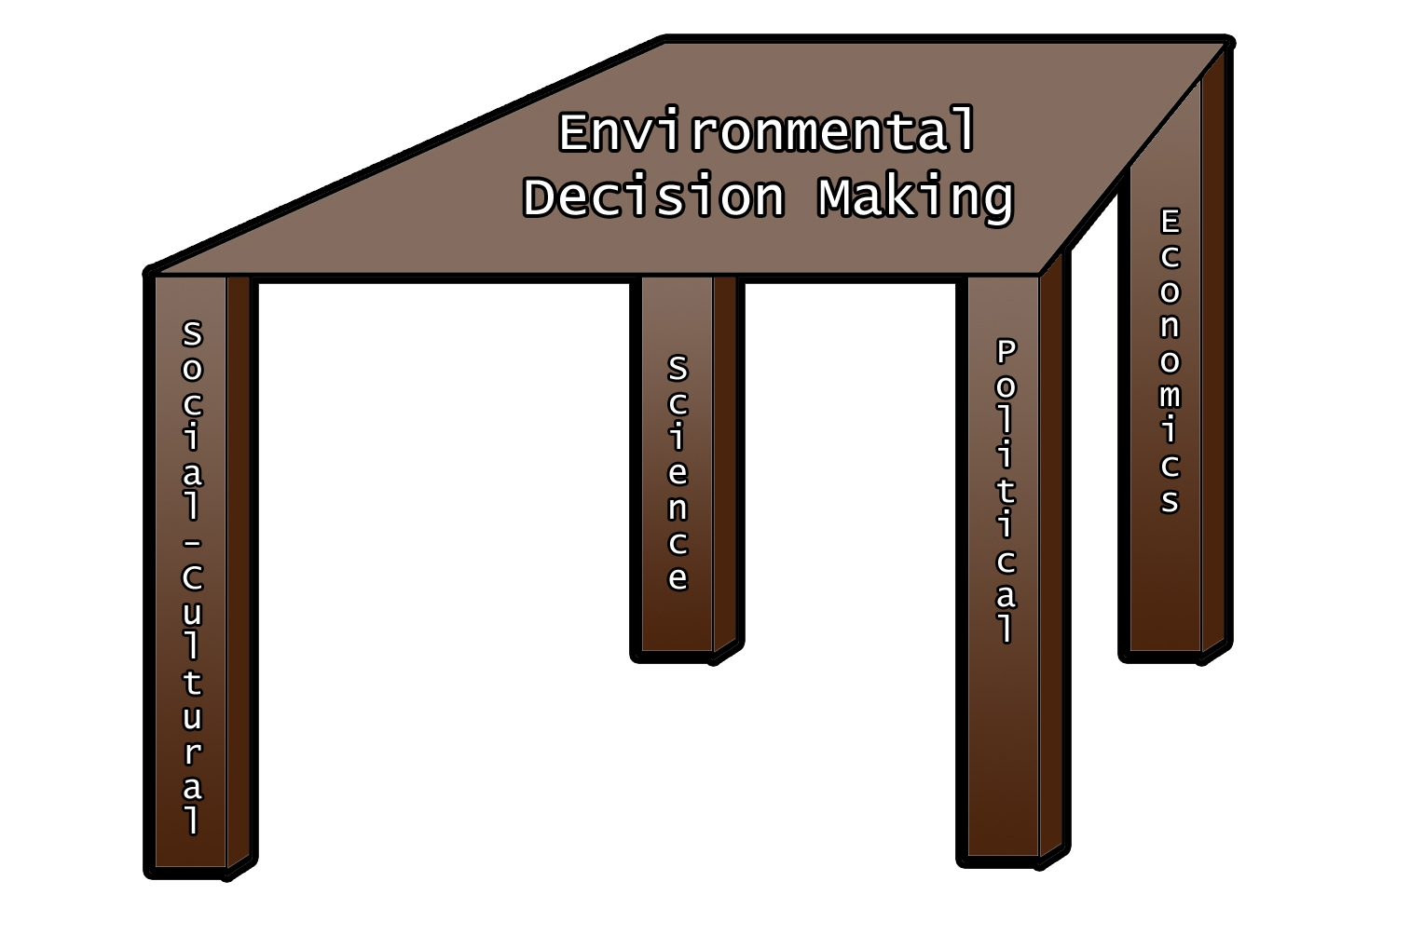
Practice
Planning and Policy
In the GoMx, what framework exists to move ecosystem services
from practice to policy?

Slide 4
The Gulf of Mexico Alliance is a partnership of the five Gulf states with the goal of significantly increasing regional collaboration to enhance the ecological and economic health of the Gulf of Mexico.
Six priority issues that are regionally significant and can be effectively addressed through increased collaboration at local, state, and federal levels:
1. Water Quality;
2. Habitat Conservation and Restoration;
3. Ecosystem Integration and Assessment;
4. Nutrients & Nutrient Impacts;
5. Coastal Community Resilience; and
6. Environmental Education
The Alliance has been widely cited by the Joint Ocean Commission and others, as an early and effective example of a regional governance approach.
Priority Issue Teams (PITs)

Slide 5
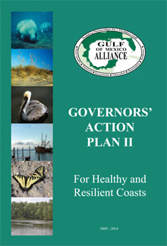
Action Plan II address four major challenges:
Sustaining Gulf Economy
Improving Ecosystem Health
Mitigating the impacts of and Adapting to Climate Change
Mitigating Harmful Effects to Coastal Water Quality
There are eleven action steps relating to
socio-economic, ecosystem services
and benefit-cost assessment in Plan II

Slide 6
The Alliance is essentially using a process I call IIVA with
regards to ecosystem services.
Identify the various habitats in the coastal zone.
(marine and terrestrial)
Inventory. Attach ES services to the habitat types via
an expert panel.
3. Value. Attach a monetary or non-monetary (index)value, where
possible, to a single habitat for all ES or, a single ES over
all habitat types.
4. Apply. The application of decision support tools.
*all of this is done in a GIS

Slide 7
While the Action Plan II says go forth and do ecosystem services,
there needs to be structure in the approach.
These are not unfunded mandates.
There are number of efforts underway:
Gulf of Mexico Ecosystem Services Collaboratory (GOMESC).
CEQ’s LA-MS Ecosystem Restoration Working Group.
Ecosystem Services Valuation Database-GoMx.
GOMA cross team project.

Slide 8
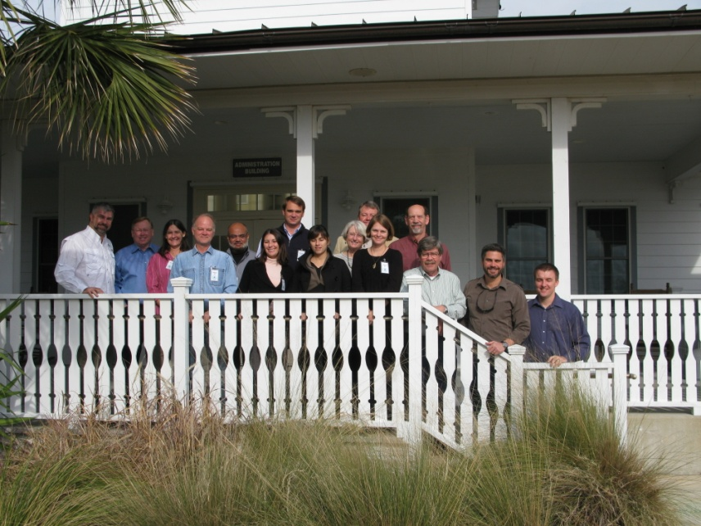
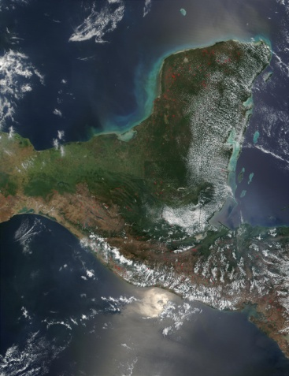
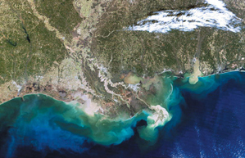
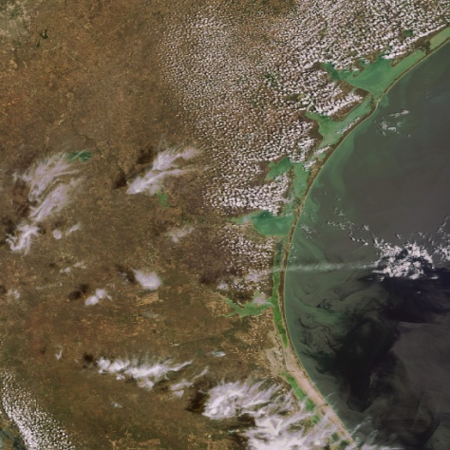
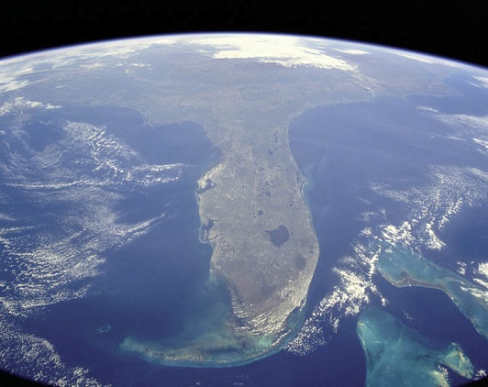
GOMESC
The first workshop of the Gulf of Mexico Ecosystem Services Collaboratory took place in January, 2010.
For the moment it is acting like a
SAB (science advisory board)
Three recommendations:
Mississippi River Delta
Yucatan, Mexico
Florida Keys
Laguna Madre

Slide 9
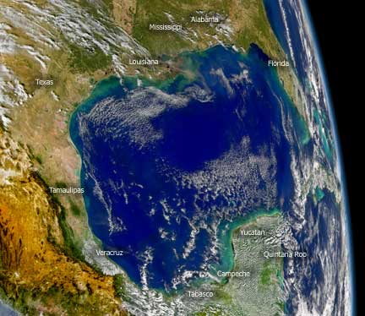
1. Identify a specific policy case that would have relevance across the Gulf region…
Wetland loss in coastal Louisiana-Mississippi.
Mississippi River Delta
Yucatan, Mexico
Florida Keys
Laguna Madre

Slide 10
2. Convene a workshop to gain consensus on approaches, definition and identification of ES, and the steps to be taken toward initiation of the test case.
Scheduled for June 16-18
This workshop was written into
the CEQ’s “Roadmap”
Yucatan, Mexico
Laguna Madre

Slide 11
3. Identify the tools and develop the products necessary for application of ES values to the policy test case.
Mississippi River Delta
Yucatan, Mexico
Florida Keys
Laguna Madre

Slide 12
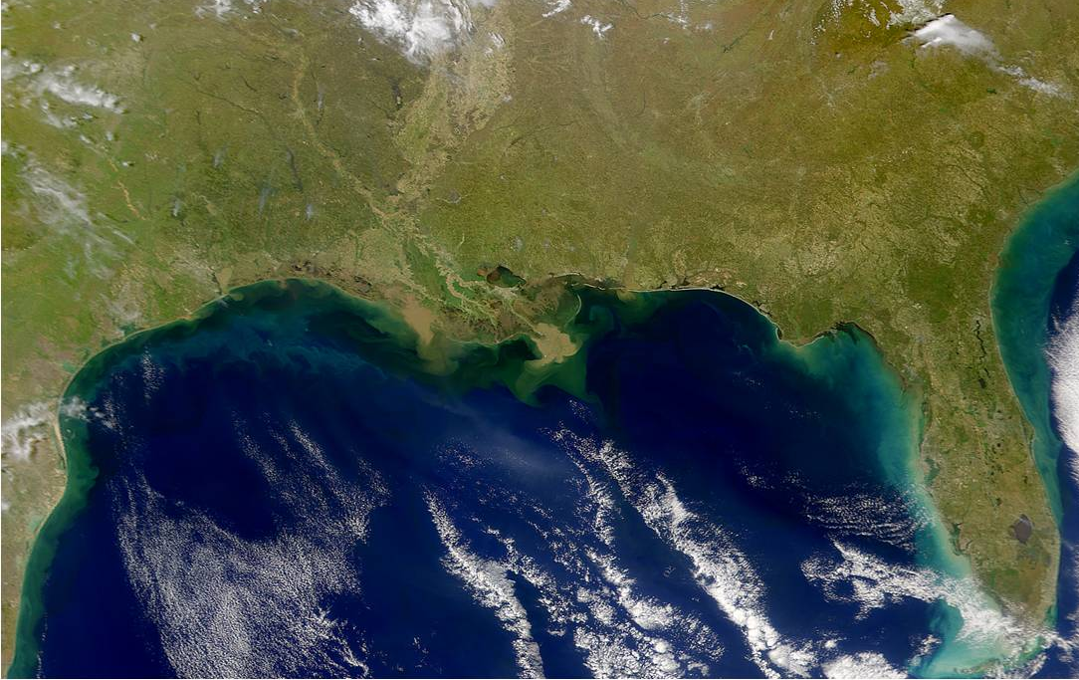
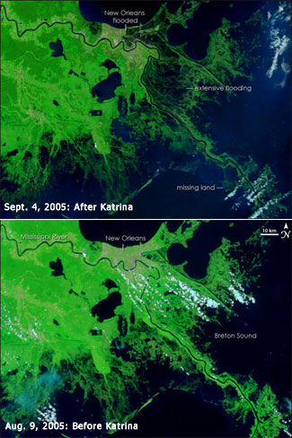
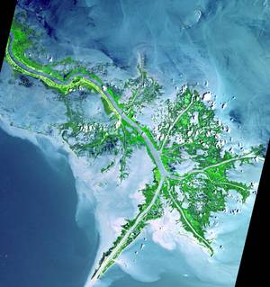
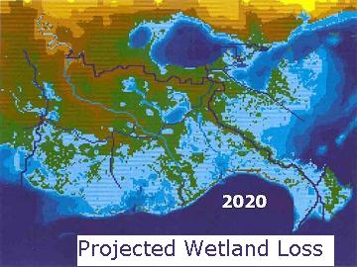
CEQ LA-MS Ecosystem Restoration Working Group
The Louisiana-Mississippi Gulf Coast Ecosystem Restoration Working Group has issued the “Roadmap” for Restoring Ecosystem Resiliency and Sustainability.
Two important actions regarding ecosystem services

Slide 13
By fall 2010, complete a review of existing economic data and;
Work with experts to identify mechanisms needed to more fully incorporate values for ecosystem services into decision processes, including cost-benefits analyses.

Slide 14
By winter 2010, present a draft approach for assessing ecosystem services provided by federally supported coastal ecosystem restoration projects in the region.
This approach will improve agency decision-making and build off of a summer 2010 workshop on regional ecosystem services sponsored by the Gulf of Mexico Alliance.

Slide 15
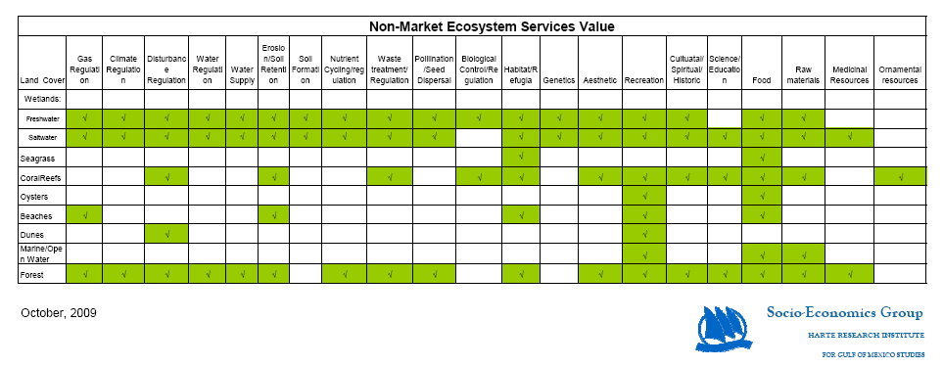
Ecosystem Services Valuation Database-GoMx
The Ecosystem Services Valuation Database-Gulf of Mexico (ESVD-GoMx) will be QA/QC’ed in July 2010 and projected to roll out to the public in Fall 2010.
The GUI (graphical user interface) is being developed this summer.
Yucatan, Mexico
Mississippi River Delta
Laguna Madre
Florida Keys

Slide 16
The ESVD-GoMx is populated by previous valuation studies that are applicable to the Gulf of Mexico coastal environment.

Slide 17
GOMA Cross Team Project
At the EIA PIT meeting in Key West in January, members of four PITs (HCR, Nutrients, EIA, and Resiliency) discussed the actions items that relate to valuing ecosystem services and socio-economic analysis that cuts across all four.
It was agreed that the PITs should work together rather than duplicate effort
Mississippi River Delta
Yucatan, Mexico
Florida Keys
Laguna Madre

Slide 18
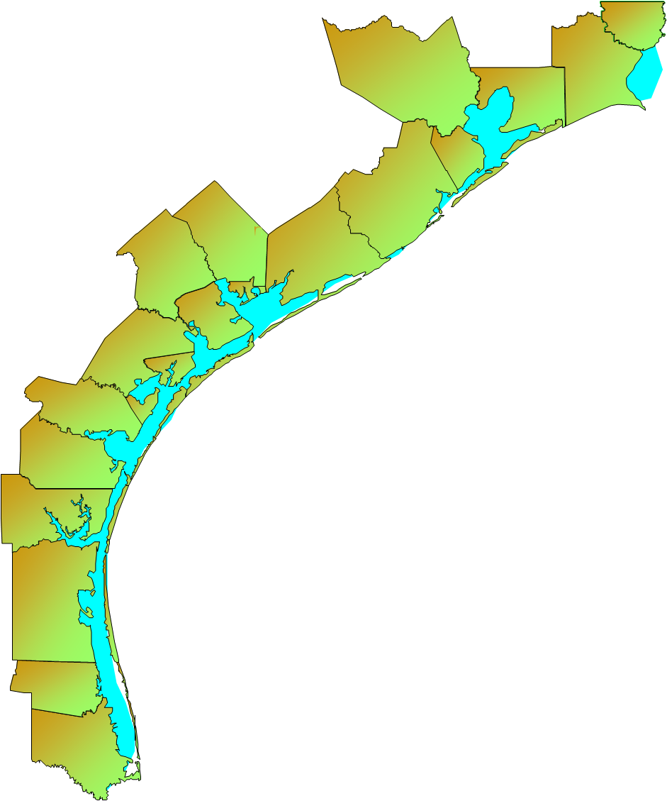
Given the focus of the various teams, Galveston Bay was suggested as a possible cross PIT pilot study site that would address the socio-economic and ecosystem services analysis needs of the PITs.

Slide 19
Finally:
What about the current efforts in light of Deepwater Horizon?
The Gulf of Mexico Alliance will become more significant
in helping organize multi-state responses and assessments and
garnering funds.
The Natural Resource Damage Assessment (NRDA) process,
we are told, will include ecosystem services.
The process of identifying the critical services for the Gulf
and mechanisms to incorporate them into decision making
becomes much more important now.
The ESVD-GoMx will play a role in providing much needed
valuation data.

