Slide 1
Diving Demand and Economic Impact for Large Ship Artificial Reefs
Bill Huth and Ash Morgan
University of West Florida and
Appalachian State University
Challenges of Natural Resource
Economics and Policy: Socioeconomic Research in Coastal Systems
CNREP: May 26, 2010, New Orleans, LA

Slide 2
Economic Concepts
Public Good: A good that is non-rivaled and non-excludable. Your consumption doesn’t reduce mine and we can consume it at will. (e.g. An artificial reef).
Consumer Surplus: The benefit to consumers from paying a price less than what they were willing to pay for a product or service.
Economic Impact: Direct impact is the expenditure injection, indirect/induced impacts are multiples of the initial expenditure and when combined produce a total impact measure. Models: Implan, REMI

Slide 3
Artificial Reefs
Florida has the most diverse artificial reef program in the U.S.
2,000+ artificial reefs
400+ submerged vessels
MARAD
Single point source for distribution of ships among coastal communities
Monitors an aging fleet of inactive vessels for disposal
300+ inactive vessels
Expensive to maintain

Slide 4
MARAD James River Reserve Fleet
“Reefing has potential that is currently constrained by limited demand for ships by coastal States. The limited demand is a result of a general reluctance of States to be responsible for the preparation, tow, and sinking of ships, and to share in the
significant costs associated with reefing activities.” MARAD 2008

Slide 5
Oriskany Sinking
AL

Slide 6
Oriskany

Slide 7
Oriskany

Slide 8
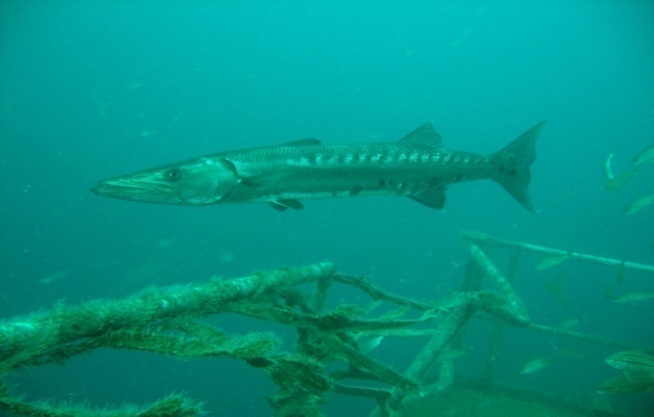
Oriskany Dives

Slide 9
Oriskany (now add 12 feet to all depths)

Slide 10
Depth Quality Change
Scenario 1: Two tank dive to top of wreck on air, no decompression, 2hr SI.
 | Depth | Dive 1 | Dive2 | Total Time
Pre | 68 fsw | 35m | 27m | 62m
Post | 80 fsw | 23m | 21m | 44m -29%
Scenario 2: Two tank dive using 30% EAN, Dive 1 an average depth of 100 fsw
and Dive 2 an average depth of 90 fsw, no decompression, 2 hour SI.
 | Depth | Dive 1 | Depth | Dive 2 | Total Time
Pre | 100 fsw | 22m | 90 fsw | 21 m | 43m
Post | 112 fsw | 14m | 102 fsw | 18m | 32m -26%

Slide 11
Ships Sunk as Artificial Reefs
Wilkes-Barre (608’) Cleveland Class Cruiser, Florida Keys in 1972.
Duane and Bib (327’) Coast Guard Cutters, Key Largo in 1987.
Yukon (366’) Canadian MacKenzie Class Destroyer, San Diego in 2000.
Spiegel Grove (510’) Landing Ship Dock, Key Largo in 2002.
Oriskany (888’) Essex Class Aircraft Carrier, Pensacola in 2006.
Vandenberg (524’) Troop Transport/Missile Tracker, Key West in 2009.

Slide 12
Motivating Literature
Hess, R., Rushworth, D., Hynes, M., and Peters. J. (2001), Disposal Options for Ships. Rand Monograph Report.
Hynes, M., Peters, J., and Rushworth, D. (2004). Artificial Reefs: A Disposal Option for Navy and MARAD Ships. RAND, National Defense Research Institute.
Leeworthy, V., Maher, T., and Stone, E. (2006). Can Artificial Reefs Alter User Pressure on Adjacent Natural Reefs? Bulletin of Marine Science 78(1), 29-37.
Adams, C., Lindberg, B., and Stevely, J. (2006). The Economic Benefits Associated with Florida’s Artificial Reefs. IFAS/EDIS Report. Univ. of Florida.
Horn, B., Dodrill, J., and Mille, K. (2006). Dive Assessment of the Oriskany Artificial Reef. Division of Marine Fisheries Management Artificial Reef Program, FWC.
Morgan, A.O., Massey, M., and Huth, W. (2009). Demand for Diving on Large Ship Artificial Reefs. Marine Resource Economics.
Morgan, A.O,, And Huth W. (2010). “Using Travel Cost Modeling to Value Large Ship Artificial Reefs: The Key West Vandenberg Sinking.” In Haab, Huang, and Whitehead (eds.), Preference Data for Environmental Valuation: Combining Revealed and Stated Approaches. Rutledge Economics, Taylor &Francis Group.

Slide 13
Research Objectives
Estimate economic aspects for the “world’s largest and second largest artificial reefs” (the ex-USS Oriskany and the ex-USS Vandenberg)
Measure value to divers from creating a "multiple ship reefing area” for future large ship reefing disposal
Policy-based (MARAD) information
Bundling public goods impact on value
Measure Oriskany economic impact to local communities from deployment (funded by Pensacola TDC)

Slide 14
Survey Design
Web Based Survey
Scuba Shack Diver Release Forms
Asked both revealed and stated preference behavior questions
Asked diver expenditure questions for economic impact measurement Here is a screen shot from the web site:

Slide 15
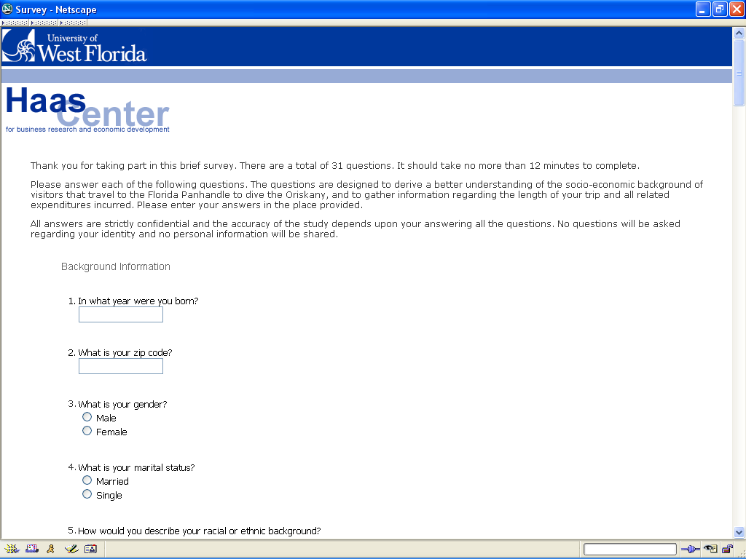
#15. How many dive trips did you take to the area to dive the Oriskany?

Slide 16
Economic Impact Model
Two versions of a regional economic impact model were estimated:
A two-county model for all economic impact to Escambia and Baldwin counties:
Total dive-trip related expenditures are an estimated $2.2 million.
Dive-related expenditures drive an annual economic impact of $3.6 million in local output, 67 jobs, and $1.4 million in local income.
A single-county model for economic impact to Escambia County:
Total dive-trip related expenditures are an estimated $1.2 million.
Total annual economic impacts from the Oriskany are $2 million in local output (56%) , 37 jobs, and $740,000 in local income.
Estimated Economic Impact Reduction Due to Quality Change: $1.2 million, A drop from $3.6m to $2.4m in total two-county economic impact. Escambia economic impact drops from $2m to about $1.34m.

Slide 17
The Travel Cost Model (TCM)
Travel
Cost
‘choke price’
tc_{X}
A = $2.25m
B = $2.2m
Demand = WTP
A
tc_{X}⁰
B
X⁰
X
Trips

Slide 18
Travel Cost Number of Trips Depends on:
Travel cost = monetary plus opportunity costs
Equipment-intensive recreational activity
Included:
Charter boat fees
Breathing gas
Equipment rental
Other Diving Opportunities

Slide 19
Estimation Information
Stacked model
Poisson
Negative binomial
Test for hypothetical bias
Isolate impact of destroyer on trips
Consumer surplus implications

Slide 20
Estimation
Two-stage analysis
Revealed preference
Ask respondents about actual trips taken in 2006 dive season
Stated preference
Ask respondents about expected trips in 2007 dive season
Plus with the addition of destroyer
Multiple-ship artificial reef

Slide 21
Bundled Public Good Scenario
Finally, the U.S. Maritime Administration has a number of out-of-service military ships of various types that are being considered for use as artificial reefs in a variety of locations in U.S. coastal waters. There are various scenarios under consideration for locating these ships as the reefing program progresses over the next several years.
One possibility is to create a "multiple ship reefing area" by sinking a Spruance Class Destroyer in the permit area with the Oriskany. A Spruance Class Destroyer is 563 feet (171.6m) long and has a beam of 55 feet (16.8m), with a displacement of 9,100 tons. The Spruance Class Destroyer would be located in the permit area (see locator map») but closer to Pensacola than the Oriskany and at a shallower depth (main deck depth of less than 130 feet (39.6m) and most likely less than 100 feet (30.5m).
Charter boats would pass close by the destroyer on their way out to and back from the Oriskany. This would create the option to dive the Oriskany on the first dive, and then, during the surface interval, travel to the destroyer. Divers then have the option to dive the destroyer, and at the end of the second dive the run back to Pensacola would be shorter in duration. There could also be an option to dive the Oriskany on one day and the destroyer the next.

Slide 22
Spruance Class Destroyer
Roughly twice the size of a WWII destroyer and about the size of a WWII cruiser.
Designed as an anti-submarine platform and redesigned as missile launch platforms.
Specifications: 563’ long, 55’ beam, 9k tons.
31 were built, all have been decommissioned , most have been sinkexed..

Slide 23
Survey TCM Questions
Approximately how many total diving trips do you expect to take to the Oriskany site in 2007?
If the destroyer was sunk and available to dive today, do you think it would change the number of diving trips you expect to take to the Oriskany site (now including the additional destroyer) in 2007?

Slide 24
Survey Descriptive Statistics n=127
Variable | Mean T (n=33) R (n=94) 26% 74%
Actual trips (2006) | 1.49 2.06 1.29
Expected trips (2007) | 2.19 2.42 1.52
Expected trips w/des (2007) | 3.96 5.00 3.21
Travel cost | $531 $681 $453
Age (years) | 43.35 45.00 42.77
Income | $99,527 $98,939 $99,733
Years Diving | 11.33 16.88 9.38
Male (dummy) | 0.77

Slide 25
TCM Variables
Dependent Variable
DAYTRIPS
Predictor Variables
TOTAL_TC: Total travel cost, monetary + opportunity
AGE: Respondent age in years
INCOME: Midpoint of income ranges
YRS_DIVE: Respondents total number of dives
TECH_DIV: Binary indicator for technical diver
KW_TC: Key West total travel cost

Slide 26
Oriskany Daytrip TCM Negative Binomial MLE/TCM Estimation
Variable | Coefficient | St’d Error | p-value
Total_TC | -0.0014 | 0.0002 | 0.00
Age | -0.0129 | 0.0068 | 0.01
Income | 0.0094 | 0.0142 | 0.36
Yrs_Dive | 0.0151 | 0.0088 | 0.02
Tech_Dive | 0.7813 | 0.1431 | 0.00
KW_TC | 0.0001 | 0.0001 | 0.21

Slide 27
Consumer Surplus Estimates
 | Without Destroyer | With Destroyer
Predicted Trips | 0.89 | 1.40
Avg. Annual Value per Diver | $559.00 | $1,082.00
Total Annual Value | $2,250,000 | $4,360,000
Annual values based on 4,209 trips.

Slide 28
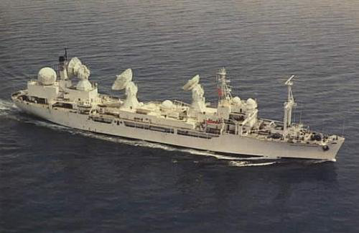
Ex-USS Vandenberg
Sunk May 27, 2009 off Key West Florida
World’s second largest artificial reef (524’)
Sunk in 140’ of water 40’ to top

Slide 29
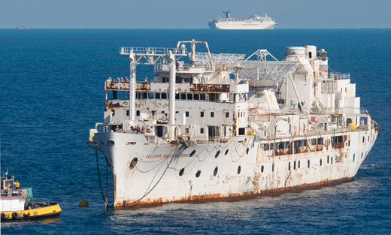
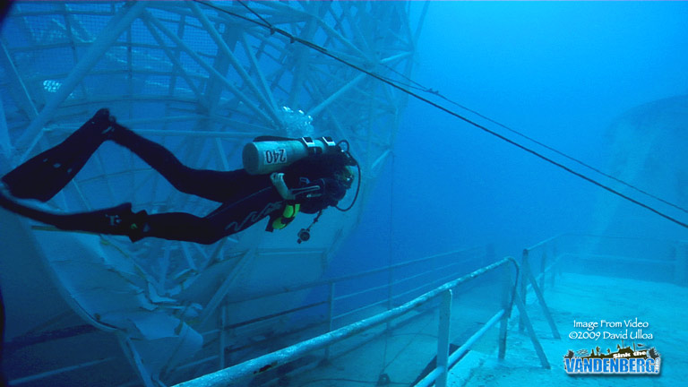
Vandenberg

Slide 30
Vandenberg Location 24.27 N, 81.44 W

Slide 31
Survey Introduction
The purpose of the survey is to gather information from individuals that dive or intend to dive artificial reefs and wrecks in the Key West area, and also from those that intend to dive the General Hoyt S. Vandenberg following its anticipated sinking. For the survey, the Key West area is defined to be the adjacent waters from Biscayne National Park on the eastern side down Highway 1 through Key Largo, Marathon, and on to Key West. We also consider Dry Tortugas National Park to be a part of the area as well.

Slide 32
Survey Information
Distributed prior to the Vandenberg Sink date
Stated and not revealed preferences
Internet based
Distributed through various scuba diving forums
Scuba Board
The Deco Stop
Rebreather World
Spear Board

Slide 33
Survey Results, N=378
Variable | Mean | Standard Deviation
Age | 41.83 | 10.09
Race | 0.93
Cert Years (experience) | 14.67 | 10.93
Adv. Open Water (dummy) | 0.79
Nitrox (dummy) | 0.78
Trip_SP1 (last year) | 0.96 | 2.32
Trip_SP2 (next w/o V.) | 1.93 | 6.00
Trip_SP3 (next with V.) | 4.21 | 10.47
TCKW (TC to Key West) | 1,433.51 | 1,201.57
TCFL (TC to Fort L.) | 1,412.68 | 1,303.94
Income | 102.08 | 47.70
SP (dummy) | 0.67
VAN (dummy) | 0.33

Slide 34
Estimation Results: DV=TRIPS Negative Binomial with MLE
Variable | Coefficient | Significance (P-Value)
Constant | -0.063 | .89
AGE | 0.020 | .01 ***
TCKW | -0.001 | .01 ***
TCFL | 0.000 | .88
RACE | -0.261 | .35
INC | 0.003 | .12
ADV_OPEN | 0.361 | .19
NITROX | -0.642 | .01 ***
CERT | -0.002 | .02 ***
SP | 0.662 | .00 ***
VAN | 0.820 | .00 ***

Slide 35
Consumer Surplus Results
Consumer Surplus Per-Person Per-Trip: $1,429
Annual CS Per-Person
Without Van: $2,135 ($1,221-$8,169)
With Van: $3,200 ($593-$3,559)
Annual CS Per-Person and adjusting for SP Bias
Without Van: $1,315 ($761-$4,211)
With Van: $1,864 ($314-$4,211)

Slide 36
Annual Total Consumer Surplus 10K Divers per Year
Without Stated Preference Bias Adjustment
$32 M ($5.93 M-$35.6 M)
With Stated Preference Bias Adjustment
$18.64 M ($3.14 M-$42.1 M)

Slide 37
Conclusions and Future Work
Initial results indicate significant diving demand for large ship artificial reefs and combining ships has significant consume value impacts.
Future Work (current proposal to FWC):
RUM - recreational diving at natural and artificial reef sites in coastal communities to establish priorities for the location and configuration of new (or expanded) dive sites based on the preferences of divers and on economic return or value, not just economic impact.
Economic artificial reef impact using REMI
Measuring fishing reef value using similar methodology
Revealed preference Vandenberg and Spiegel Grove studies
Redo Oriskany study with changes in quality.

Slide 38
Thank You, Questions?

